Slide 1
https://gdaha.surgenet.org

Slide 2
MCI Communications Tools: OHTrac, GDAHA Surgenet MCI Page, et al
Lisa Rindler, GDAHA
Regional Healthcare Coordinator
Mary Porter
Healthcare Preparedness Program Coordinator
David Gerstner, Dayton FD
Regional MMRS/RMRS Coordinator

Slide 3
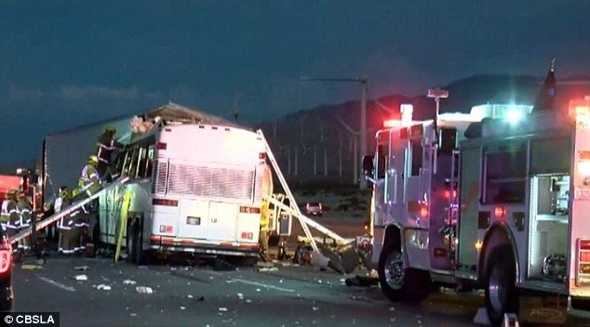
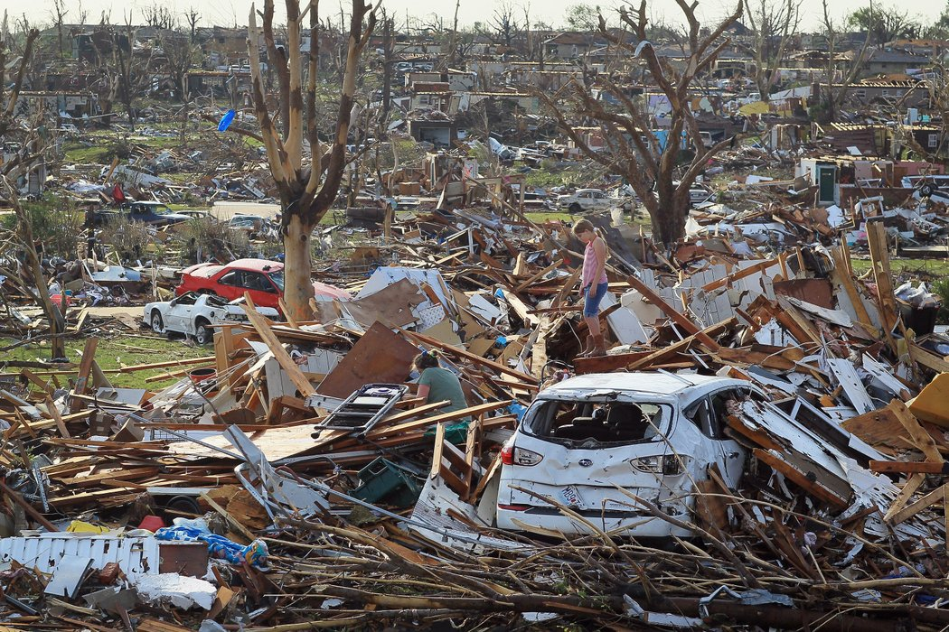
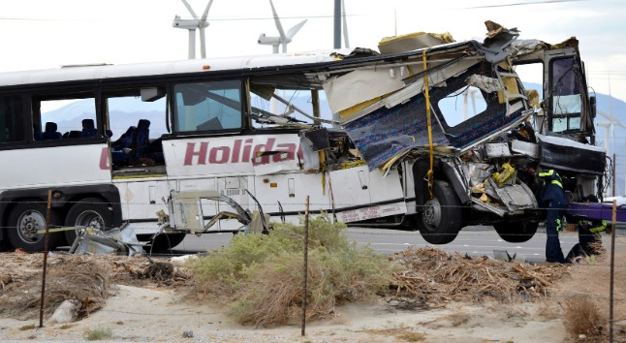
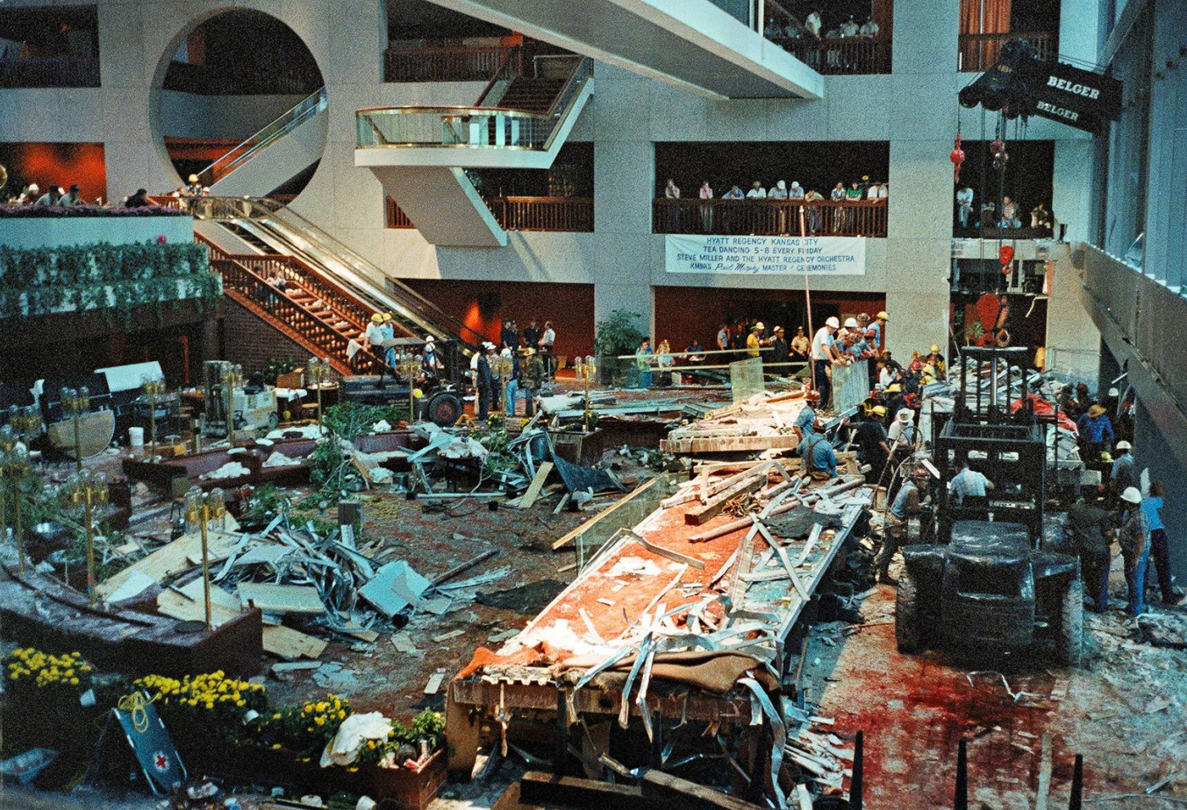
Notes:
We all have to be prepared to deal with all types of disasters and MCIs from transportation accidents to structural collapses.
Just parenthetical - Top right and bottom left - Joplin Tornado; All bus pictures - California tour bus

Slide 4
SALT
Acronym for:
Sort
Assess
Life Saving Interventions
Treatment/Transport
SALT is fastest triage system!

Slide 5
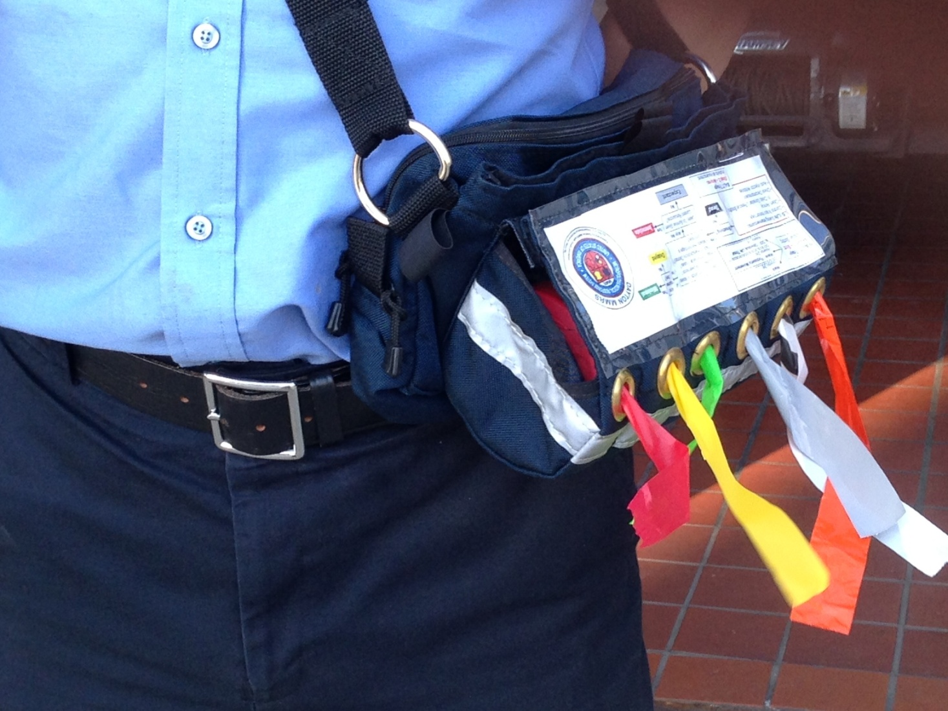
Ribbon Colors Match ID-MED Triage Categories
Immediate
Delayed
Minimal
Expectant
Dead
(Ribbon/Tag zebra-striped)
Notes:
Answers to the “key questions” allow you to place the patient in one of the 5 categories. Each category is given a color code so that they can be recognized quickly.

Slide 6
STEP 1: Global Sorting

Slide 7
Mnemonics for Assess Questions
C – Follows Commands
R – No Respiratory Distress
A – No (uncontrolled) Arterial bleeding
P – Peripheral Pulse Present
“Bad” answer to any one or more: Pt. is either Red or Gray

Slide 8
Can usually assess 3 of 4 before even touching patient!
C – Commands /Purposeful movements?
R – Respiratory Distress?
A – Uncontrolled (Arterial) bleeding?
P – Peripheral Pulse Present?

Slide 9
Identifying Patient Status
Begin with Triage Ribbons
Add Triage Treatment Tags at Treatment Area or at point of transport
Right wrist for both Ribbon and Tag

Slide 10
MCI Communications Quarterly Triage Day Drills
Agreed on by GDAHA Domestic Preparedness Coalition, GMVEMSC, MVFEA, GMCFCA, et al
24 hours each quarter
Day of week different each quarter so all ED & EMS personnel have opportunities to participate
Day selected each quarter by GDAHA Communications Committee
Communicated to all hospitals and EMS agencies
Includes Ribbons, “Treatment” Tags, MCI Radio Talk Groups, MCI page, OHTrac
OPPORTUNITY FOR US ALL TO WORK TOGETHER

Slide 11
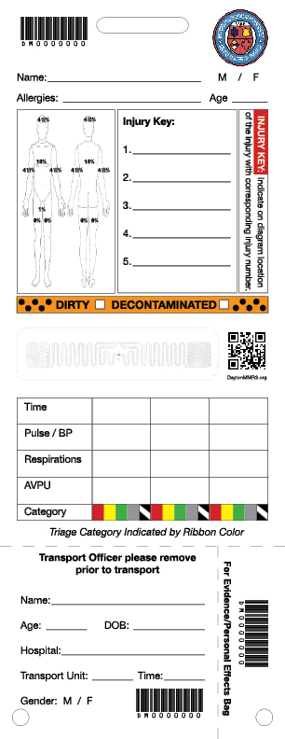
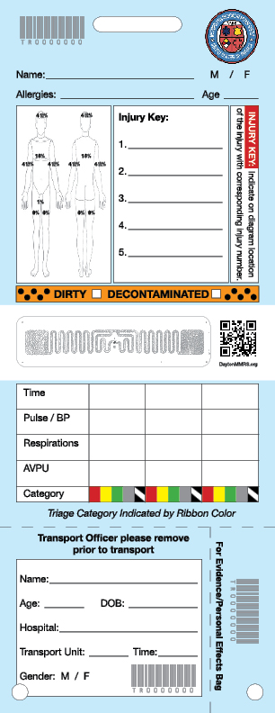

Slide 12
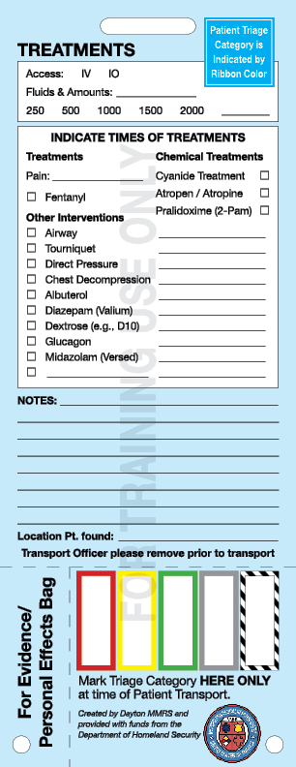

Slide 15
Burns
1

Slide 17
Notes:
The squiggly symbol represents an RFID tag that is only on Live (white) Treatment Tags. The RFID is read-only by healthcare facilities that use them, and the only information in the RFID is a number to be used as a patient identifier. It does not contain any of the information written on the tag. The QR code simply routes someone who scans it to
the website www.DaytonMMRS.org so they can find more information.

Slide 22
Indicate Agency/Unit #

Slide 26
OHTRac
State of Ohio tool for patient tracking and family reunification during an MCI
Statewide tool available to track patients transported to different hospitals

Slide 27
Notes:
You can log patients on the MMRS Transport Log distributed throughout the region, but OHTrac is faster, easier, and your information is instantly shared with hospitals.

Slide 28
Indications for Using OHTrac
A Mass Casualty Incident is:
ten or more persons being injured, incapacitated, made ill, or killed (ORC 4766.01)
resources needed exceed local capabilities
discretion of Incident Commander
can be less than 10
patients transported to multiple hospitals
No harm in creating OHTrac incident and not using it if unneeded

Slide 29
267 Victims at 27 Hospitals
Notes:
Imagine if someone you care about was at the Boston Marathon in 2013? How would you find out if they were at a hospital, or which hospital?

Slide 30
Family Reunification
After an MCI, hospitals, dispatch centers, and others overwhelmed with calls from families searching for loved ones
Worst is when they come to the scene

Slide 31
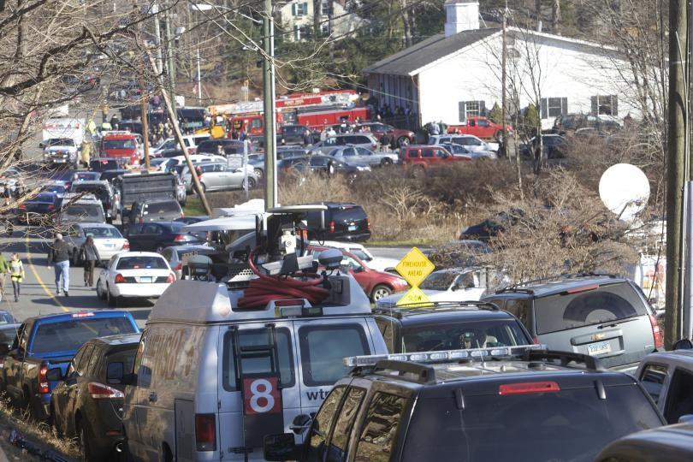
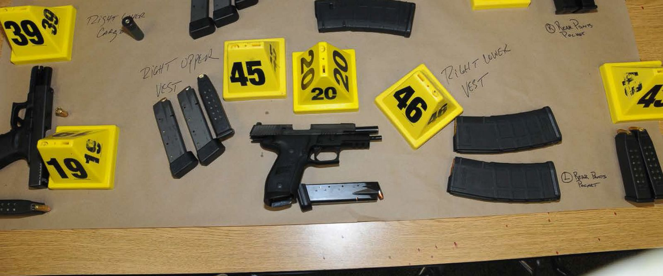
Notes:
Sandy Hook School, Newtown, CT

Slide 32
OHTrac
Permits hospitals, dispatch centers, Red Cross, EMAs, coroners to locate patients
Family reunification
Critical tool in Family Assistance Centers

Slide 33
Multiple OHTrac Incident Creation Options
Hospitals can create OHTrac incident
Dispatch Centers (or alternate dispatch centers) can create incident upon notification
Regional Coordinators can create incident
Fire/EMS agencies can create incident using the web-based version of OHTrac
And now, incidents can be created with a single phone call to 1-888-822-4900

Slide 34
ERS

Slide 35
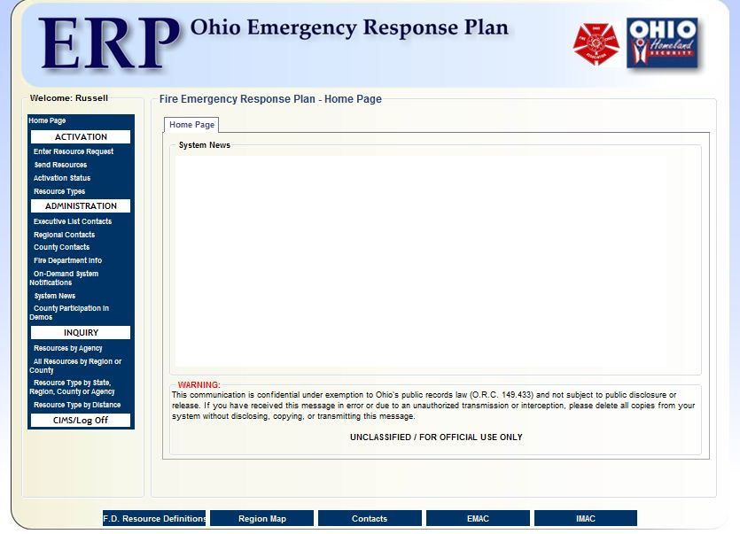
WE ARE ASKING EMS TO ENTER ONLY ESSENTIAL INFORMATION
3 mandatory fields to add patients
Patient Number / Triage Number
Patient Triage Level
Gender
Then, when patient(s) are transported add:
Enroute status
Hospital location
This allows fire/EMS agencies flexibility in how patients are entered during the MCI incident

Slide 36
OFCA ERS
Ohio Fire Chiefs Association Emergency Response System (ERS)
Provides for response to catastrophic emergency incidents including incidents that are beyond local resource capabilities
OFCA ERS provides for mobilization, deployment, organization, and management to provide assistance

Slide 37
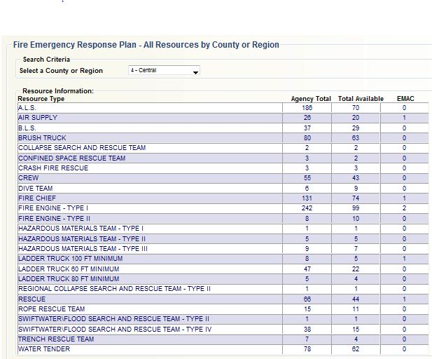
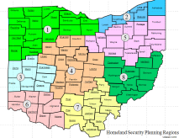
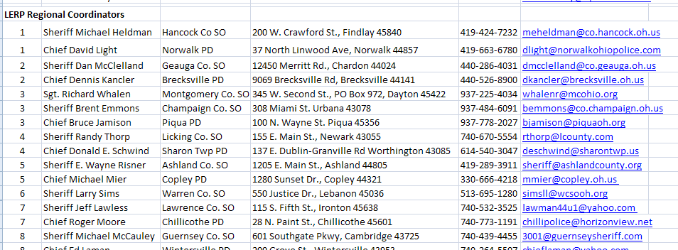
Fire ERP Home Page
From the home page you can:
Send Resources
Update agency information & resource data sheet
View resources by agency
View resources by region or county
Find a specific resource by region, county or agency
Find the distance of resources from your location
Fire ERP Tools

Slide 38
Benefits of Using OFCA ERS for OHTrac Incident Creation
Fast
Easy:
just call 1-888-822-4900
Prevents duplicate OHTrac incidents created during a single event

Slide 39
Using OFCA ERS for OHTrac Incident Creation
OHTrac incidents created by ERS will default to hospitals in the region of the state
If you will be transporting patients to hospitals in multiple regions:
Have them add specific hospitals
Or have them include all hospitals in radious you specifiy
For training and exercise incidents, advise ERS whether you want this on the Test or the Live site

Slide 40
Test Site
Always on
Available for your use, but…
Use real site for major exercises
https://gdaha2.surgenet.org

Slide 41
Test Site
Password changes and adding users must be done on LIVE site
Those changes not available on test site until after midnight

Slide 42
OHTrac
Demonstrate manual incident creation
Notes:
If you don’t remember how, look in the “Policies and Documents” section on gdaha.surgenet.org

Slide 43
Using OHTrac
Adding patients
Moving patients
Arriving patients
Viewing/searching for patients

Slide 44
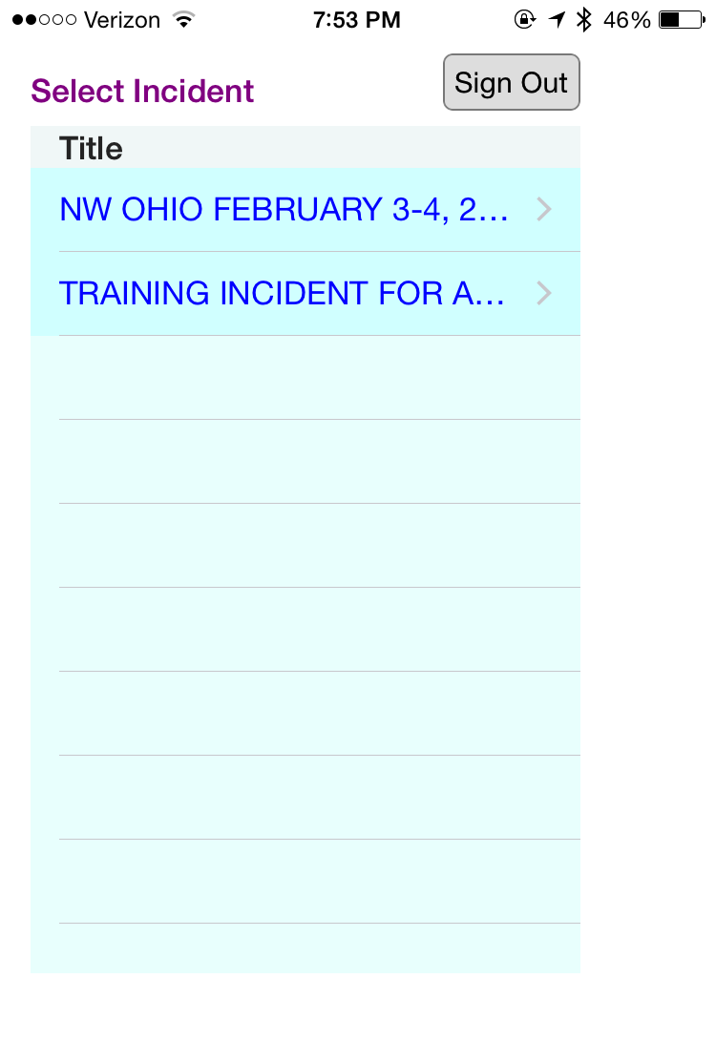
OHTrac App
App designed for EMS
For agencies using it, allows patient tracking to begin at the scene
Can be used by hospitals, too
Scan Triage Tag bar code
Can only be used on live site
INCIDENT FOR APP PRACTICE/TRAINING
Notes:
Pre-hospital EMS will improve their patient tracking accuracy by using OHTrac. Early use of OHTrac will also improve the accuracy of patient tracking as for the incident as the incident progresses.
The second option for entry of patients into OHTrac is for the Transport Officer to enter all patient data at just prior to them being transported to a healthcare facility.

Slide 45
Login

Slide 46
When Setting Up Generic Logins for Your Agency
As a Facility Administrator, you can create an unlimited number of logins for your agency
Restriction is you can’t use a login that someone else has
For example, there may already be an LFD-EN41.
Just create something easy for your crews, e.g., CoffeeFD-EN7
If crews are often on different apparatus, use the same PW for all

Slide 47
Select Correct Incident
After you log on to OHTrac, the first step is to select the correct incident to begin entering patients
NOTE: OHTrac incidents can not be created from the APP
Notes:
Hospitals and some EMS providers are using OHTrac for regional drills and exercises, so there may be more than one incident showing. When incidents are created, their titles should be easily recognizable so that agency’s responsible for patient entry pick the correct incident and do not create a duplicate incident. Regional drills have shown that duplicate incidents are a potential issue and personnel with regional hospital administrator permission levels have the ability to “copy” patients from one incident to another in order to combine duplicate incidents.
The APP was designed for patient entry only and an incident can not be created from the APP. There will be more information on this later.

Slide 48
Patient Entry is Simple to Accomplish
The next step is to add patients.
Selecting ADD PATIENTS tab “turns on” bar code scanner
Used to scan the barcode on the triage tag
Notes:
The app has a built in scanning operation that will scan the bar code on triage tags. This slide shows the initial screen for patient entry when using the app.
The app was designed with pre-hospital EMS providers giving input during the development process. The steps to enter patients are intuitive for the users. EMS providers can enter patients while in the CCP, by the Transport Officer just prior to transport, or by crews enroute to a hospital.

Slide 49
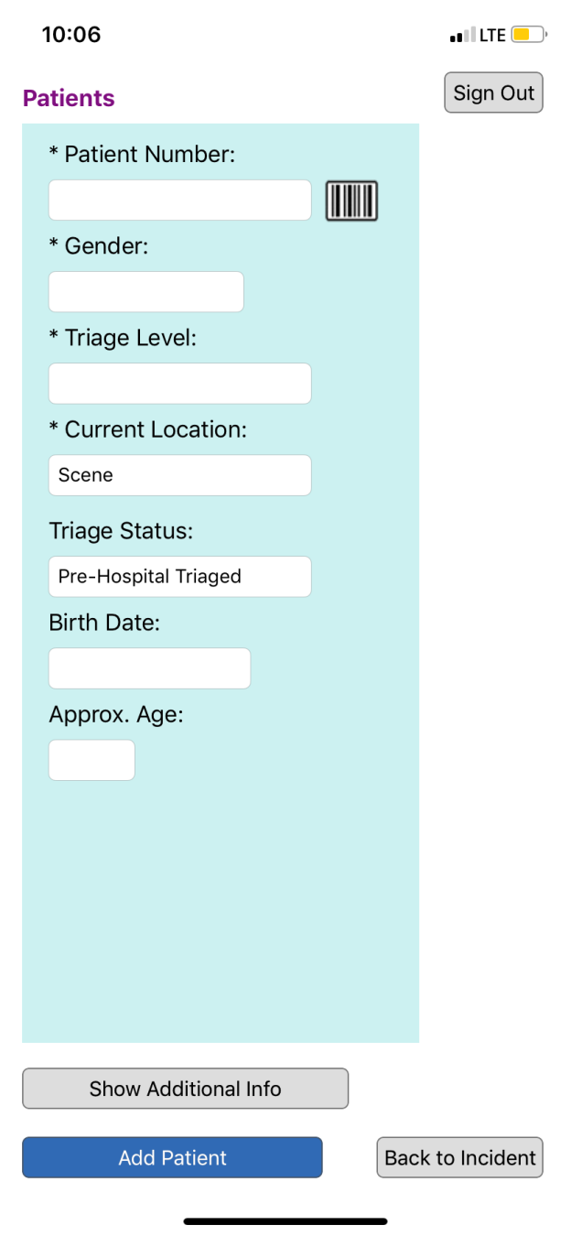
EMS ENTERs ESSENTIAL INFORMATION
Four required fields to add patients:
Patient Number/Triage Number
Gender
Patient Triage Level
Current location (default)
Transport Group can add:
Enroute status
Hospital location
Flexibility: e.g., enter patients in CCP, show enroute to hospital in Transport Area
Notes:
There are only three (3) mandatory fields required to enter a patient. The status and location for the patients defaults to Patient Triaged and their location listed as Scene to eliminate the need for EMS providers to add these fields. After these three (3) mandatory fields are entered and the patient is ready for transport, the Transport Officer can update the patient data to include the enroute status (the patient listed as enroute) and hospital location This can be easily accomplished and is demonstrated later.
The second option for entry of patients into OHTrac is for the Transport Officer to enter all patient data at just prior to them being transported to a healthcare facility.

Slide 50
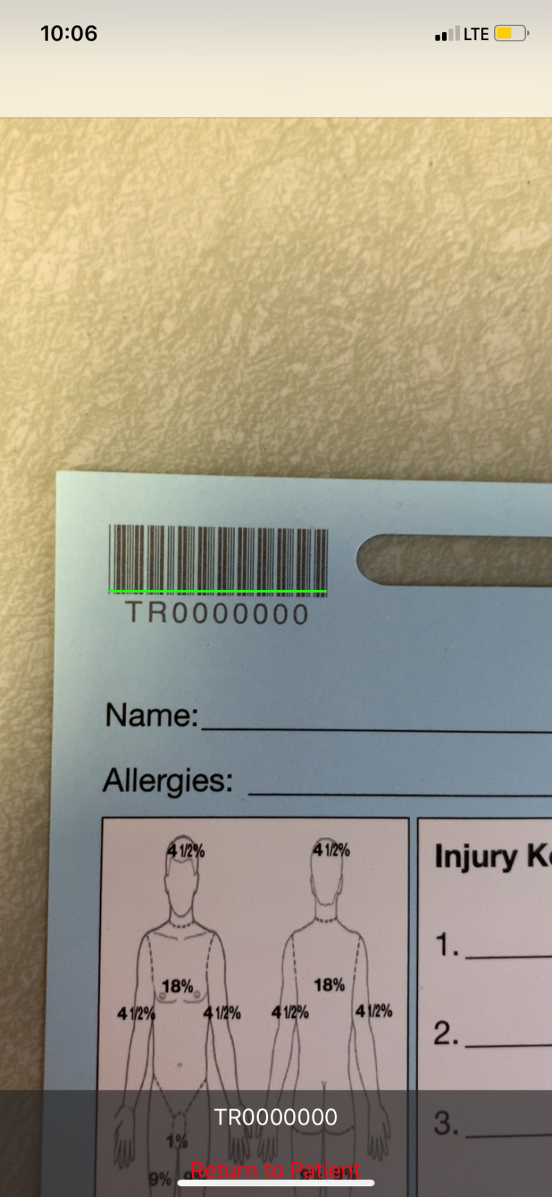
Scanning
Green bar must appear
Patient number will be displayed
Click “Return to Patient”

Slide 51
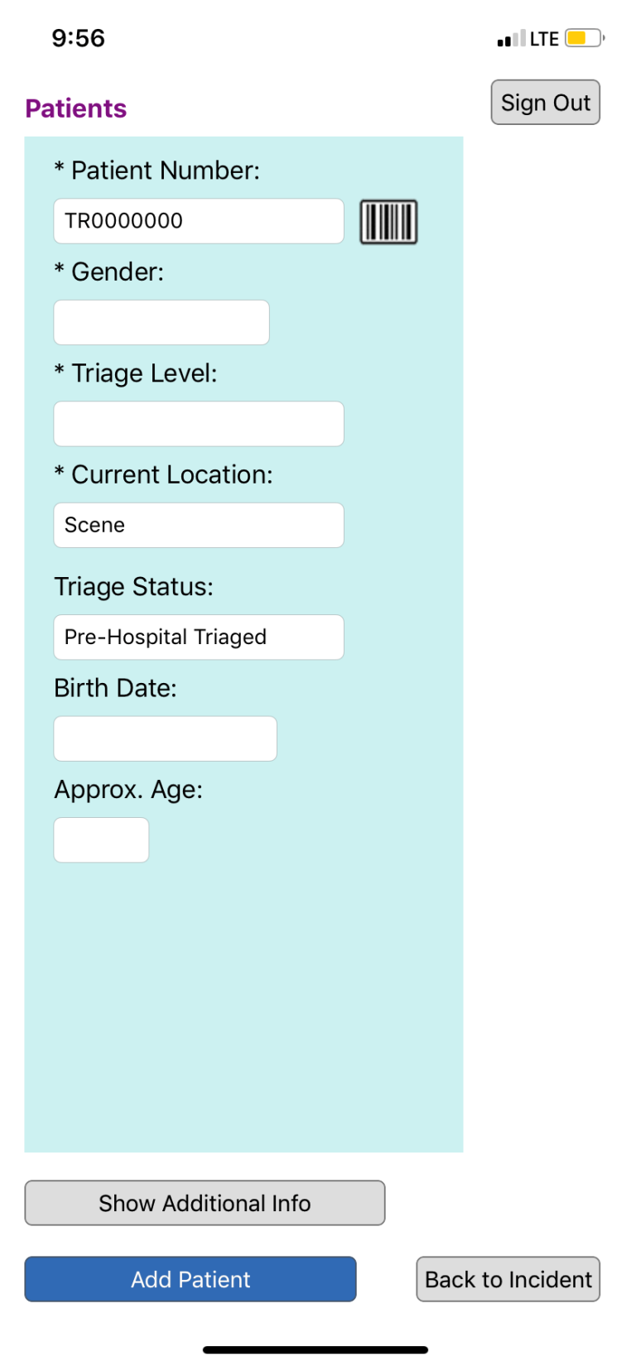
Enter Information
Patient Tag number is entered automatically after scan
Select “Add Patient”
If you select “Back to Incident,” patient information will not be recorded
Male
Immediate

Slide 52
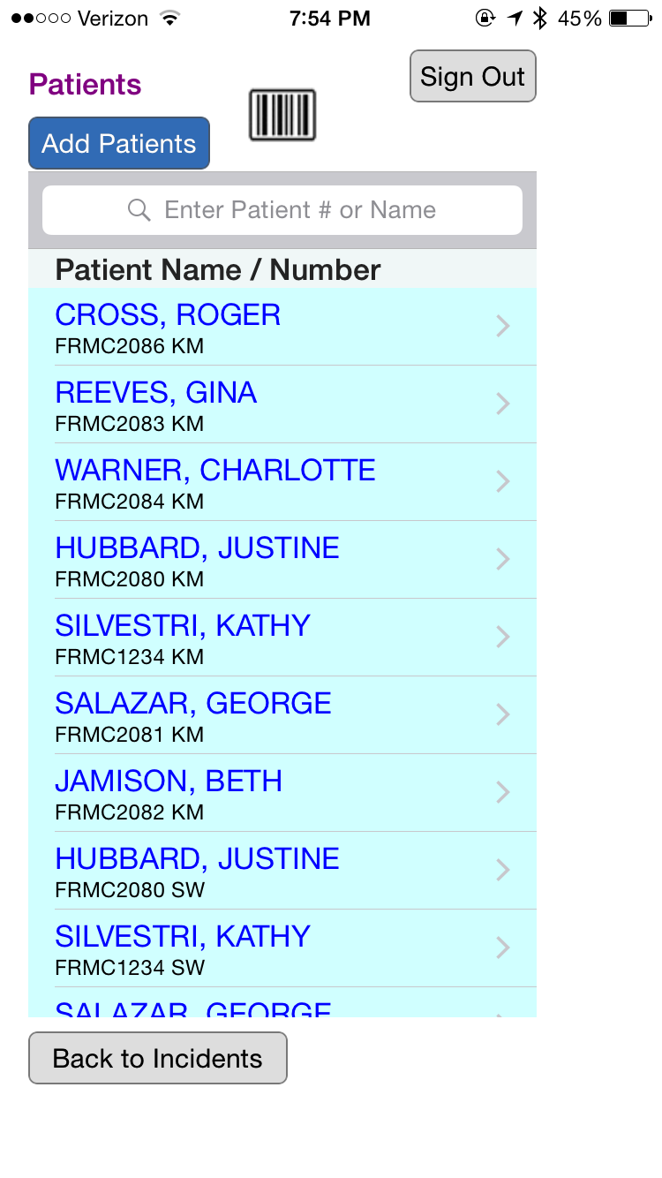
Transport officer can also use barcode scanner at transport to find patients easily and update transport status
Notes:
UPDATING PATIENTS BY THE TRANSPORT OFFICER As mentioned previously, the APP has a scanning function for the bar codes on triage tags. This screen shot shows the initial patient entry page after patients have been triaged and entered into OHTrac. The Transport Officer can use this scanning function to find the patient that is ready for transport to a hospital. Once the patient is found, their status can be changed to “ENROUTE” and the location changed to the HOSPITAL where the patient is being transported. SEE NEXT SLIDE The data that EMS providers are being asked to enter is minimal and intuitive using the APP.

Slide 54
Male
Immediate

Slide 55
HOSPITALS
Upon arrival at ED, list patient as “arrived” by tapping “triage status”
Additional identifying information will be added:
First and Last Name
Initials only for QTD & Exercises
Patient Age or Age Range
Other information to assist with patient identification (e.g., tattoo or identifying marks)
GSW or penetrating trauma
Notes:
No medical information is added to the OHTrac System. This is intentional as the system was designed for family reunification, not medical record keeping. OHTRAC has undergone legal review and is HIPAA compliant.

Slide 56
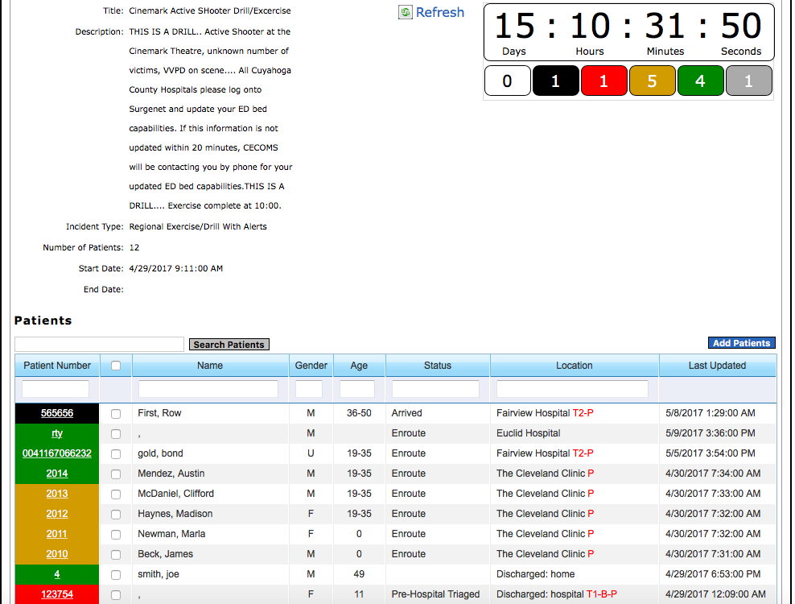
Notes:
The slide presents the web-based view of OHTrac. If the Transport Office or a Dispatch Center has access to this system, all the patients entered into the incident are displayed on a single page. The total number of patients by each triage category (triage status) are displayed on under the incident clock by their triage color. The patients are also listed on the incident page by triage color and which hospital they are being transported. The data in the patient field can be sorted by hospital to display how many patients and what severity of patients are being transported to that hospital. In addition, when selecting the END LOCATION for the hospital destination, the hospitals are listed by specialty type for the Transport Officer. For example, P = Pediatric hospital, B = Burn Center, and the various levels of Trauma Hospitals are displayed.

Slide 57
GDAHA Surgenet MCI Page

Slide 58
GDAHA Surgenet MCI Page
Increasingly emphasized to EMS importance of distributing patients to hospitals during MCIs
GDAHA Surgenet MCI Page allows hospitals to indicate how many patients received, by category
During MCI, MCI Web Page allows hospitals to indicate by category how many more can be handled
Hospitals asked to update GDAHA Surgenet MCI page every 20 minutes during an incident

Slide 59
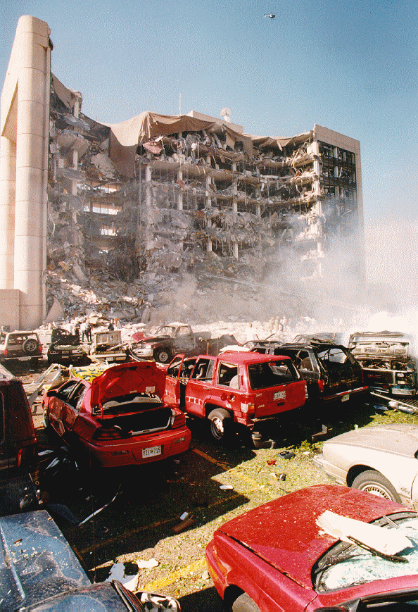
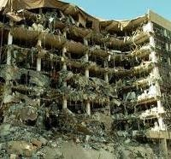
Notes:
Alfred P. Murrah Building, Oklahoma City, 1995

Slide 60
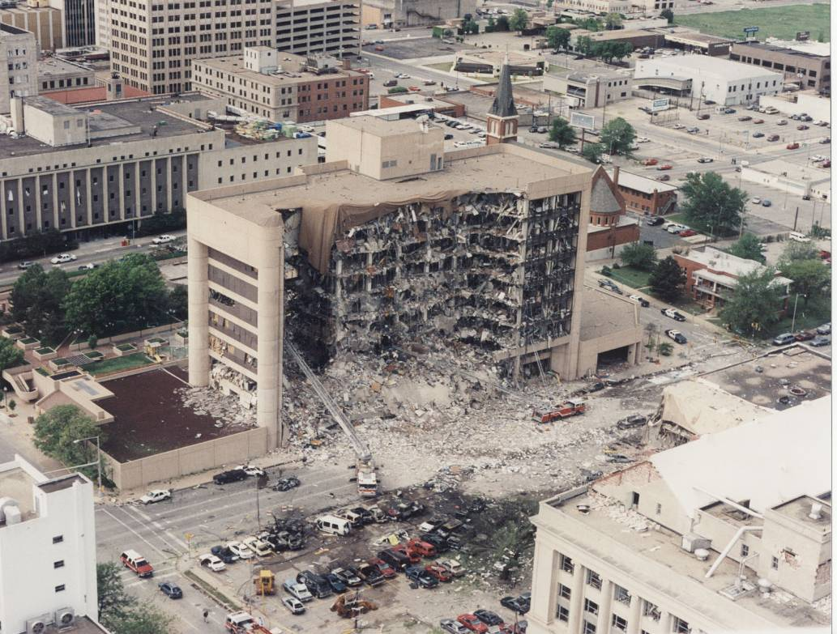
Oklahoma City, 1995
169 dead, >800 injured
>65% not transported by EMS
>60% went to hospitals within 1.5 miles of event
Notes:
In the 1995 bombing of the Murrah Federal Building in Oklahoma City, 169 were killed, and over 800 were injured. Evidence from the response indicated:
More than 65% of the injured were transported by means other than EMS—self-transport!
More than 60% went to hospitals within 1.5 miles of the event, showcasing the geographic effect (casualties go to the closest hospital to the event).
Bystanders performed the initial rescue efforts.
Reference: Hogan DE, Waeckerle JF, Dire DJ, Lillibridge SR, Emergency department impact of the Oklahoma City terrorist bombing , Ann Emer Med. 1999, 34(2), 160—167.

Slide 61
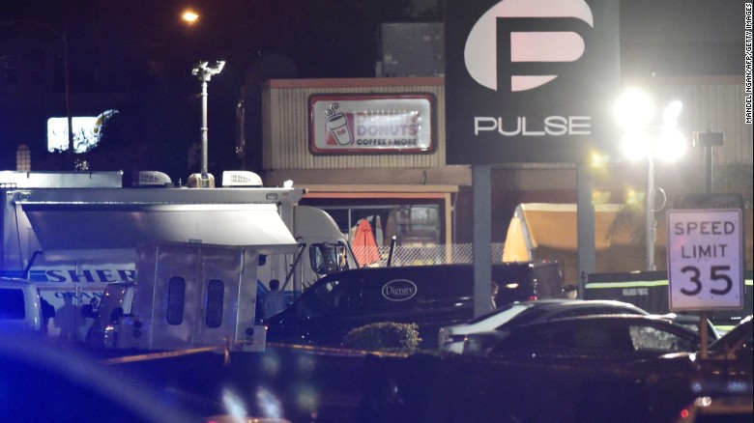
Orlando, FL – June 12, 2016
49 dead, 53 wounded
Worst mass shooting in US history (at the time)

Slide 62
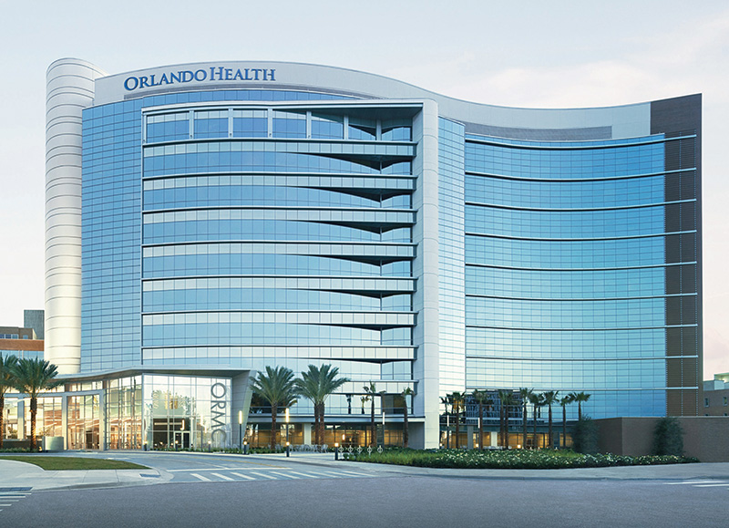
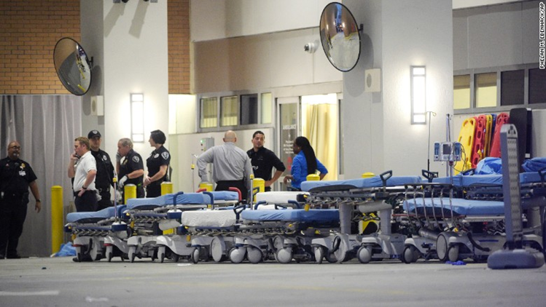
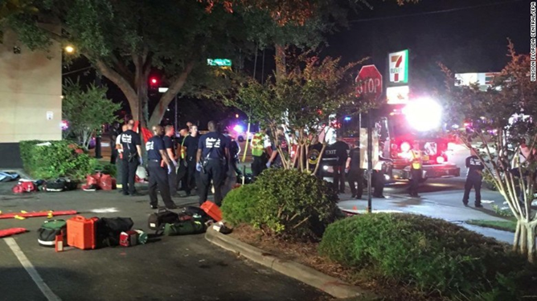
Orlando Response

Slide 63
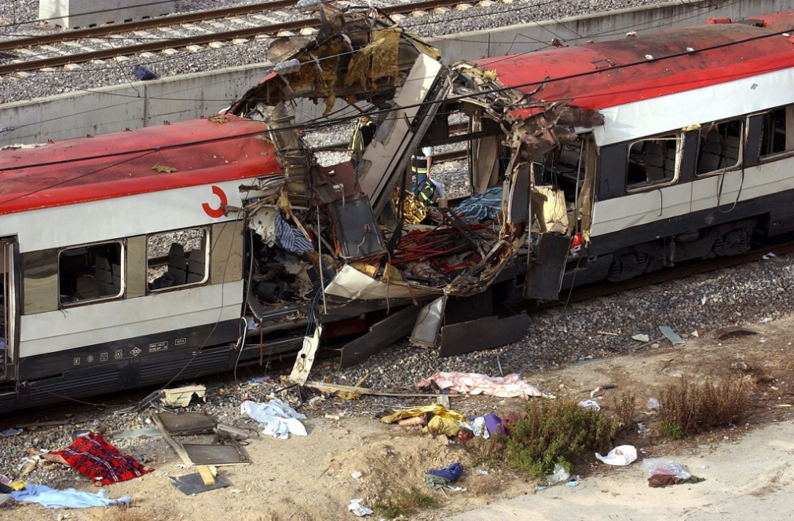
Madrid Attacks Killed 191 and wounded 1,841

Slide 64
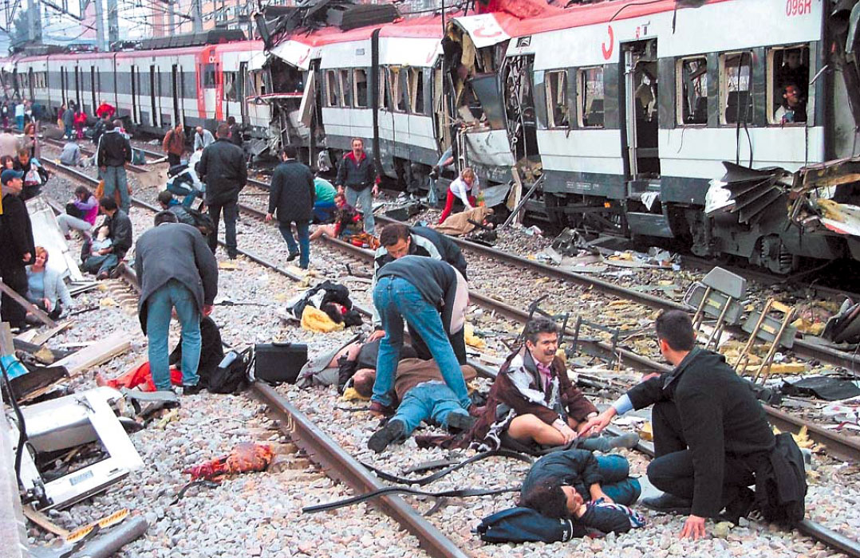
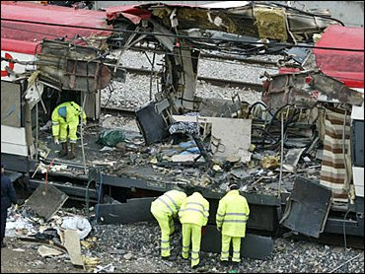
966 patients to 15 hospitals
More than 270 patients went to the closest facility

Slide 65
Notes:
Las Vegas Harvest Route 91 Festival Shooting

Slide 66
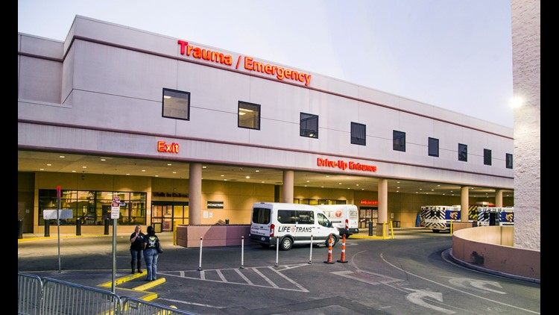
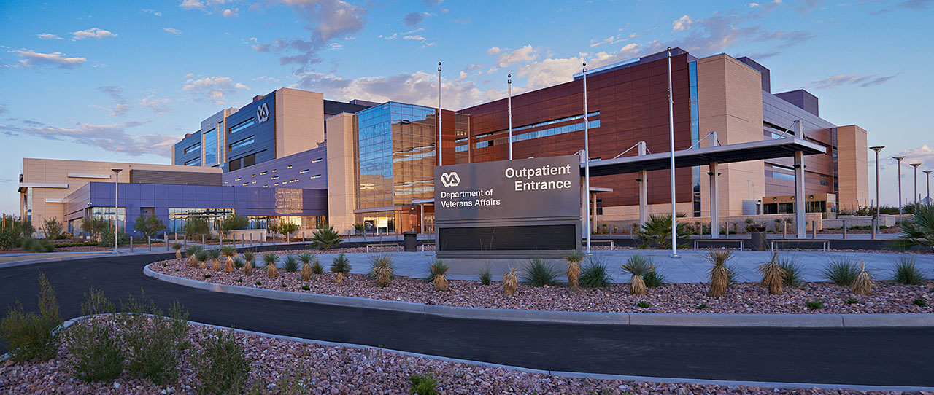
Sunrise Medical Center
University Medical Center
VA of Southern Nevada

Slide 67
TRANSPORT Officer/Group/Unit
Crucial to overall success in MCI
Ensure rapid removal of “Red” patients
Must ensure appropriate hospital allocations
EMS:
Do NOT relocate the disaster to the hospital!!
Use non-Trauma Center and more distant hospitals as needed
Hospital allocation: Consider patients transported by LE, Lyft, Uber, taxi, civilians, etc. as well as EMS transports
Transport Red and obvious serious patients ASAP but each must be logged with Transport Officer
Patient allocation/distribution is one of EMS’ most crucial tasks

Slide 68
OHTRAC & MCI Page
Transport Officer could use OHTrac to determine patients sent to various hospitals…
Notes:
…or a dispatch center could log on to OHTrac and access the MCI incident to view how many of each triage level patients have been transported to each hospital. Existing local communication methods and protocols could be integrated with OHTrac so that the triaged patients are transported to appropriate hospitals.

Slide 69
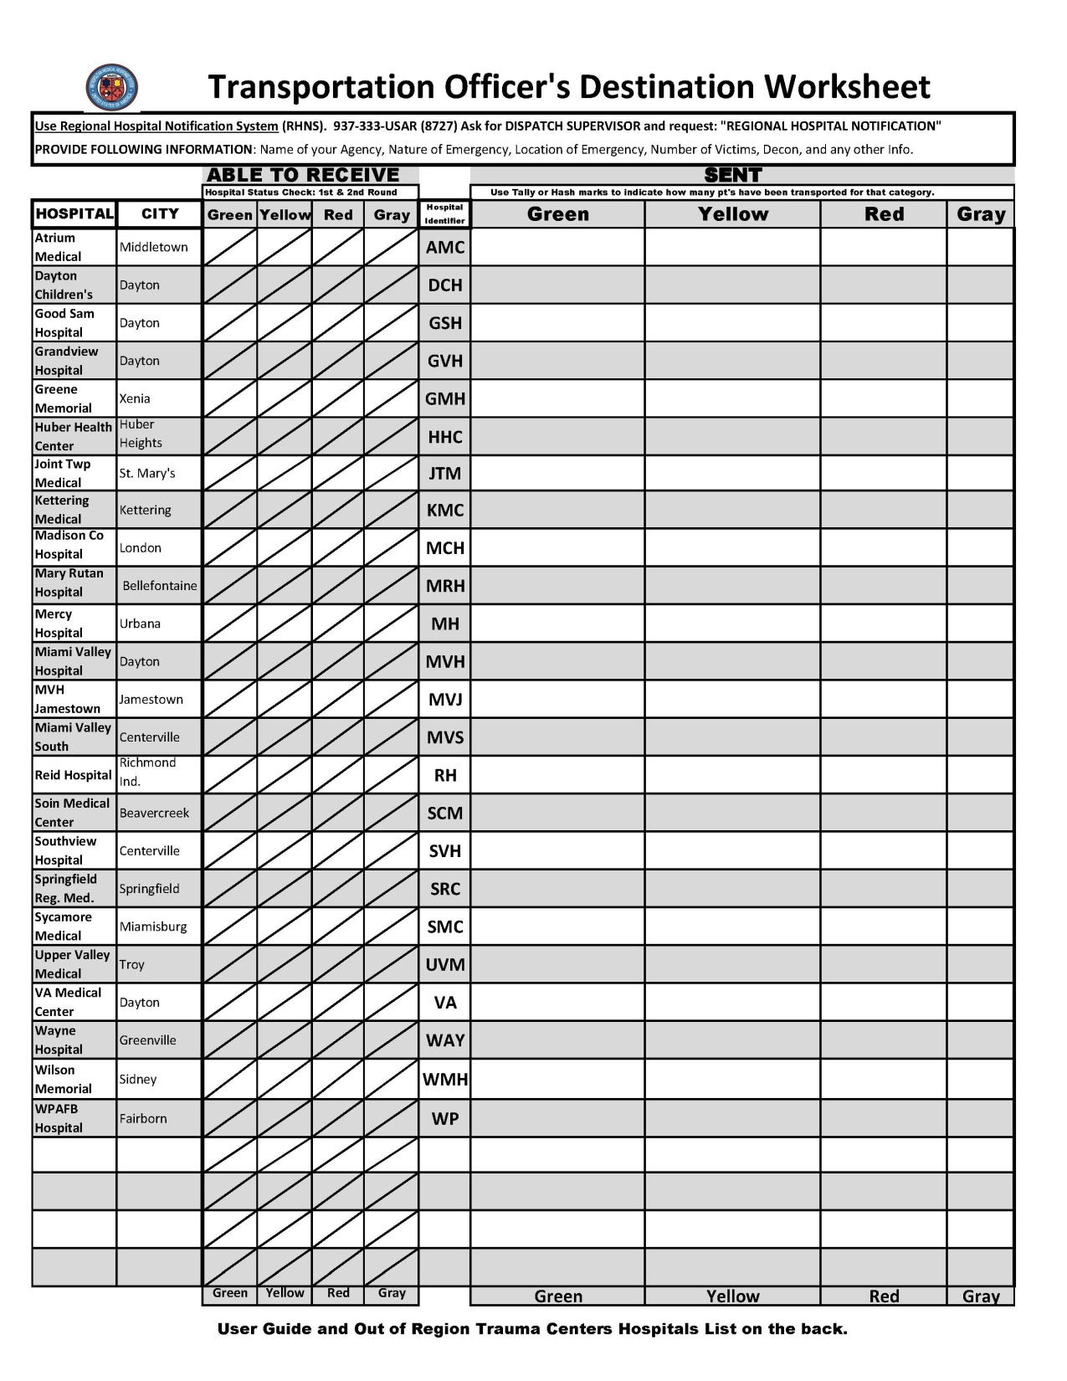
Notes:
You can track hospital capabilities with the MMRS Transport Officer Worksheet, but the MCI page is faster, much more effective, and dramatically reduces radio traffic.

Slide 70
Notes:
But for EMS, MCI page is MUCH better

Slide 71
Other MCI Tools

Slide 72
“HSR3 MCI” MARCS Radio Talkgroup
MCI MARCS - additional hospital ED radio used solely in an MCI
Used to notify each hospital of patients they will receive
Used to provide ALL hospitals with a “common operating picture” simultaneously
Hospitals can ask questions about incident over HSR3 Radio Talk Group

Slide 73
HSR3 MCI-MARCS Radio Talkgroup
>90% of EMS communication during MCI should come from Transport Officer or Transport Comm Aide
Hospital radios may have two primary TGs
HSR3 MCI MARCS Talkgroup
HSR6 MCI MARCS Talkgroup
Can be patched together by Dispatch Centers

Slide 74
HSR3 MCI-MARCS Radio Talkgroup
No alerts on MCI TGs!
During an event, hospitals turn on MCI talk group (TG)
Monitor MCI radio
Request to monitor HSR3MCI Radio is included in Communications Job Aid, but hospitals should plan to do so on any MCI notification

Slide 75
REGIONAL HOSPITAL NOTIFICATION SYSTEM (RHNS)
One number for EMS, hospitals, and EMAs to call
Makes rapid, simultaneous notifications during MCI or other major emergency
Use whenever an incident could involve a significant number of region’s hospitals
Also used for “stand down” messages

Slide 77
MCI Job Aid for RHNS
Copy of this was sent to all agencies in region
The Transport Officer clipboard on each apparatus should have a copy of the job aid
Provides personnel with everything they need to activate RHNS
More MCI Job Aids are in development!

Slide 78
REGIONAL HOSPITAL NOTIFICATION SYSTEM (RHNS)
Numbers for each hospital chosen by that hospital
Recommended that emergency messages on cell phones should get both text and voice (if one system down, other may go through)
Receiving RHNS Messages
Alerts hospitals plus regional coordinators, some EMAs, etc.
RHNS is tested monthly and during most area exercises

Slide 79
MCI Communications Continuing Education Programs
Available on www.GMVEMSC.org
Greater Miami Valley EMS Council website
EMS Con Ed (for EMS and nurses) courtesy of GMVEMSC

Slide 80
Difference between:
Facility Admin
Edit/Facility User

Slide 81
System Access
Facility Admin View
Adding/editing users
Changing User Passwords

Slide 82
Setting Up Devices
App store (iOS or Google/Android)
Download “OHTrac”
Login
That’s it!

Slide 83
Exercise:
Scan a Green Tag into the “Incident” for your training
Enter the mandatory fields
Hand the tag to another student
Second student scans the tag to pull up that patient
Then adds additional patient info

Slide 84
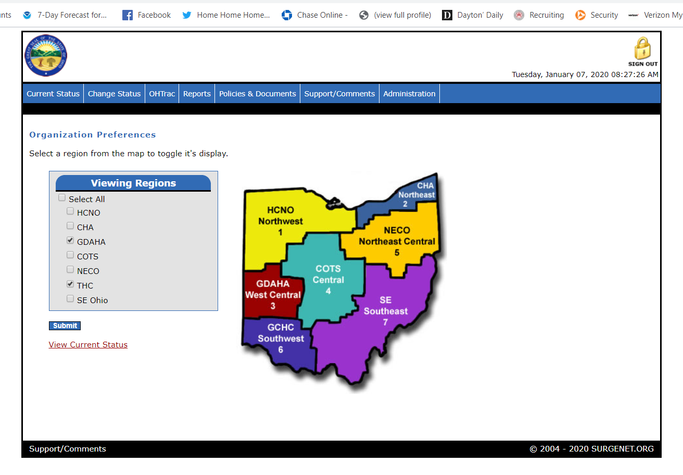
Helpful Documents On Website

Slide 85
Questions????
??????????????

