Slide 1


2017 Protocol Changes
GMVEMSC

Slide 2

What follows are the 2017 GMVEMSC Protocol updates.
This PowerPoint will cover topics related to all levels of Ohio EMS Providers including EMR, EMT, AEMT, and PM.
Some of the material may be beyond your scope of practice and is presented herein so that you may understand what has changed within the GMVEMSC region, and what you should expect to see when interfacing with other providers both above and below your level of certification.
If there is something you don't understand, ask for clarification.
Optional skills are NOT included within this presentation, and are the responsibility of the Agency and its Medical Director to educate, train, skills verify, and test. Refer to the GMVEMSC Optional Skills Training Manual as needed.

Slide 3
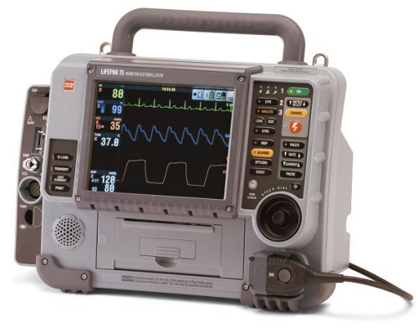
Transferring Patients Into The ED
For all patients, especially those who are intubated, provide a summary report. For any department whose monitors have summary capabilities, that summary report must be presented with the patient.
  Any patient in respiratory distress on oxygen or whose O₂ sats indicate a need for oxygen, shall remain on oxygen until care is transferred to the hospital.
  Help to ensure adequate ventilation & oxygenation.
  Help to identify tube displacement during patient transfer.
  Print a summary report to include ETCO2 readings.
  Attach summary report to EMS run sheet.
    Transferring patients to the hospital
    continues to be a problem.

Slide 4
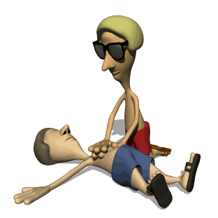
Resuscitation On Scene:
Providers are expected to provide resuscitative care at the scene for some patients and other patients should be rapidly transported.
If you are less than 30 minutes from an interventional facility and defibrillation is the only needed intervention to establish a perfusing rhythm, transport the following patients rapidly:
  Patients with a documented STEMI and you witness their cardiac arrest after brief resuscitative efforts, including defibrillation as indicated.
  Your patient has ROSC after VFIB or ROSC with evidence of ST elevation.
The following patients require prolonged resuscitation efforts:
  Patients with a PEA > 40. The pt may not be in true cardiac arrest, but simply not have palpable pulses due to profound shock.
  If the pt has an upward trending or persistent EtCO₂ > 20, or refractory VF or VT.

Slide 5
Resuscitation On Scene:
The patient in profound hypothermia should be rapidly transported to a Trauma Center, especially if they arrest.
Consider aeromedical transport for transports > 30 minutes if the patient has ROSC.

Slide 6
FIELD TERMINATION:
♦ Following all appropriate efforts, field termination requires MCP approval, and may only be considered when the following criteria are met:
  18 years or older
  In asystole or PEA rates < 40
  Not be in arrest due to hypothermia
  Have an advanced airway in place
  Have vascular access in place
  There are no signs of neurological function such as reactive pupils, response to pain or spontaneous movement
♦ EMS must contact MCP directly to receive consent for field termination and be able to provide the following:
    The duration of the resuscitation:
    How long the patient may have been in arrest prior to EMS arrival at the scene
    Witnessed or unwitnessed
    EtCO₂
    Blood glucose
    Presenting rhythm

Slide 7
INITIAL CARE: Fluid Administration
Follow BLS or ALS and airway algorithms as indicated based on current AHA Guidelines.
Obtain chief complaint (OPQRST, see Abdominal Pain), SAMPLE history, and vital signs per patient condition:
  SAMPLE: Signs and Symptoms, Allergies, Medications, Past medical history, Last oral intake, Events leading up to present illness or injury.
Utilize cardiac monitor or other monitoring device, pulse oximeter, etc. as appropriate.
IN medication administration must be via Mucosal Atomizer Device (MAD).
Start IV fluids or Saline Lock (SL) as appropriate
Crystalloid solutions have been changed to include Normosol, Plasmalyte, LR or NS in that order. pH is closer to neutral.

Slide 8
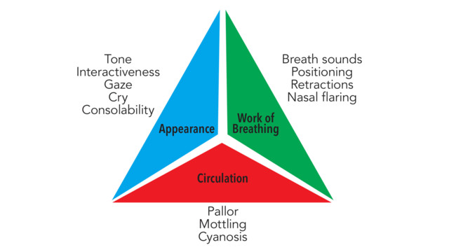
The Pediatric Assessment Triangle
Many changes arise from QA/QI problems. Much attention needs to be directed to the pediatric population.

Slide 9
Pediatric Assessment Triangle (cont.)
The Pediatric Assessment Triangle establishes a level of severity, assists in determining urgency for life support measures, and identifies key physiological problems using observational & listening skills.
Appearance reflects adequacy of: oxygenation ventilation, brain perfusion, CNS function
One mnemonic used for pediatric assessment is: TICLS.
Tone- Moves spontaneously, sits or stands (age appropriate)
Interaction- Alert, interacts with environment
Consolability- Stops crying with comfort measures (holding, warmth, distraction)
Look/gaze – Makes eye contact with clinician, tracks objects
Speech/cry – Uses age appropriate speech or crying

Slide 10
Pediatric Assessment Triangle (cont.)
Breathing-Work of breathing is a more accurate indicator of oxygenation and ventilation than respiratory rate or breath sounds (standards used in adults)
Circulation reflects adequacy of cardiac output and perfusion of vital organs (core perfusion).
Cyanosis reflects decreased oxygen levels in arterial blood, vasoconstriction and respiratory failure.
Mottling of the skin indicates hypoxemia, vasoconstriction and respiratory failure.

Slide 11

Spinal Motion Restriction
The age qualifier of 70 was dropped. Not everyone 70 years of age is in need of SMR.
All trauma patients should be moved in-line as a unit
There is no evidence that trauma patients with penetrating trauma benefit from immobilization. The damage occurred at the moment of penetration.
Handling does not necessarily mean on a backboard

Slide 12
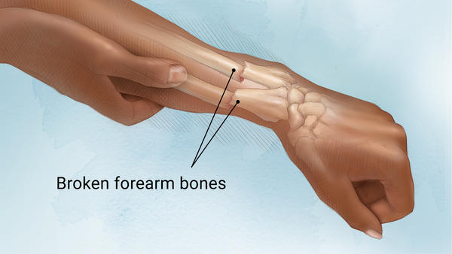
Pain management

Slide 13
Pain Management:
For moderate to severe pain relief when the patient is alert:
  Consider Fentanyl 50-100 mcg slow IV, provided SBP > 100.
  If no response, or inadequate response to IV Fentanyl and a second drug bag is available:
      May repeat slow IV Fentanyl 50-100 mcg, after 15 minutes provided SBP > 100.
And if pain persists after 15 minutes:
  Consider Ketamine 25 mg IV.
      May repeat Ketamine 25 mg IV, after 15 minutes.
DO NOT GIVE KETAMINE TO SUSPECTED CARDIAC CHEST PAIN

Slide 14
Pain Management: (Cont)
If unable to obtain IV:
  Give Fentanyl 50-100 mcg IN or IM.
      Repeat dose of Fentanyl 50 mcg IN or IM, no sooner than 15 minutes, if second drug bag is available.
And if pain persists after 15 minutes:
  Give Ketamine 25 mg IN or 50 mg IM.
      May repeat Ketamine 25 mg IN or 50 mg IM, after 15 minutes.
Always consider the weight of your patient when dosing pain meds, especially for the elderly.

Slide 15
Pain Management: Pediatrics
♦ MCP CONTACT REQUIRED BEFORE ADMINISTRATION OF FENTANYL FOR PEDIATRIC PATIENTS WITH ABDOMINAL PAIN.
FENTANYL IS NOT TO BE ADMINISTERED TO ANYONE < 2 YEARS OF AGE.
KETAMINE IS NOT TO BE ADMINISTERED TO ANYONE < 16 YEARS OF AGE FOR PAIN.
For severe pain relief when the patient is conscious and alert the first choice is:
  Fentanyl 1 mcg/kg IN, max dose 100 mcg.
  May repeat Fentanyl 1 mcg/kg IN after 15 minutes, if an additional drug bag is available.
  Consider Fentanyl 1 mcg/kg, slow IV, max dose 100 mcg, provided appropriate normal SBP (80 + 2x age in years).
  May repeat Fentanyl 1 mcg/kg, slow IV after 15 minutes, max dose 100 mcg, if still in pain, appropriate SBP and a second drug bag is available.
If unable to obtain IV: IM FOR PEDS IS A LAST RESORT.
  Give Fentanyl 1 mcg/kg IM, max dose 100 mcg
  Repeat dose of Fentanyl 1 mcg/kg IM, max dose 100 mcg, repeat no sooner than 15 minutes if a second drug bag is available.

Slide 16
IO Insertion: Three 45’s
  The longer yellow (45 mm) needle should be used for humeral IOs in adults.
IO Insertion at Humeral Head Site
  Insert the needle at a 45 degree angle to the frontal plane and aimed at the inferior portion of the sternum (roughly a 45⁰ angle)

Slide 17
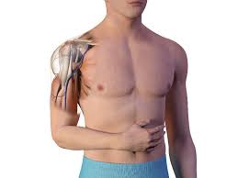
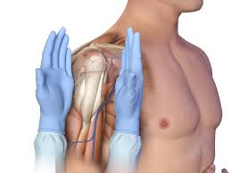
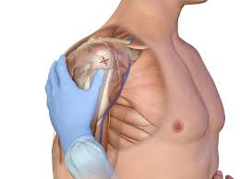
Position patient’s shoulder adducted by placing the patient’s hand on their navel.
Aim IO needle toward the inferior sternum to obtain the correct angle.

Slide 18
Several sections have been combined
Cardiac arrest, smoke inhalation or suspected cyanide poisoning have been combined and then referenced throughout the book.
Hypoglycemia is referenced throughout

Slide 19
ACLS H's and T's Modified
Trauma and hypoglycemia were removed by AHA recommendations
Cpr
Compression rate changed to 100-120 per minute

Slide 20
Medication notes and changes
Calcium chloride: call for orders with a renal dialysis patient in wide complex bradycardia.
Norepinephrine: max drip changed to 45 drops per minute.
Diazepam: removed diazepam from protocol for seizures and crack cocaine OD

Slide 21
Solu-medrol
Solu-Medrol will be given to all patients treated within the allergic reaction, anaphylaxis and asthma protocol only after any other applicable first-line medications have been delivered:
DO NOT EXPECT FIELD RESULTS FROM SOLUMEDROL.
Solu-Medrol 80 mg IV.
Solu-Medrol 2 mg/kg IV, max dose 80 mg.

Slide 22
Sepsis: 1-6 million cases per year in U.S.
A patient with a known or suspected infection and an EtCO₂ < 32 or > 47, with 2 or more of the following criteria:
  Respiratory rate ≥ 22
  Altered mental status (GCS < 13)
  Temperature > 100.4 (38 C) or < 96.8 (36 C)
  Heart rate > 90
  Systolic BP < 100 or MAP < 65. MAP (mean arterial pressure) is considered to be the organ perfusion pressure. MAP = (SBP + 2 X DBP) / 3 and is normally 70 – 110 mm/hg.
Treatment:
  1 liter of IV fluid
  O₂
  ♦ For additional fluids and or Norepinephrine starting at 30 gtts/min.

Slide 23
Trauma Triage Criteria: modified by state
Anatomy of Injury: open skull fracture
Physiological: needs ventilatory support
Physiological Peds: respiratory rate less than 20 per
minute in infants less than 1 year old.
Mechanism of Injury: vehicle telemetry data consistent
with high risk of injury

Slide 24
Crush syndrome:
- Deleted time frames
- Removed Versed
- Added sedation
CRUSH SYNDROME TRAUMA
History: Entrapped or under an extreme load and crushed.
♦ Contact MCP immediately and prior to relieving the load.
♦ Consider sedation:
  A Ketamine 250 mg IM, may repeat after 2 minutes
  Ketamine 5 mg/kg IM, max dose of 500 mg

Slide 25
Anaphylaxis: weight ranges and doses modified
If severe allergic reaction:
  If < 15 kg, EpiPen Jr or Epi (1:1,000) 0.01 mg/kg IM (max 0.15 mg).
  If ≥ 15 kg and < 30 kg, Adult EpiPen or Epi (1:1,000) 0.01 mg/kg IM (max 0.3 mg)
  May repeat Epi (1:1,000) 0.01 mg/kg IM (max 0.5 mg) after 5 minutes.
If ≥ 30 kg, give both Adult EpiPen and EpiPen Jr or Epi (1:1,000) 0.5 mg IM
♦ May repeat Epi (1:1,000) 0.5 mg IM after 5 minutes.
If patient remains hypotensive after IV fluid, Epi (1:10,000) 0.1 mg, slow IV, every 3 minutes up to 0.5 mg

Slide 26
OD or Poisoning: Added Routes for Initial Narcan
Narcotic Overdose
If patient has a pulse, Naloxone should be administered before inserting an ETT.
Consider patient restraint before administration of Naloxone:
If respirations are impaired or there is suspicion of narcotic overdose, administer Naloxone, up to 2 mg IN, 2 mg IV or 4 mg IM.
If respirations don’t improve after three minutes, Naloxone 2 mg IV or 4mg IM. Titrate to adequate respirations.
May repeat Naloxone doses.
After administration of Naloxone, patient transport by EMS is encouraged.

Slide 27
OD or Poisoning (cont.)
Narcotic Overdose – Pediatric
Naloxone:
  ≤ 20 kg 0.1 mg/kg IN, IV, IM (max dose 2 mg), may repeat x one
  > 20 kg 2 mg, IN, IV, IM, may repeat x one
  Naloxone slow IV is preferred, but it may be given IN before IV is established.
  Titrate to adequate respirations.
  If using IN route and respirations don’t improve after 3 minutes, establish IV and administer IV dose.

Slide 28
OD name changed to Stimulant OD
Stimulant Overdose (cocaine, methamphetamines, amphetamines, crack cocaine):

Slide 29
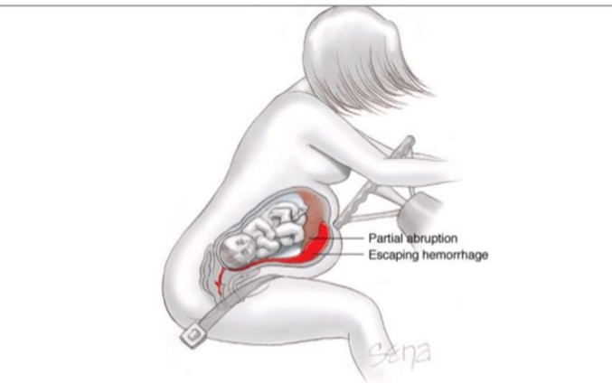
OBSTETRICAL EMERGENCIES
ABSOLUTELY NO PREGNANT PATIENTS TO DAYTON CHILDREN’S HOSPITAL

Slide 30
Abdominal Pain:
Ensure an abdominal exam which includes inspection, auscultation and palpation is performed and documented on every patient with abdominal pain.

Slide 31
Apparent Life Threatening Event - ALTE
An Apparent Life Threatening Event involves any infant < 1 year of age that is witnessed with a frightening event by an observer and involves some combination of the following:
Apnea
Choking or gagging
Color change (cyanosis, pallor)
Change in muscle tone (limpness, sometimes rigidity)
*Children who experience an ALTE event often times have a normal exam on assessment. However, they should be transported to the hospital for further assessment. It is possible they have a serious underlying condition and the observed symptoms may reoccur. Assume the history given by the caregiver is accurate. Be persistent about the seriousness of the event and the need to transport.

Slide 32
ALTE (cont.)
Also referred to as a BRUE (Brief Resolved Unexplained Event)
Support ABCs
Obtain a medical history- most common causes of ALTE include: gastroesophageal reflux disease (GERD), nervous system disorders (such as seizures or brain tumors), and infections (such as meningitis). Less common causes include heart disorders, metabolic disorders, child abuse, and narrowing or blockage of the airways. A cause cannot be determined in 50% of ALTE cases.
Perform a complete a Head–to-Toe physical exam.
Keep warm, transport to the hospital

Slide 33
ALTE (cont.) THE FOLLOWING SHOULD BE NOTED, BUT NOT LIMITED TO:
Document symptoms of the event given by the observer:
Was the child apneic, cyanotic or limp during event?
Infant’s color, respirations and muscle tone
Was seizure-like activity noted?
Was any resuscitation attempted or did event resolve spontaneously?
How long did the event last?
Past Medical History:
Recent trauma, infection (e.g., fever, cough)
History of gastroesophageal reflux (GERD)
History of congenital heart disease
History of seizures
Medication history
Birth defects

Slide 34
ALTE (cont.)THE FOLLOWING SHOULD BE NOTED, BUT NOT LIMITED TO:
Examination/Assessment:
Head-to-Toe exam for trauma, bruising, or skin lesions
Check anterior fontanel: is it bulging, flat or sunken?
Pupillary exam
Respiratory exam for rate, pattern, work of breathing and lung sounds
Cardiovascular exam symmetry of brachial and femoral pulses
Neuro exam for level of consciousness
Observe for repeated event of reported occurrences

Slide 35
Combative patients: Added Excited Delirium
Combative patients, including those with excited delirium:
Ketamine 250 mg IM (anterolateral thigh, wait 2 minutes, if desired effect is not achieved, repeat 250 mg in opposite thigh).
Or Ketamine 100 mg slow IV.
After 10 minutes and an additional drug bag is available, may repeat Ketamine 250 mg IM (anterolateral thigh, wait two minutes, if desired effect is not achieved, repeat 250 mg in opposite thigh).
Or repeat Ketamine 100 mg IV after 5 minutes.
-OR-
Midazolam 10 mg IN (5 mg each nostril), or Midazolam 2 mg slow IV or Midazolam 4 mg IM.
Or repeat Midazolam 10 mg IN (5 mg in each nostril) after 5 minutes
If an excited delirium patient goes into arrest:
  ♦ Consider Sodium Bicarbonate 100 mEq IV

Slide 36
Nerve Gas: changed pounds to kilograms
♦ Adults and children > 40 kgs, give Mark I Atropine and 2-PAM auto-injector, DuoDote, or Atropine 2 mg, IV, IM
♦ Children 20 – 40 kgs, give 1.0 mg Atropine, or the 1.0 mg Atropen auto-injector.
♦ Children < 20 kgs, give 0.5 mg Atropine, or the 0.5 mg Atropen auto-injector.

Slide 37
Drug bags
Do not place any used vials or trash in any drug bag!
Several investigations have involved empty vials being in the drug bags.
Effective immediately, all apparatus will be required to keep a drug bag log on the apparatus that tracks all drug bag exchanges. This can not be over emphasized!

Slide 38
Documentation
Documenting GCS for trauma patients is crucial!
  25% of patients with head injuries do not have a pre-hospital GCS documented.
Pre-Hospital Alerts
  If a pre-hospital alert is called (cardiac, trauma, stroke) it needs to be documented in the PCR.

Slide 39
Hospital Radio Reports
Reports should be:
  Clear
  Concise
  To the point with pertinent information
  If you are calling a pre-hospital alert, state this at the beginning of your communication.

Slide 40
Infectious Disease Exposure
DEFINITION OF A BLOODBORNE EXPOSURE
An EXPOSURE incident that may place a public safety worker at risk for Hepatitis B Virus (HBV), Hepatitis C Virus (HCV), or Human Immunodeficiency Virus (HIV) infections or other blood borne pathogens that includes:
  A percutaneous injury (e.g., a needle stick or cut), or
  Contact of mucous membrane or non-intact skin (e.g., exposed skin that is chapped, abraded, or afflicted with dermatitis) with blood, tissue, or other body fluids that are potentially infectious.
What is NOT an exposure?
  A percutaneous injury with a clean or sterile needle or instrument.
  Intact skin splashed with potentially infectious blood, body fluid, or tissue.
What is the process?

Slide 41
Infectious Disease Exposure

Slide 42
Quick review
By what route can the first round of Naloxone be administered if an overdosed patient has impaired respirations?
  IV, IM or IN are acceptable routes for administration.
When a patient has been transported to the hospital on supplemental O2, should the patient remain on O2 from the ambulance to the ER bed?
  Yes, patients should remain on O2 from the time they leave the ambulance until care has been transferred to the ER staff.
Is intact skin that comes in contact with potentially infectious blood, bodily fluid or tissue considered an exposure?
  No, it must be a percutaneous injury or come in contact with a mucous membrane or non-intact skin
4. When is prolonged resuscitation efforts required?
  For patients with a PEA > 40 who may not be in true cardiac arrest, but simply do not have palpable pulses due to profound shock or if the patient has an upward trending or persistent EtCO₂ > 20, or refractory VF or VT
(True or False) The three legs of the pediatric triangle are: Circulation, Work of Breathing and Patient Assessment?
  False: Circulation, Work of Breathing and Appearance.

Slide 43
Quick Review
When is Ketamine an option for Pain Management and what is the dosage?
  When Fentanyl has been given and pain persists after 15 minutes, 25 mg IV
When is Solu-Medrol given to patients with allergic reactions or anaphylaxis?
  Only after any other applicable first-line medications have been delivered!
Name at least two criteria of a septic patient with a known or suspected infection with an EtCO₂ < 32 or > 47,?
  Respiratory rate ≥ 22;
  Altered mental status (GCS < 13) ;
  Temperature > 100.4 (38 C) or < 96.8 (36 C);
  Heart rate > 90
  Systolic BP < 100 or MAP < 65. MAP (mean arterial pressure) is considered to be the organ perfusion pressure. MAP = (SBP + 2 X DBP) / 3 and is normally 70 – 110 mm/hg.
An ALTE or BRUE involves any infant < 1 year of age that is witnessed with a frightening event by an observer and involves some combination of the what events?
Apnea / Choking or gagging / Color change (cyanosis, pallor) / Change in muscle tone (limpness, sometimes rigidity)
(True or False) Under the Crushed Syndrome protocol, Versed was removed for respiratory purposes and Ketamine was added for sedation purposes?
  True

Slide 44

Questions?

Slide 45
Thank You for Your Service & Dedication!
GMVEMSC is now on Facebook!

