Slide 1
GMVEMSC Database Tutorial

Slide 2
Overview
This tutorial is focused on the following roles:
  Individual User Account
  Department Administrator
  Skills Evaluator
  CBT Proctor
  Medical Director
Please refer to the GMVEMSC Implementation Guide Dated 12/2019 for specific responsibilities related to these positions

Slide 3
Website
https://www.gmvemscsodb.com/auth/login

Slide 4
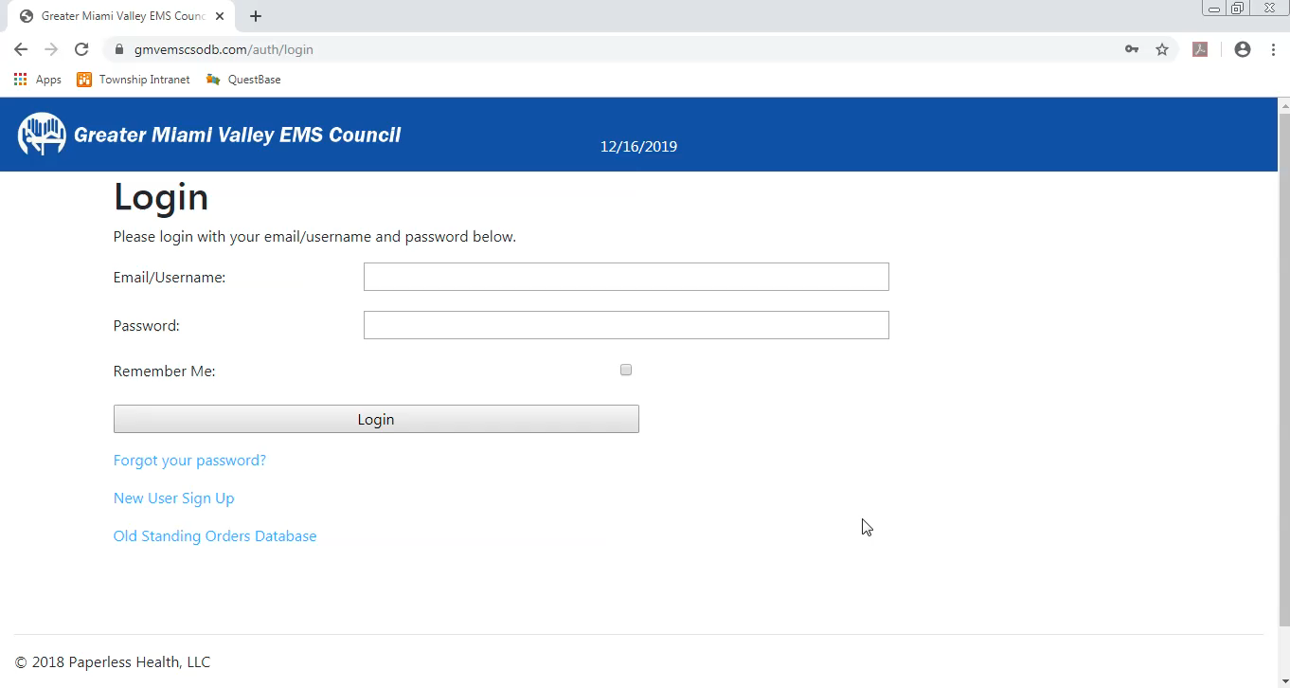
Individual User Account – Part 1

Slide 5
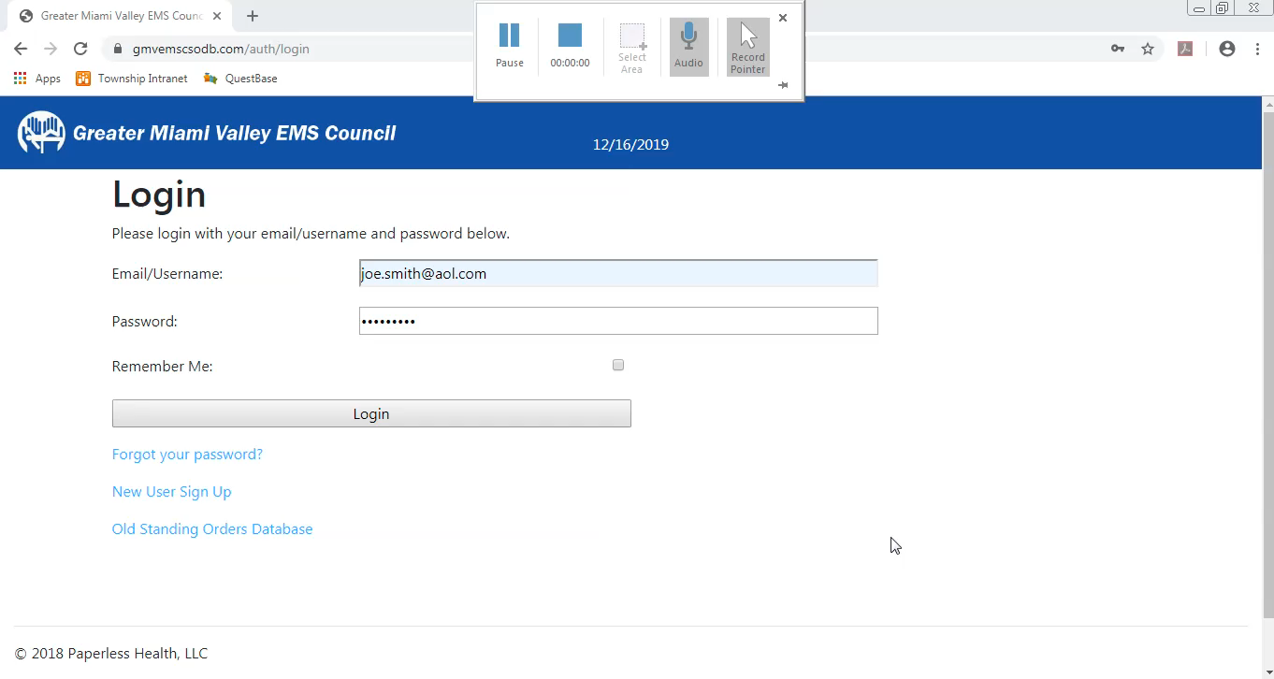
Individual User Account – Part 2

Slide 6
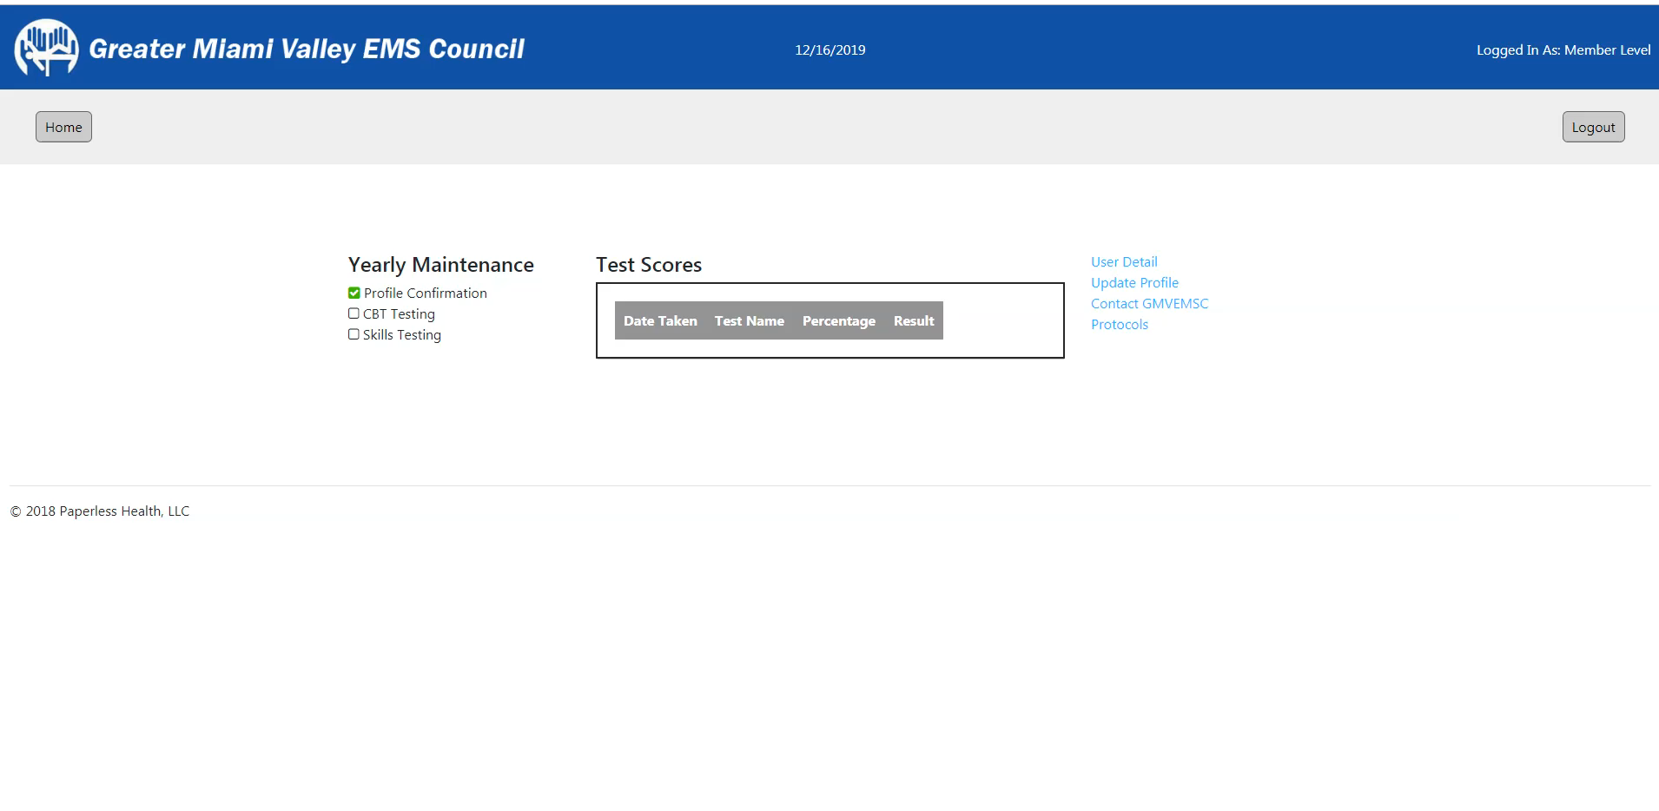
Dashboard Review

Slide 7
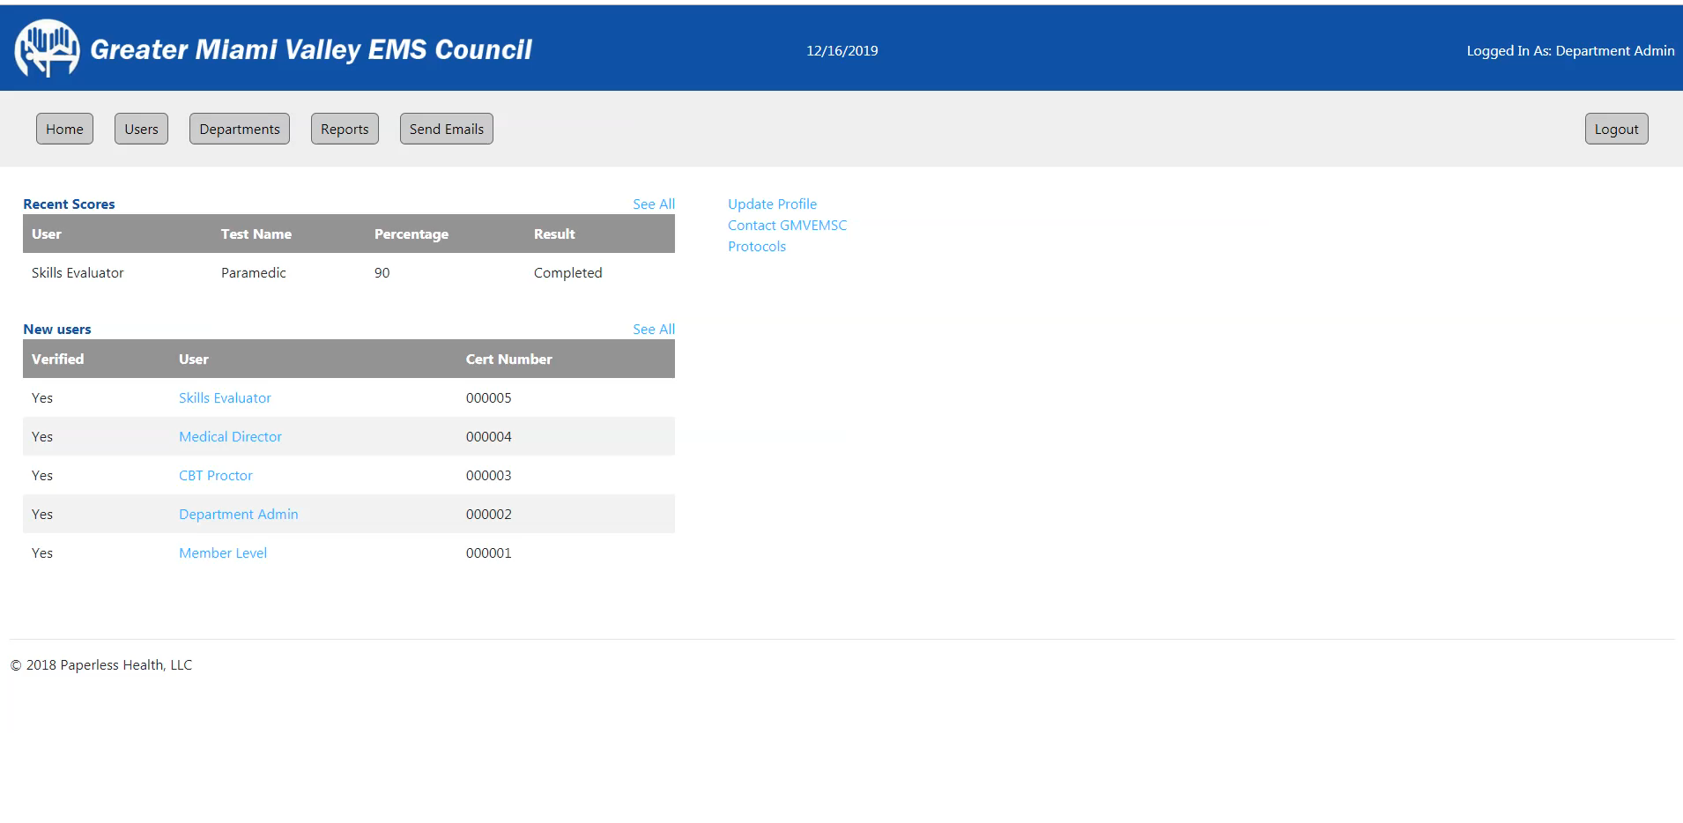
Department Administrator – CBT Proctor Designation

Slide 8
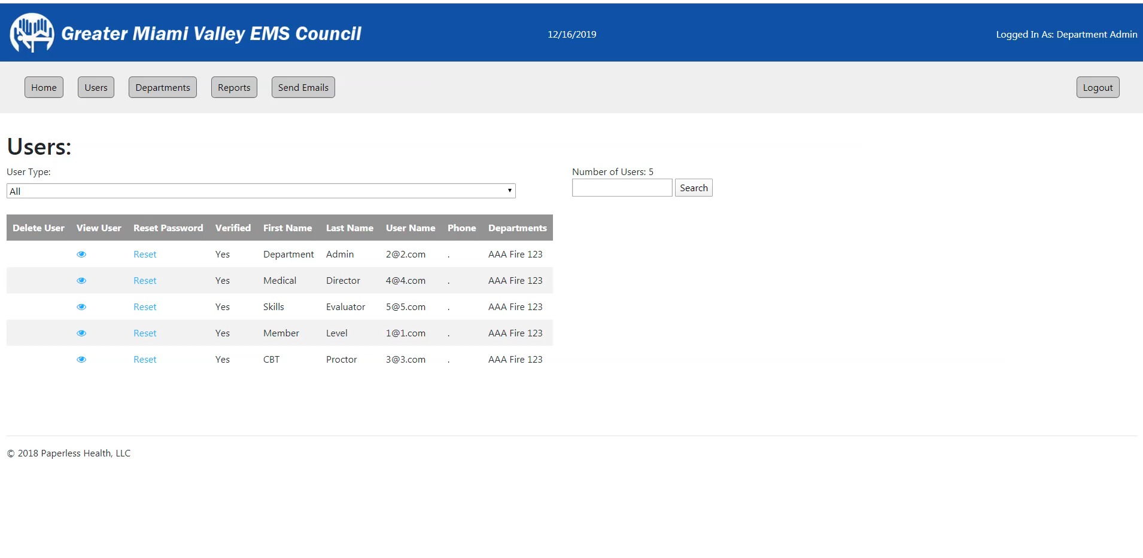
Department Administrator – Skills Evaluator Designation

Slide 9
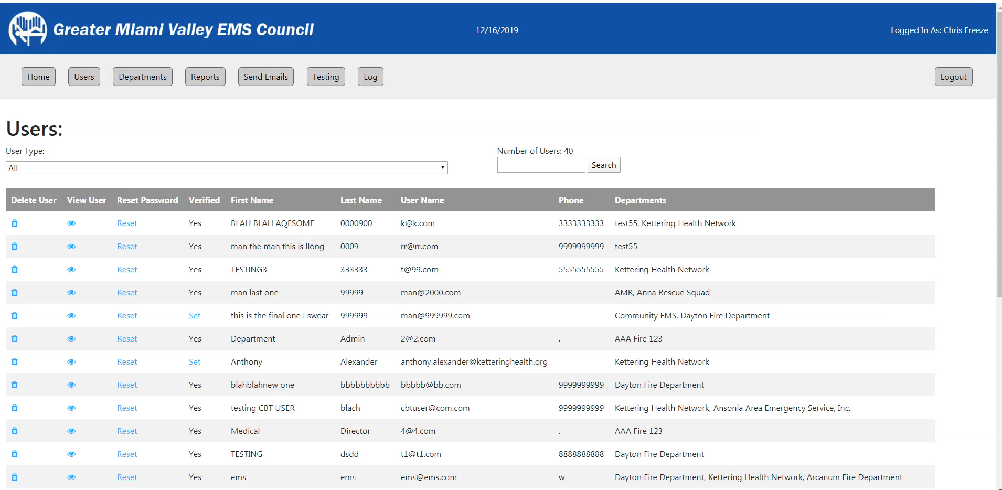
CBT Proctor

Slide 10
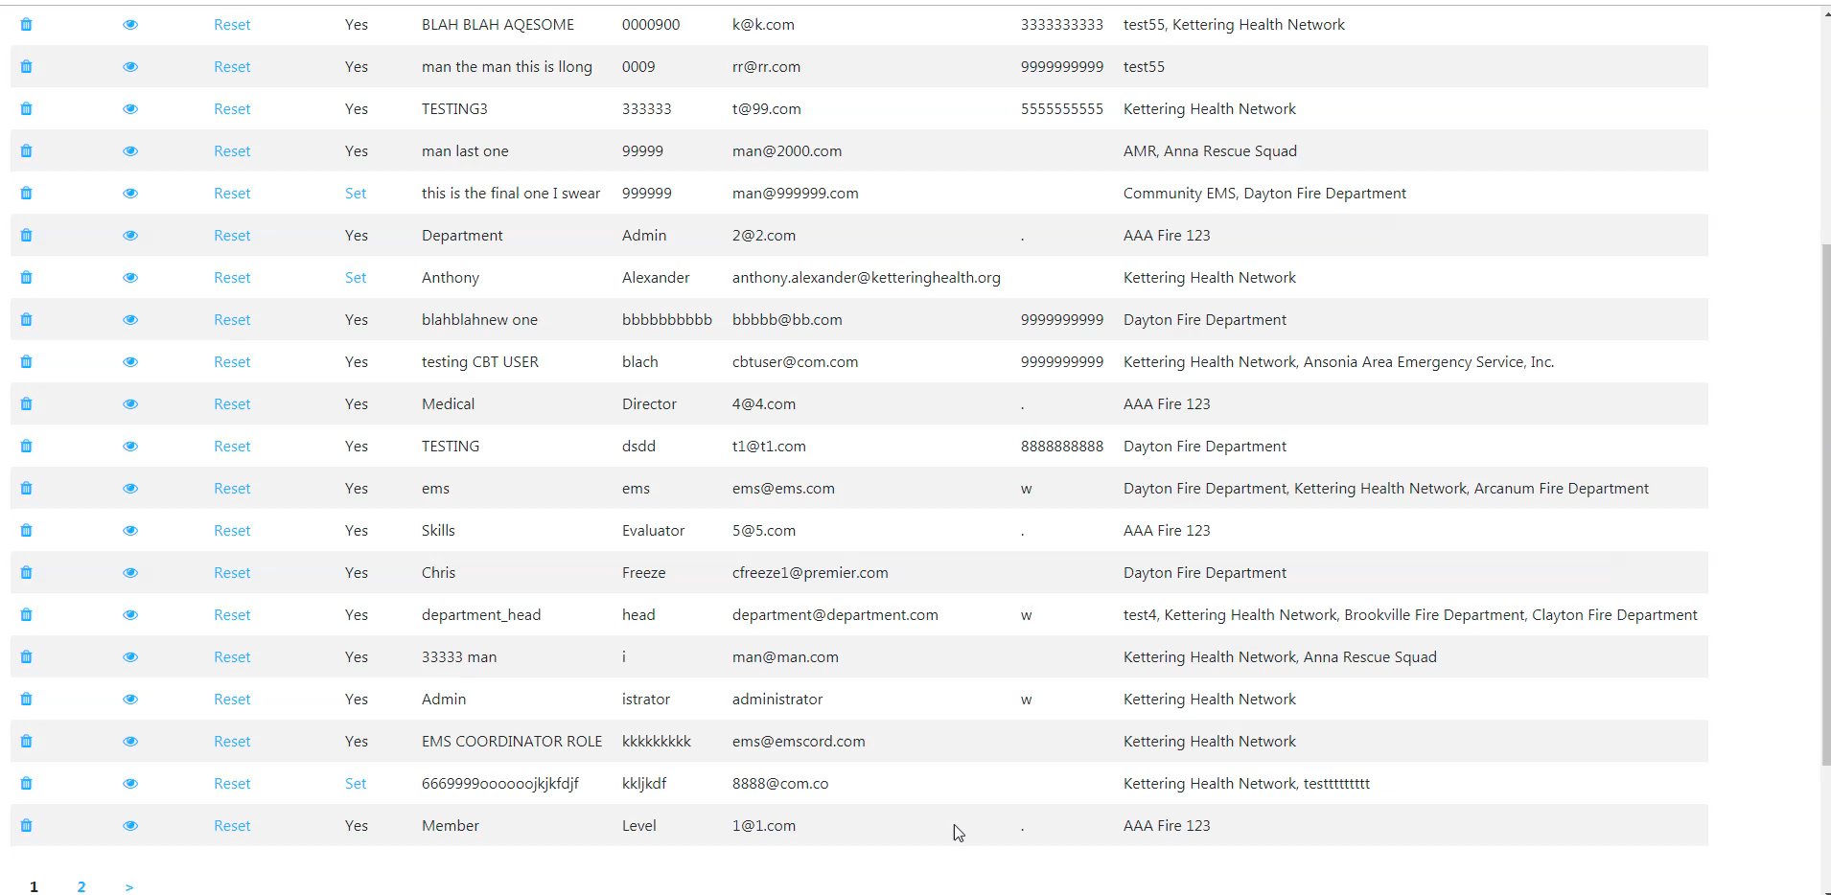
Skills Evaluator

Slide 11
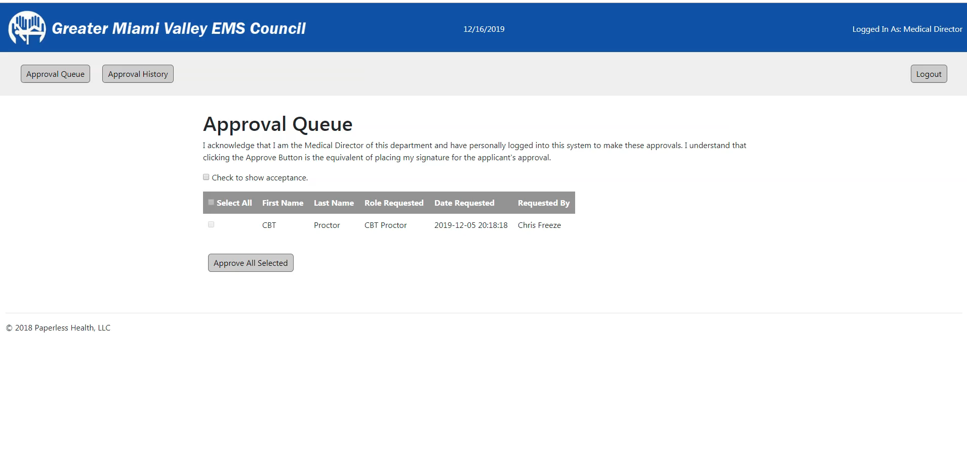
Medical Director

