Slide 1
Healthcare & Hospital Active Shooter
Response and Prevention

Slide 2
Collaborative Planning/Response: We are all in this together!
Andrew Booher, Kettering Health Security
Sandy Booher, KH Emergency Management
Ryan Burke, TCHHN
Michael DeLong, Wayne Healthcare
Cpt. Brad French, Dayton Fire Department
Gregg Gaby, Premier Health DPS
David Gerstner, Regional MMRS Coordinator
Woody Goffinett, Wilson Health
BC Andy Harp, Miami Valley Fire District
Gregory Howard, DHS, CISA
Ken Johnson, Clark County EMA
Chief Jacob King, WPAFB Fire Department
Sgt. Chad Knedler, Dayton Police Department
Chris Marker, President, Greater Miami Valley EMS Council
William R. Marriott, MD; Premier Health
Jordan Marsh, Intern, Dayton MMRS
Mark Moore, Dayton Children’s Hospital
Nancy Pook, MD FACEP ; Kettering Health
Mary Porter, RN; Regional Healthcare Coordinator, GDAHA
William Rose, Intern, Dayton MMRS
Jonathan D. Shecter, DO; WSU BSOM DEM
Brian Springer, MD; WSU BSOM DEM
Nick Thornton, Mercy Health
Aundray Toney, Dayton Children’s Hospital Public Safety
Chief Deputy Daryl Wilson, MCSO
DMMRS
Public Health
Fire, EMS, Law Enforcement, EMA
Hospitals (GDAHA)

Slide 3
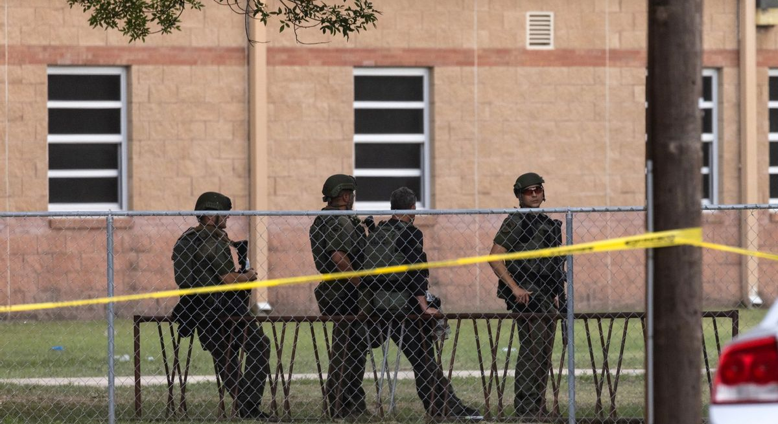
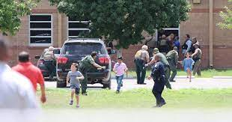
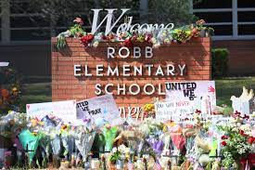
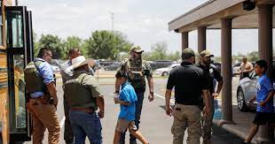
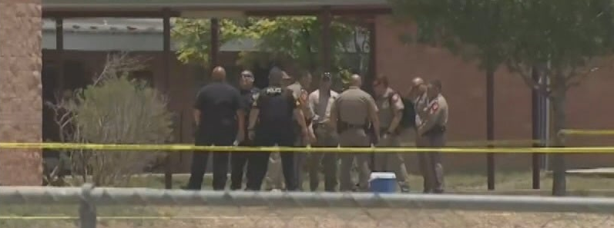
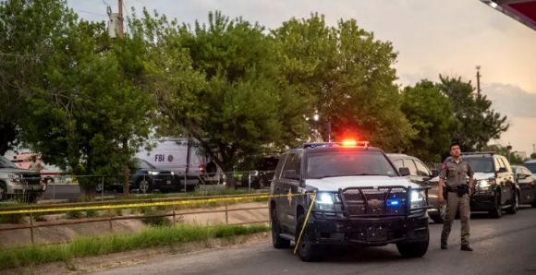
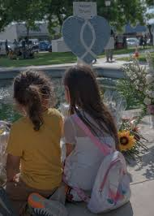
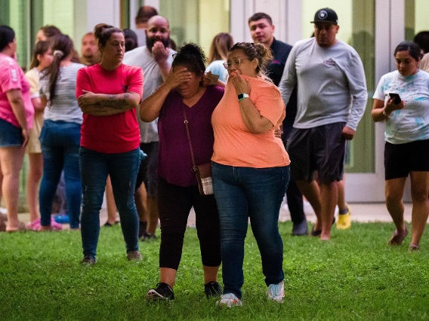

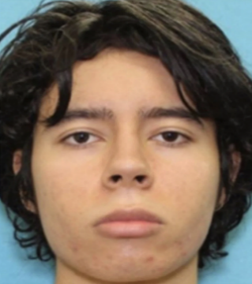
Uvalde, TX
School Shooting
May 24, 2022
21 Dead,
17 Injured
Notes:
David Gerstner

Slide 4
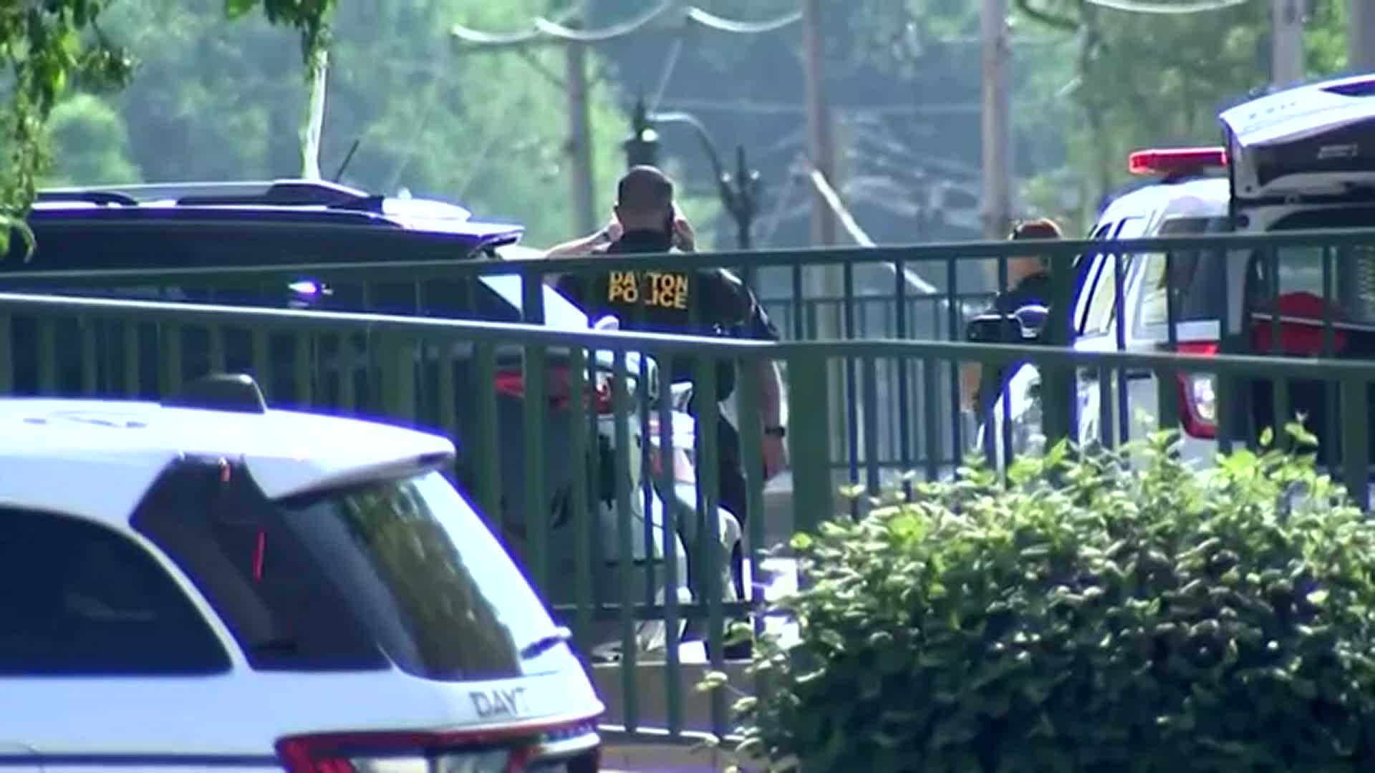
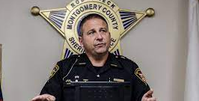
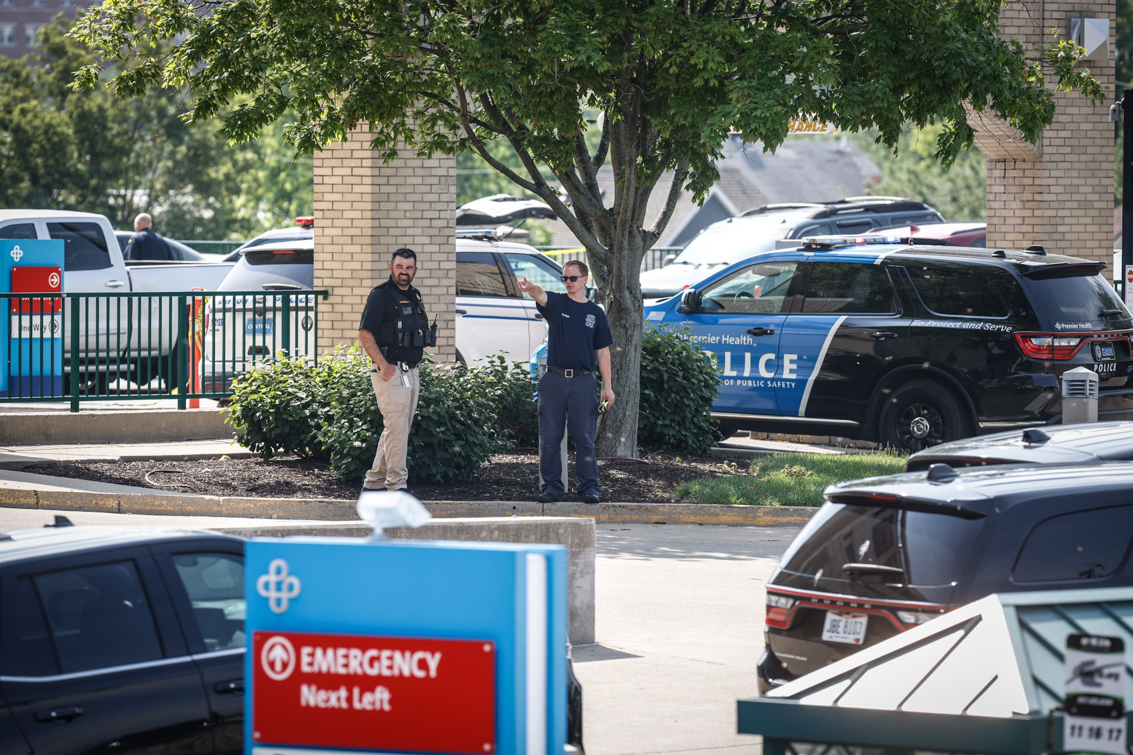
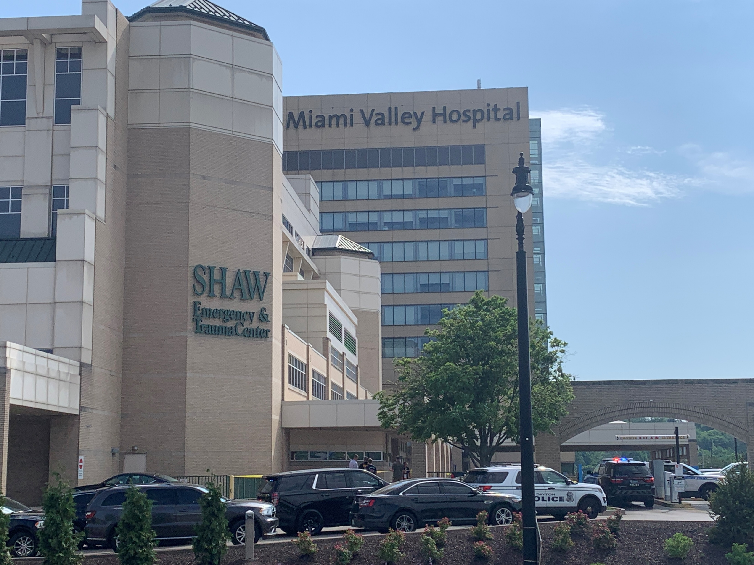
Miami Valley Hospital
Murder-Suicide
June 1, 2022
Notes:
David Gerstner

Slide 5
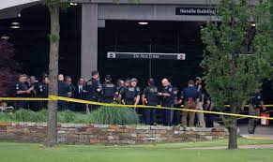
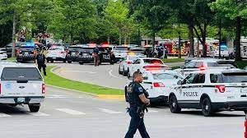
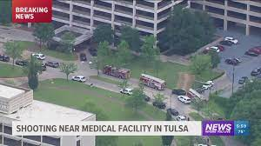

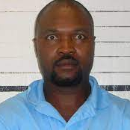
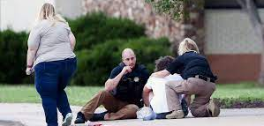
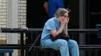
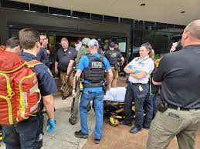
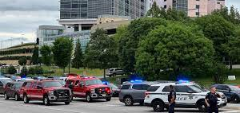
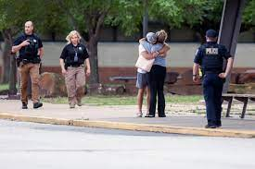
4 Dead
Tulsa, OK
Hospital ASI
June 1, 2022

Slide 6
We need to provide healthcare workers with reassurance about what is being done in our hospitals and reminders of actions to take in an Active Shooter Incident
- Nancy Pook, MD FACEP
Notes:
Nancy Pook

Slide 7
Law Enforcement throughout our region including hospital law enforcement are trained and committed to aggressively respond to active shooter incidents.

Slide 8
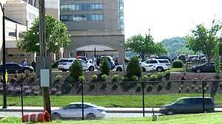
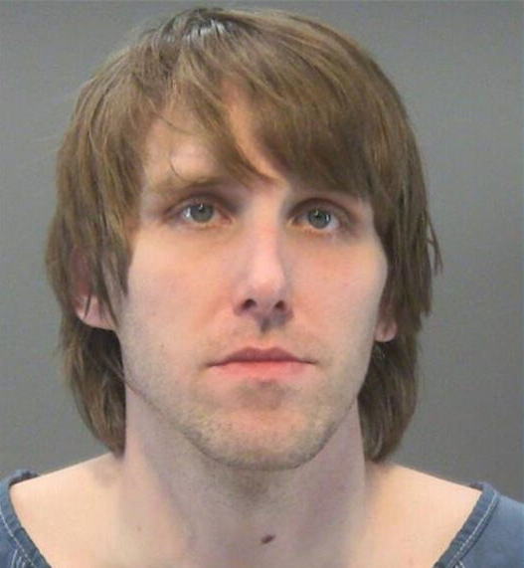
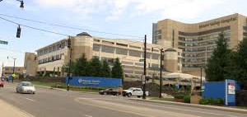
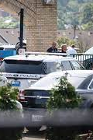
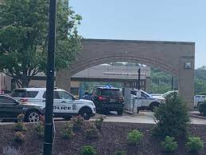
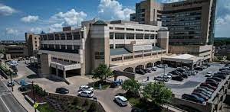
Premier Health Miami Valley Hospital
Murder-Suicide
(Not an Active Shooter Incident)
June 1, 2022
2 Dead
(including shooter)

Slide 9
Prepare and Prevent

Slide 10
HCW Concerns and Communication
Many healthcare workers are concerned about violence (including active shooters) in hospitals, public health facilities, urgent cares, doctor’s offices, and elsewhere
Facilities should plan messaging for personnel, such as:
  Preparedness
  Wellbeing check-ins
  Shift change information
  Logistical information
  If you See Something, Say Something!
Notes:
Jake, Springer, or Gerstner

Slide 11
Prepare and Prevent
Stay vigilant
Know your nearest exits
Review workplace evacuation plans, and have a backup route
Consider optimal safe room location and assets
  e.g., first-aid or trauma kits, locking doors, means to barricade
  Consider places like radiology rooms
Greet individuals with “hello” to detect suspicious behavior

Slide 12
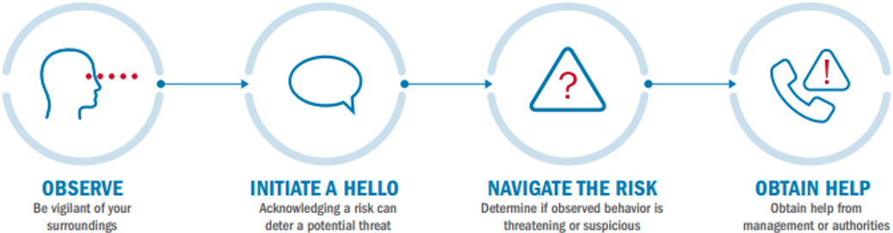
“The Power of Hello”
When used effectively, the right words can be a powerful tool
Simply saying “Hello” can prompt a casual conversation, providing an opportunity to both observe and establish a connection
www.cisa.gov

Slide 13
Prepare and Prevent
If you:
  See something suspicious…
  Say something!
    (tell someone!)
    Do not hesitate to contact security or local law enforcement - even if you’re not sure

Slide 14

Prepare and Prevent
Make sure your facility has a plan for active violence
  Involve everyone in the facility
Attend trainings facilitated by:
  Your hospital, agency, or facility
  GDAHA, MMRS, and others
Review resources such as this Run, Hide, Fight Video:

Slide 15
Response

Slide 16
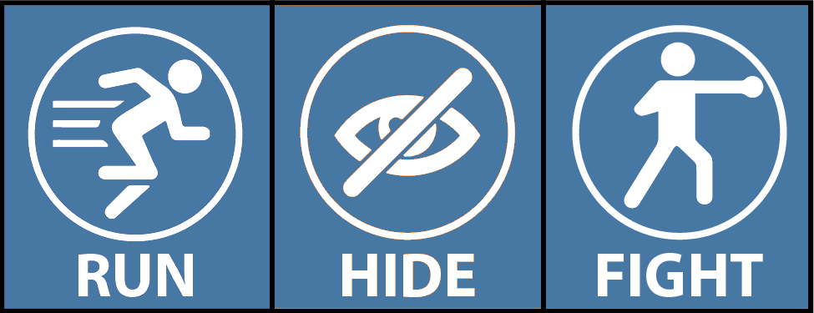
Response
In an Active Shooter Incident (ASI), there are three critical steps that you can take to keep yourself and others safe:
RUN
HIDE
FIGHT
Some training programs teach these concepts:
AVOID
DENY
DEFEND

Slide 17

Run
Evacuation is based on the specific circumstances:
  Location of the shooter
  Whether you can evacuate safely
Evacuate to an assembly area for an accounting of personnel, patients, and others
Consider all escape routes (e.g., windows on lower floors)

Slide 18
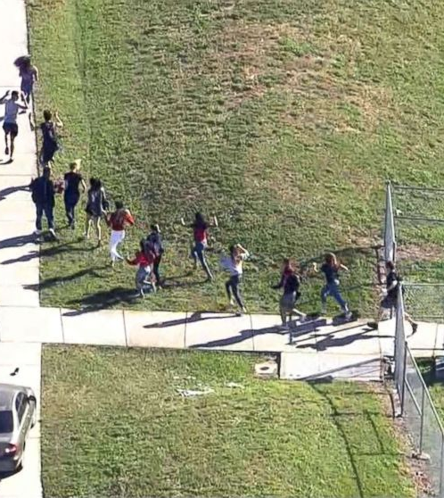
Run
Run how?
  Hands up, palms facing forward
  Unless stopped by officers, keep running
  Do not touch officers
  If asked questions, step aside & try to talk rather than yelling

Slide 19
Hide
If evacuation is not feasible, find a place to hide
Use anything available to secure the area and
prevent the shooter from entering
Stay out of sight
Turn off devices that emit sounds
Be aware: the shooter may bang on the door, yell for help, or entice you to open the door of a secured area
Do not respond to voice commands until you can verify their source

Slide 20
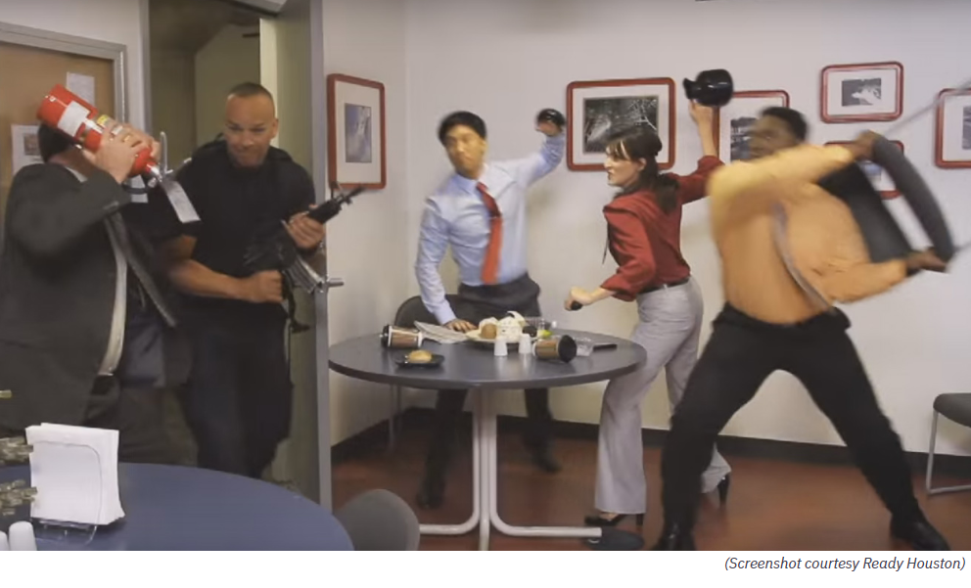
Fight
As a last resort, take aggressive action against a shooter when faced with imminent danger
If you must:
  Commit to the decision
  Try to disrupt and/or incapacitate the shooter
    Act as aggressively as possible
    Throw items and improvise weapons
  Act as a team if others will join
  Do whatever is necessary to neutralize the situation
Notes:
Sandy Booher Slide 21

Slide 21

Communications During Incidents
Notify Facility Security and call 911
Warn others!
When safe, report:
  Location & description of shooter
  Location & condition of patients
Consider “Code Silver” and/or “Code Yellow” for your facility

Slide 22
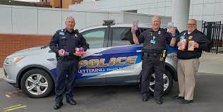
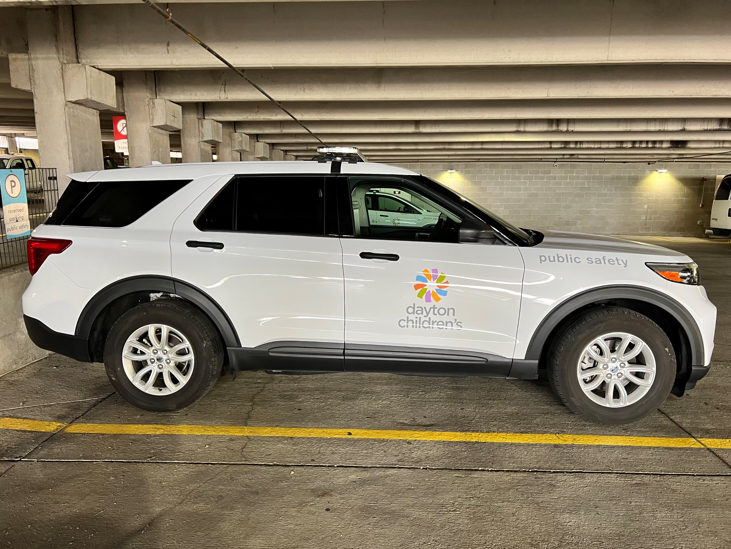

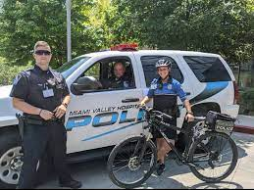
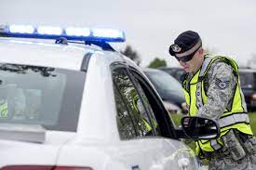
If your facility has armed security, call them first
        Have the number for your facility’s security in your cell and posted by all work phones
Notes:
Rohrer or Gaby

Slide 23
Duty to Care
As healthcare workers, you have a duty to your patients
In the event of an ASI at your facility:
  Provide guidance and care for patients and others
  Try to secure critical areas
  Try to block entry if patients can’t be moved
You have the power to protect

Slide 24
Other Steps During an ASI:
Remain calm
  Take a deep breath and allow yourself to understand the situation
Rely on your training
Help keep others safe
Sharing information helps save lives

Slide 25
External Communications
Communications are crucial
Use the Regional Hospital Notification System (RHNS) to advise hospitals throughout the region and others
Diversion/Reroute
  Use “Lockdown” in situations where the ED is completely shut down to EMS

Slide 26
Local and Regional Efforts

Slide 27
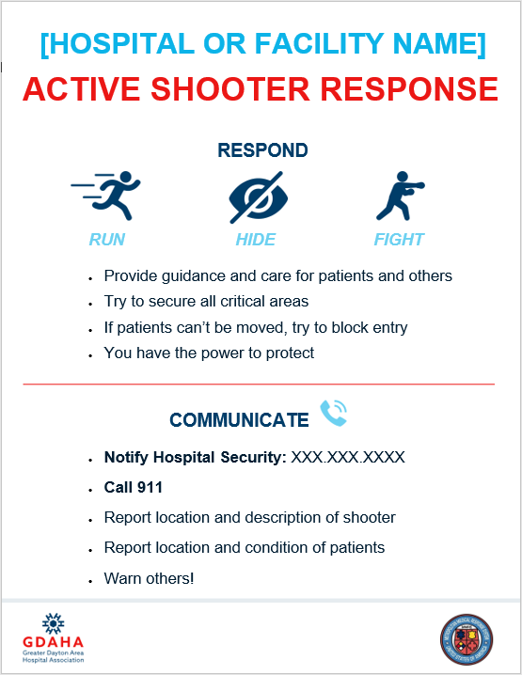
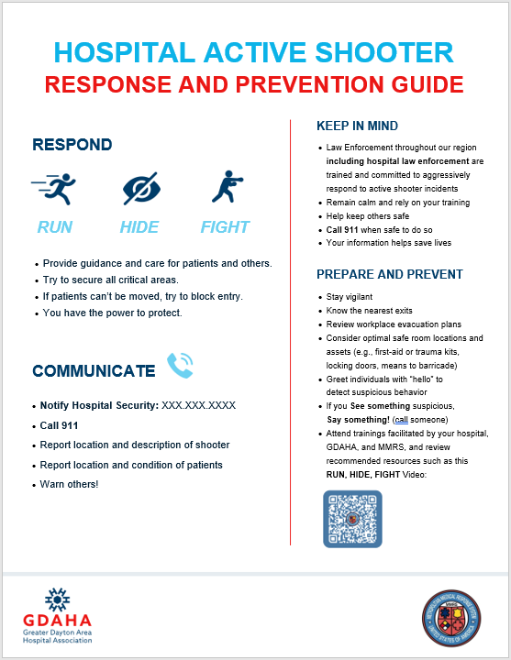
Healthcare ASI Publications
Tailor the flyers for your facility and post both
Add facility name at the top and co-brand with your logo
Use in clinics, physician’s offices, urgent cares, public health and other healthcare locations (delete the word “Hospital”)
Add the phone number for your facility’s security since they will be the fastest response
  If your facility does not have armed law enforcement, remove that line so that personnel immediately call 911
Add any special instructions for using 911 from work phones (e.g., dialing 9 first)

Slide 28
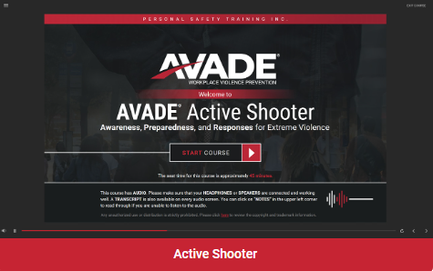
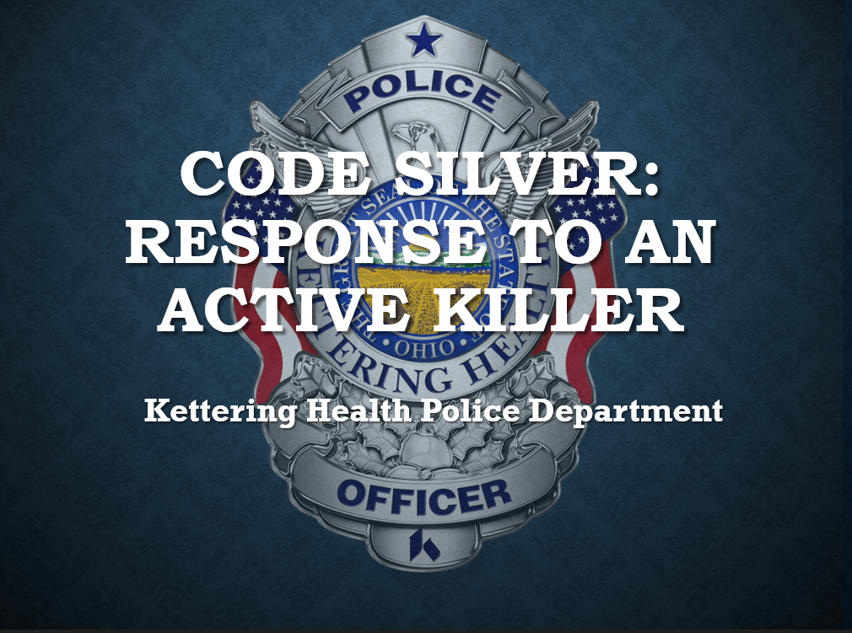
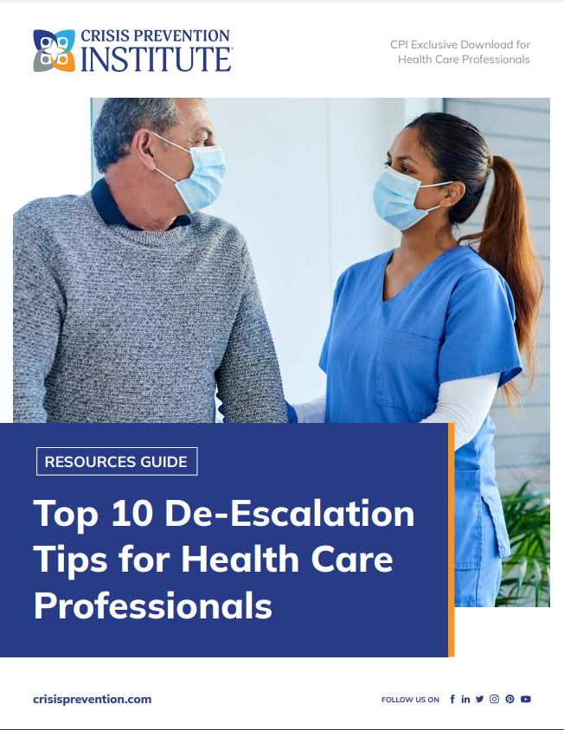
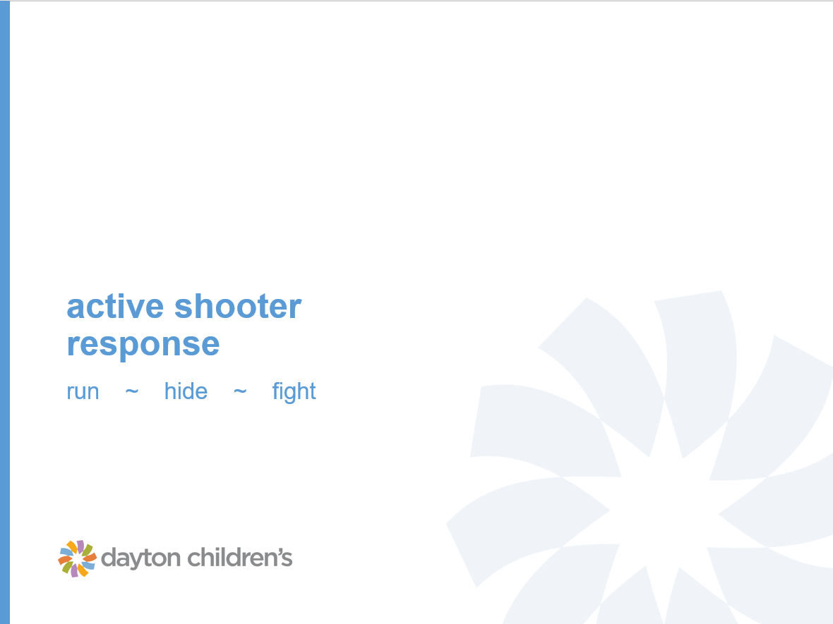
Hospitals Are Providing Trainings

Slide 29
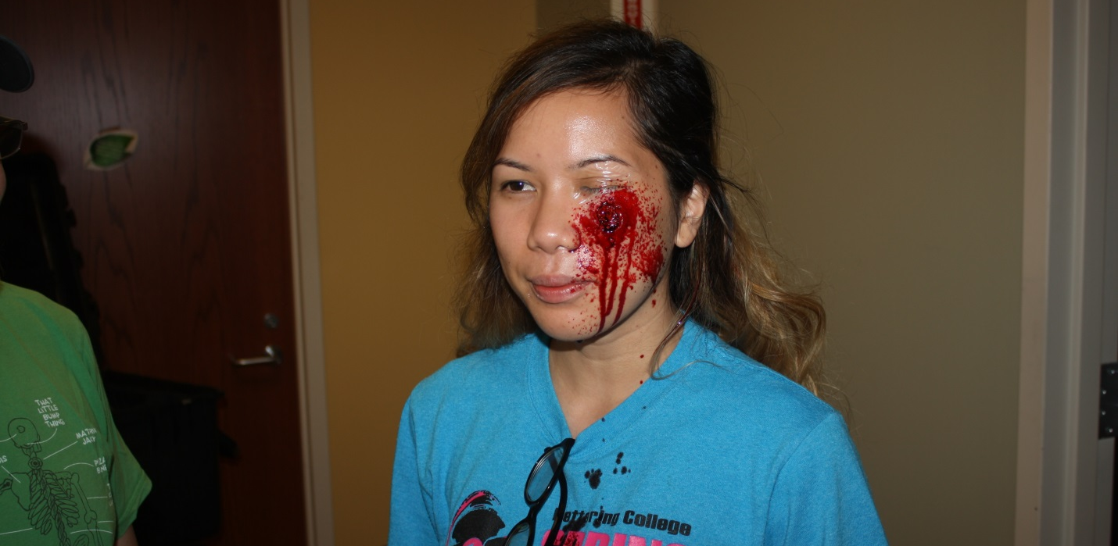
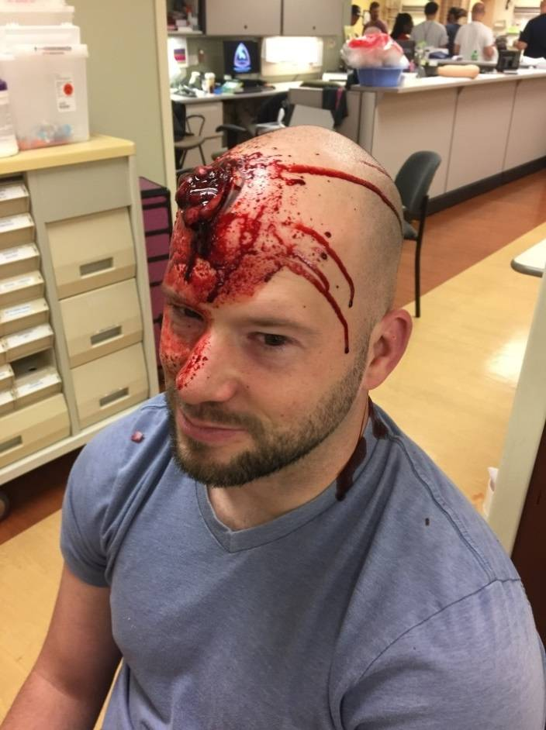
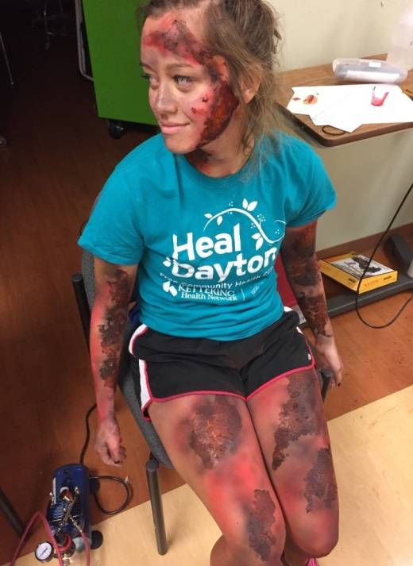
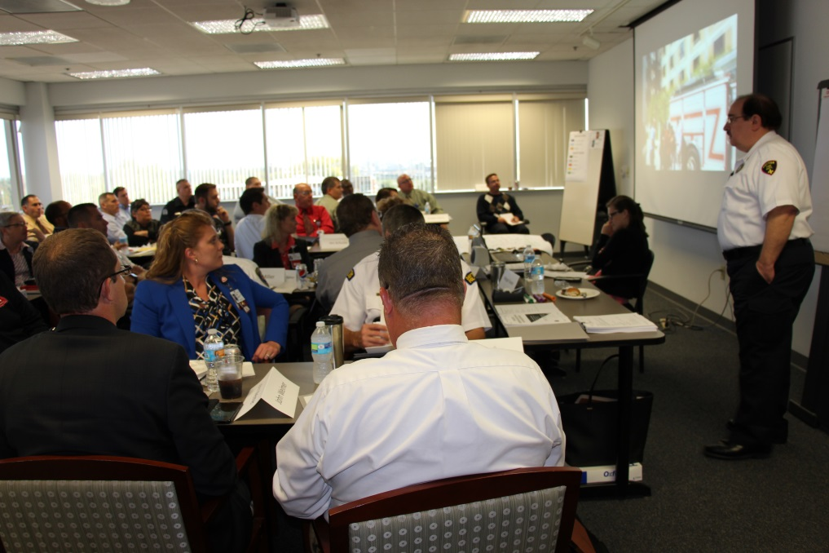
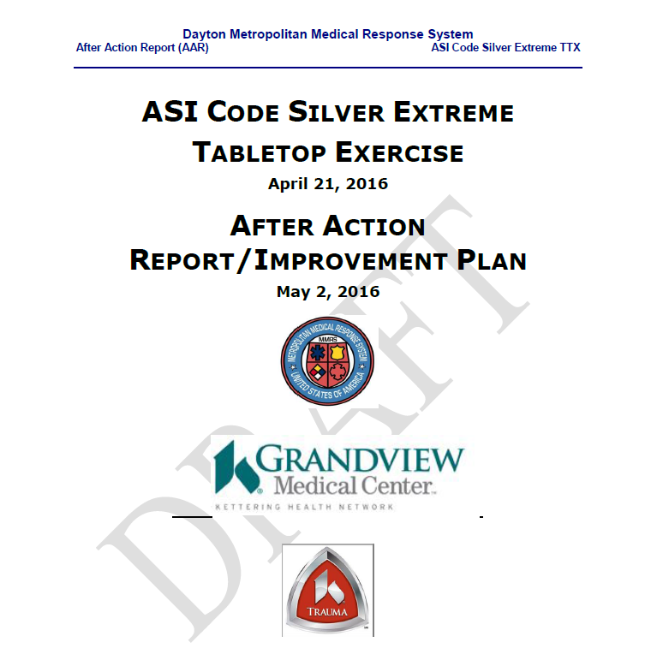
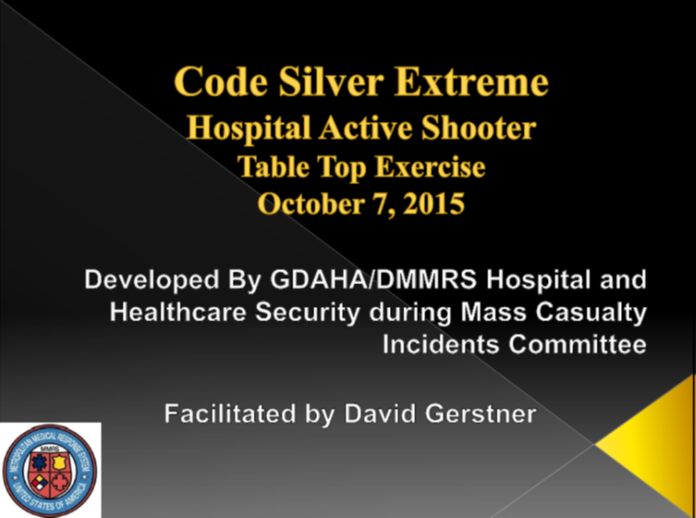
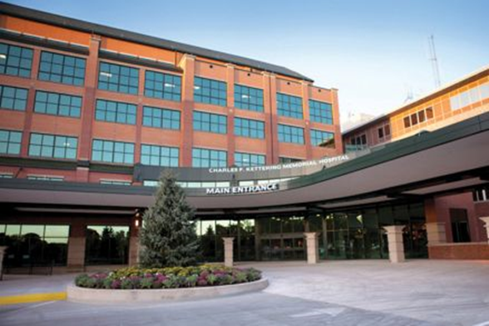
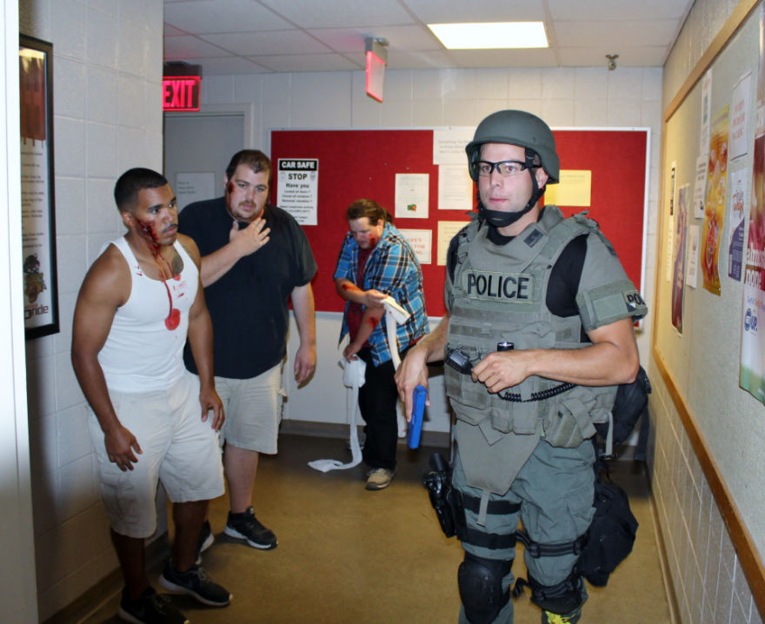

Other Regional Trainings

Slide 30
Collaborative Planning & Response
DMMRS
Public Health
Fire, EMS, Law Enforcement, EMA
Hospitals (GDAHA)
We are ALL in this together!

Slide 31


Thank you for helping keep our region safe!
SPM David Gerstner
Regional Coordinator
Dayton MMRS/RMRS
Mumbai Committee Chair
david.gerstner@daytonohio.gov
Mark Moore
Corporate Director
Protective & Support Services
Committee Training Workgroup Chair
moorem4@childrensdayton.org

