Slide 1
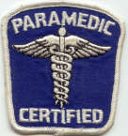
Regional MCI Communications and Exercise (Drill) Plan

Slide 2
Topics
Mass Casualty Incident (MCI) Communications and Drills (small exercises)
Planning process
SALT Triage and Materials
Regional Hospital Notification System (RHNS)
Regional MCI Radios and Talkgroups
GDAHA Surgenet MCI Page
OHTrac
Drill Plan

Slide 3
Objectives
Be familiar with Regional Mass Casualty Incident (MCI) Communications Plan and Job Aid
Be able to utilize SALT Triage and materials
Understand use of Regional Hospital Notification System
Be able to locate and use the HSR3 MCI MARCS Radio Talk Group in your radio template
Be familiar with the GDAHA Surgenet MCI Page
Understand relationship of RHNS, Surgenet MCI Page, OHTrac, and MCI-MARCS Radio TG in Mass Casualty Incident communications
Be familiar with MCI Communications Quarterly Triage Drill Day Plan

Slide 4
collaborative PLANNING
DMMRS
Public Health
Fire, EMS, Law Enforcement, EMA
Hospitals (GDAHA)

Slide 5
MCI Communications Planning
Recognized need to bring together the pieces of communications during MCIs
Developed RHNS
Developed plans for use of GDAHA Surgenet MCI page
Added MCI Talkgroups to EMS radios (for much of the region)
Hospitals agreed to purchase MCI radios for each ED
Developed Job Aids

Slide 7
MCI Communications Quarterly Triage Day Drills
Agreed on by GDAHA Domestic Preparedness Coalition, GMVEMSC, MVFEA, GMCFCA, et al
24 hours each quarter
Day of week will be different each quarter so all ED & EMS personnel have opportunities to participate
Day selected each quarter by GDAHA Communications Committee
Communicated to all hospitals and EMS agencies
More info later

Slide 8
SALT Triage

Slide 9
SALT Triage Categories: ID-MED
Immediate
Delayed
Minimal
Expectant
Dead
(Ribbon/Tag zebra-striped)
Notes:
The answers to these questions will allow you to place the patient in one of the 5 categories shown here. Each category is given a color code so that they can be recognized quickly.

Slide 10
Notes:
This schematic shows the full triage process. We will break down each step of this process. The key is to remember that you first Sort the patients globally by giving them voice commands. Then you will individually asses the patients providing quick and simple life saving interventions and then assigning the patient a priority for treatment and/or transport.

Slide 11
Dayton MMRS Contributions to SALT – Two Mnemonics
CRAP:
C – Follows Commands
R – No Respiratory Distress
A – No (uncontrolled) Arterial bleeding
P – Peripheral Pulse Present
“Good or Bad”
“Bad” answer to any one or more: Pt. is either Red or Gray

Slide 14
Regional Hospital Notification System (RHNS)

Slide 15
REGIONAL HOSPITAL NOTIFICATION SYSTEM (RHNS)
One number for EMS, hospitals, and EMAs to call
Makes rapid, simultaneous notifications during MCI or other major emergency
Use whenever an incident could involve a significant number of region’s hospitals
Also used to indicate no need for action
Montgomery County Regional Dispatch Center (RDC) puts out computerized message

Slide 16
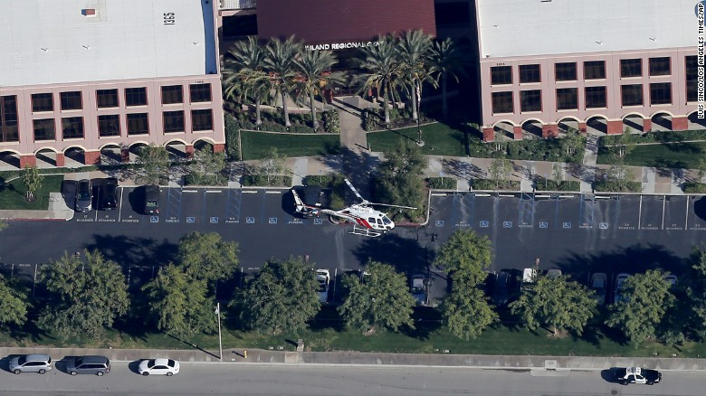
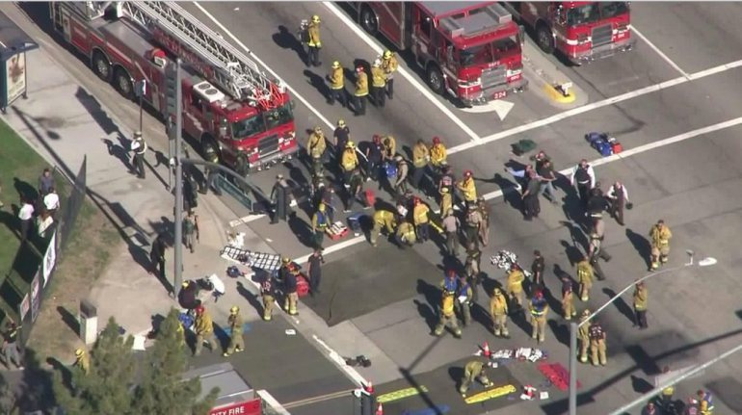
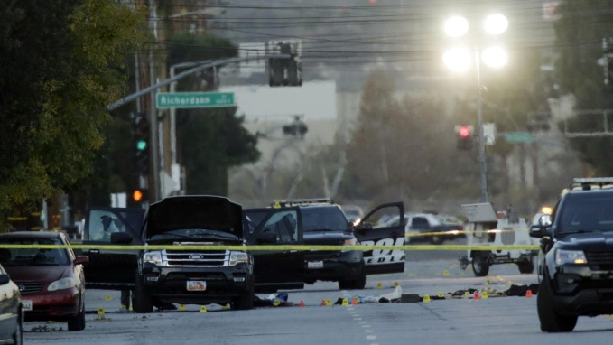
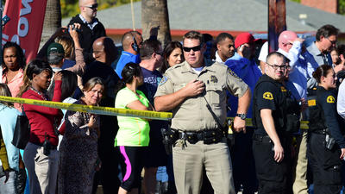
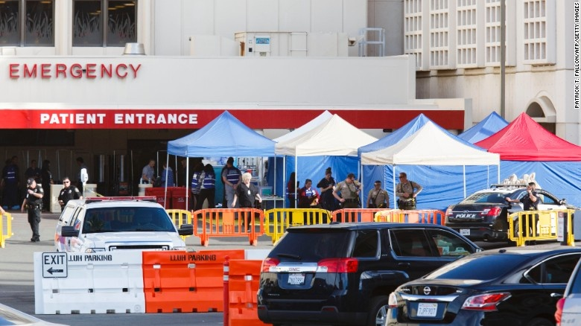
San Bernardino

Slide 17
REGIONAL HOSPITAL NOTIFICATION SYSTEM (RHNS)
Use RHNS for any incident likely to involve or concern six or more hospitals (+ or -)
Examples include “gear up”
“Three dozen seriously injured victims being extricated…”
Any request for a CHEMPACK in our region
Advise hospitals that patients will need decon
EMAs could use for incidents (e.g., tornadoes) involving multiple jurisdictions

Slide 18
REGIONAL HOSPITAL NOTIFICATION SYSTEM (RHNS)
…or to tell hospitals disaster preparations are NOT needed
Middletown school shooting, cyanide spill in Dayton, a local hospital shooting, et al
Dispatch Center Job Aid provided

Slide 19
REGIONAL HOSPITAL NOTIFICATION SYSTEM (RHNS)
Primary purpose of RHNS is:
Let hospitals know what is going on
And what preparations are needed or not needed
Hospitals - do NOT call Dispatch Center to request additional information
Use MCI radio (more to come)
Do contact Dispatch to put out an update or to send message to close the incident notification

Slide 20
REGIONAL HOSPITAL NOTIFICATION SYSTEM (RHNS)
Numbers for each hospital chosen by that hospital
Recommended that emergency messages on cell phones should get both text and voice (if one system down, other may go through)
Receiving RHNS Messages
Alerts hospitals plus regional coordinators, some EMAs, etc.
RHNS is tested monthly and during most area exercises

Slide 21
REGIONAL HOSPITAL NOTIFICATION SYSTEM (RHNS)
To activate RHNS (use the MCI Comm Job Aid):
Call 937-333-USAR (8727)
Ask for Dispatch Supervisor
Request a “Regional Hospital Notification”
Provide information below:
Name of agency
Nature of emergency
Location of emergency
General statement on severity, such as approximate number of victims
Any other information to be conveyed

Slide 22
MCI MARCS Radios & TG
Ohio MARCS
Multi-
Agency
Radio
Communication
System
Talk group (TG) – channel

Slide 23
“HSR3 MCI” MARCS Radio Talkgroup
MCI MARCS - new, additional hospital ED radio be used solely in an MCI
Used to notify each hospital of patients they will receive
Used to provide ALL hospitals with a “common operating picture” simultaneously
Hospitals can ask questions about incident over HSR3 Radio Talk Group

Slide 24
HSR3 MCI-MARCS Radio Talkgroup
No alerts on MCI TGs!
During an event, hospitals turn on MCI talk group (TG)
Monitor MCI radio
Request to monitor HSR3MCI Radio is included in Communications Job Aid, but hospitals should plan to do so on any MCI notification

Slide 25
HSR3 MCI-MARCS Radio Talkgroup
>90% of EMS communication during MCI should come from Transport Officer or Transport Comm Aide
Hospital radios may have two primary TGs
HSR3 MCI MARCS Talkgroup
HSR6 MCI MARCS Talkgroup
Can be patched together by Dispatch Centers

Slide 26
GDAHA Surgenet MCI Page and OHTrac

Slide 28
gdaha.surgenet.org

Slide 29
GDAHA Surgenet MCI Page
Increasingly emphasized to EMS importance of distributing patients to hospitals during MCIs
GDAHA Surgenet MCI Page allows hospitals to indicate how many patients received, by category
During MCI, MCI Web Page allows hospitals to indicate by category how many more can be handled
Update the GDAHA Surgenet MCI page

Slide 30
Surgenet: OHTrac
State of Ohio tool for patient tracking used during any MCI or disaster situation for family reunification
MCI incident alerts can be sent
Not primary method of communication
Regional Drills/Exercises and Real World Incidents
Hospitals responsible for ensuring patients received from incident entered and tracking information updated
Including “walk-in” patients

Slide 31
Surgenet: OHTrac
Can allow dispatch centers to assist a Transport Officer in hospital destination decisions
EMS & dispatch centers can (at their option) log on and view numbers of each triage level at each hospital
Integrating all communication methods helps EMS ensure triaged patients are transported to appropriate hospitals

Slide 32
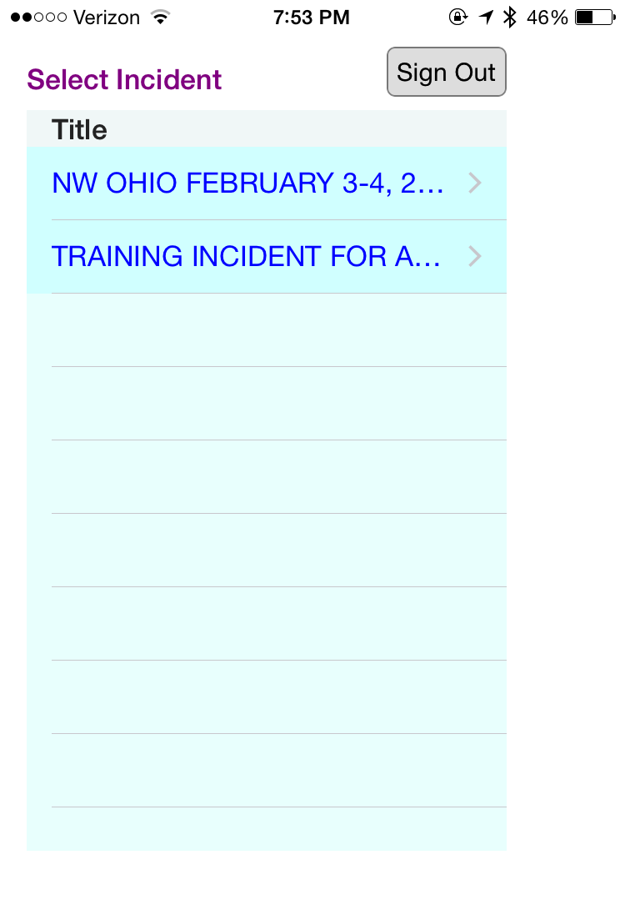
OHTrac App
App designed for EMS
For agencies using it, allows patient tracking to begin at the scene
OHTrac
Allows increased patient tracking accuracy
Provides for family reunification
Allows hospitals and other agencies to see the number and acuity of patients en-route
Notes:
A dispatch center could log on to OHTrac and access the MCI incident to view how many of each triage level patients have been transported to each hospital. Existing local communication methods and protocols could be integrated with OHTrac so that the triaged patients are transported to appropriate hospitals.
Pre-hospital EMS will improve their patient tracking accuracy by using OHTrac. Early use of OHTrac will also improve the accuracy of patient tracking as for the incident as the incident progresses.

Slide 33
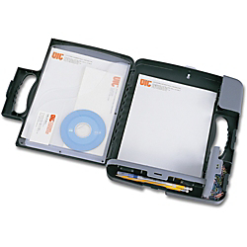
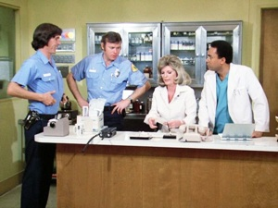
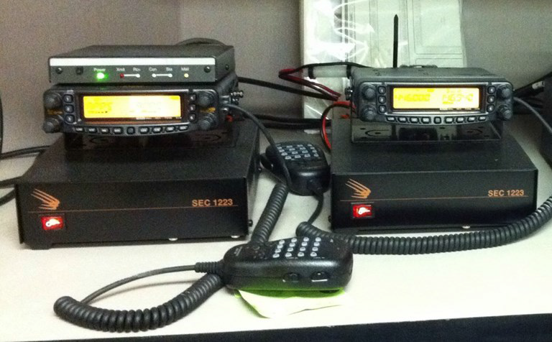

Slide 34
MCI Scenario

Slide 35
Scenario
County Fair
Stage collapse
Summer
One EMS unit on site at fair as standby
Initial estimate of 50 injured, some severe

Slide 36
Hospitals Receive RHNS Notification:
“There has been an MCI reported as a result of a stage collapse at the County Fair, with initial estimates of 50 injured. All hospitals should update their GDAHA Surgenet MCI page. All hospitals monitor HSR3 MCI MARCS talkgroup.”

Slide 37
Hospital Actions
Receives RHNS
Monitors HSR3MCI Radio
Updates MCI page
Indicate number of Red, Yellow, and Green patients you are able to receive
Prepare to receive casualties
Make internal notifications
Prepare for use of OHTrac

Slide 38
Scenario (continued)
County Fair Stage Collapse
1 EMS unit on scene, full response requested
Multiple Victims (Roughly 50)
Initial Triage: 26 Red, 14 Yellow, 10 Green, 2 Black

Slide 39
Scenario
When does it end?
IC or delegate should use RHNS again to indicate that all or most patients have cleared the scene
Hospital receives 2nd RHNS notification:
Incident is nearly over; patients have all been transported

Slide 40
MCI Communications GDAHA Quarterly Triage Day Drills (QTD Drills)

Slide 41
Quarterly Triage Day Drills
Every patient in every ED gets a Triage Ribbon and Triage Tag
If not applied by EMS, ED will apply
Each EMS & ED receiving supply of GREEN Triage “Drill” Tags

Slide 42
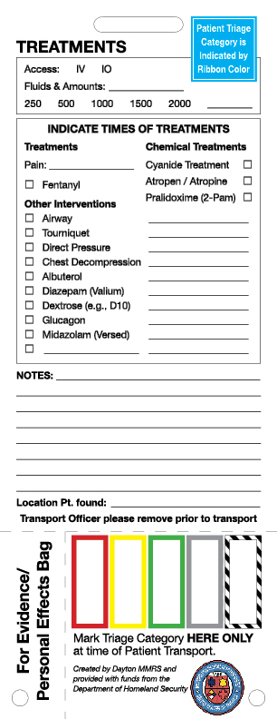
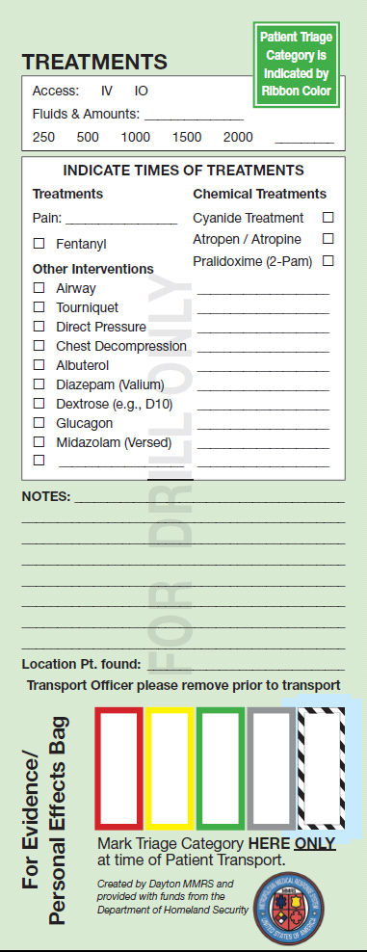
QTD Drills or Exercises: Use Green Tags but Real Ribbons!

Slide 43
Quarterly Triage Day Drills
Tags do not have ties – use Triage Ribbon to attach the Tag
Each Tag will have a bar-code and a matching number. Patient’s Tag can be scanned into OHTRac

Slide 44
Quarterly Triage Day Drills
All patients arriving via EMS should have a Triage Ribbon and a GREEN Triage Drill Tag
ED personnel place a Triage Ribbon and Drill Tag on any patient (regardless of mode of arrival) without one

Slide 45
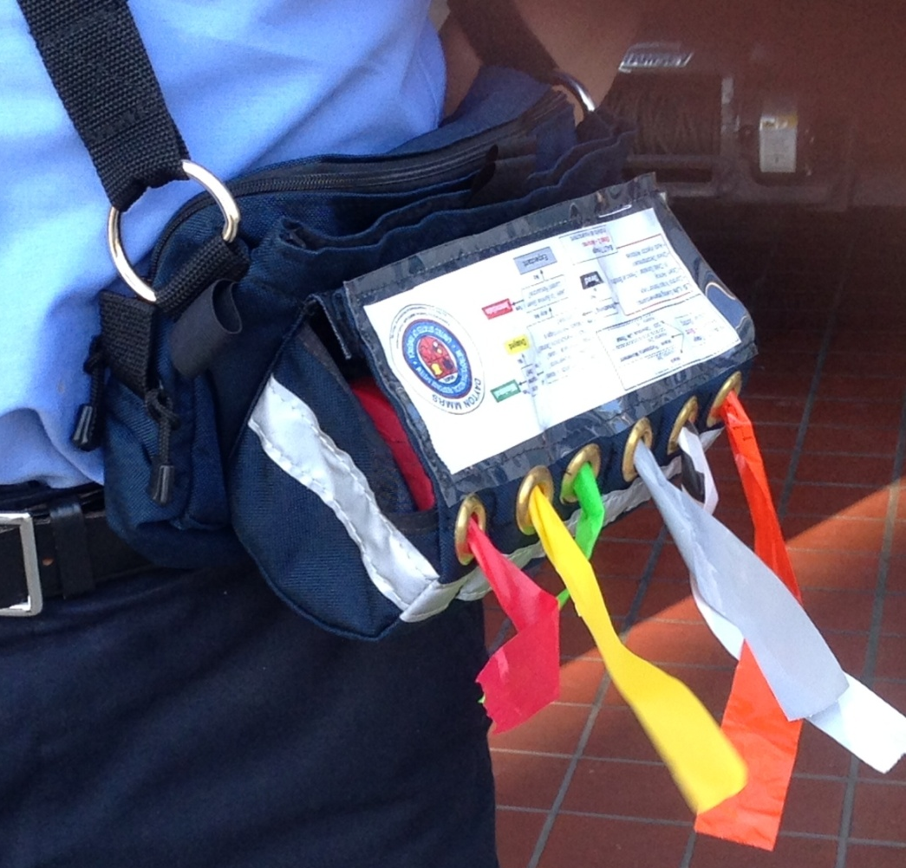
Quarterly Triage Day Drills
EMS places and fills out one GREEN Triage Drill Tag on every patient during QTD Drills
Assign patient to appropriate triage color/category
Use actual patient information on triage tags
Fill out run report as usual

Slide 46
Quarterly Triage Day Drills
Each EMS has a Blue Triage Ribbon Kit for use in actual MCIs
Use actual Triage Ribbons during QTDs
Each EMS is receiving a supply of GREEN Triage “Drill” Tags through County EMAs
White Tags for real incidents; Green for Drills

Slide 48
MCI Radio Talk Groups
Drills will incorporate use of the MCI TGs
EMS agencies will make brief reports to the hospital over the HSR3MCI TG
Only items to be covered are number of patients and triage color
Possibly one or two word description of medical issue, e.g., chest injury
e.g., “Wayne Hospital, this is Greenville Medic 591 en route with one Yellow”
Any more extensive information or requests, the Medic Crew will call by cell phone or on the hospital’s regular radio channel
No call will be made on MCI TG if crew workload does not permit

Slide 49
Handout Materials
Attached to this training are copies of:
SALT Hospital Handout
MCI Communications Job Aid
Real and…
Current exercise version

Slide 52
Continuing Education
Complete the accompanying quiz
EMS Con Ed for this program (for EMS and nurses) provided courtesy of GMVEMSC

