Slide 1
Triage & Tools for QTD
EMERGENCY DEPARTMENT

Slide 2
Quarterly Triage Days
Agreed on by GDAHA, GMVEMSC, RPAB, et al
24 hours each quarter
Day of week different each quarter
Communicated to all hospitals and EMS agencies
Includes Ribbons, “Treatment” Tags, MCI Radio Talk Groups, and more

Slide 3
Quarterly Triage Days
QTDs are opportunities
  There’s no way to know when – or where - the next MCI will happen
  That is NOT the time to figure out how to use SALT, Ribbons, Tags, and Radios
OPPORTUNITY FOR US ALL – EDs and EMS - TO WORK TOGETHER!

Slide 4
SALT for QTD
Expect a Ribbon & Tag on EVERY EMS patient brought in during QTDs
Expect a radio call on the MCI Talk Group on EVERY EMS patient during QTDs
For EVERY ED patient not already tagged:
  Assign a realistic SALT Category

Slide 5
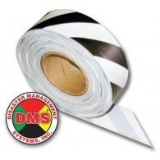
Triage Categories/Ribbons:
ID-MED
Immediate
  Can’t follow commands, in respiratory distress, uncontrolled arterial bleeding, wrist pulse not palpable
Delayed – Serious illness or injury
Minimal – Minor illness or injury
Expectant – not applicable for QTD
Dead – hopefully not applicable for QTD
    (Ribbon/Tag zebra-striped)
Notes:
The answers to these questions will allow you to place the patient in one of the 5 categories shown here. Each category is given a color code so that they can be recognized quickly.

Slide 6
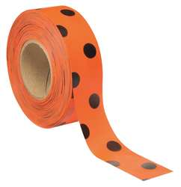
Triage ribbons
ORANGE Ribbons for contaminated victims
  Black Dots to distinguish from red ribbons in poor light
Notes:
The answers to these questions will allow you to place the patient in one of the 5 categories shown here. Each category is given a color code so that they can be recognized quickly.

Slide 7

SALT C-R-A-P Assessments
7-8 seconds:
C – Commands /Purposeful movements?
R – Respiratory Distress?
A – Uncontrolled (Arterial) bleeding?
P – Peripheral Pulse Present?
Clinically “bad” to one or more assessment questions: patient is Red or Gray

Slide 8
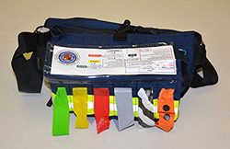
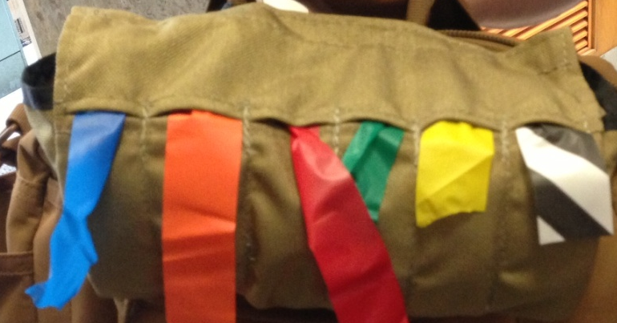
Attach a Ribbon
Use Triage Ribbon per the category you assigned
  Right wrist for both Ribbon and Tag

Slide 9
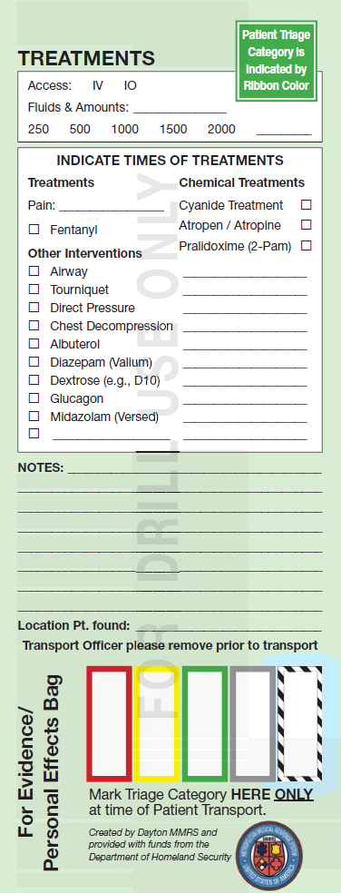

Ribbons & tags
Use Ribbons to attach the Tags
If Triage Category changes:
  Change the ribbon!
But keep the same Tag

Slide 10
TAGGING PatientS
Expect EMS to provide GREEN (Drill) Tags for QTDs
  Review the tag:
    Patient info
    Assessments
    Treatments
    EMS should keep the bottom section of tags for their records

Slide 11
TAGGING PatientS
ED personnel including all nurses should ribbon every patient and complete at least ONE tag per shift (on walk-ins or other patients)
  Fill it out to document:
    Patient info
    Assessments
    Treatments
Collect all Tags for EMS Coordinators to review

Slide 12
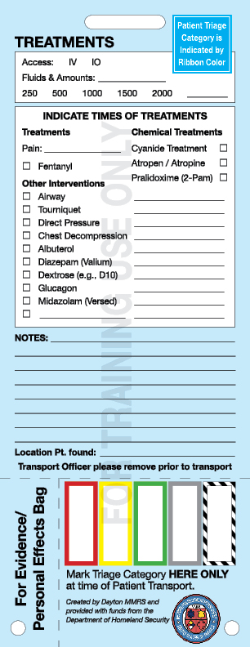
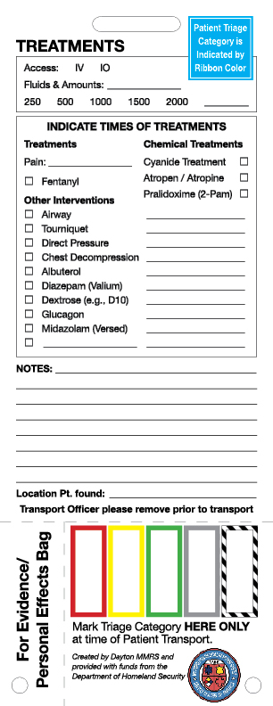
QTD Tags
Do NOT use White or Blue Tags for QTDs

Slide 13
expectations
Expect a Ribbon & Tag on EVERY EMS patient during QTDs
  (and during a real-world MCI!)
ED personnel are to place a ribbon on all patients not brought by EMS
ED personnel are to complete at least one tag per shift on a patient not brought by EMS
Expect a radio call on the MCI Talk Group on EVERY EMS patient during QTDs
Collect all Tags for EMS Coordinators to review
  See the next MCI QTD Crash Course!

