Slide 1


2016 Protocol Changes
GMVEMSC

Slide 2

What follows are the 2016 GMVEMSC Protocol updates.
This PowerPoint will cover topics related to all levels of Ohio EMS Providers including EMR, EMT, AEMT, and PM.
Some of the material may be beyond your scope of practice and is presented herein so that you may understand what has changed within the GMVEMSC region, and what you should expect to see when interfacing with other providers both above and below your level of certification.
If there is something you don't understand, ask for clarification.
Optional skills are NOT included within this presentation, and are the responsibility of the Agency and its Medical Director to educate, train, skills verify, and test. Refer to the GMVEMSC Optional Skills Training Manual as needed.

Slide 3
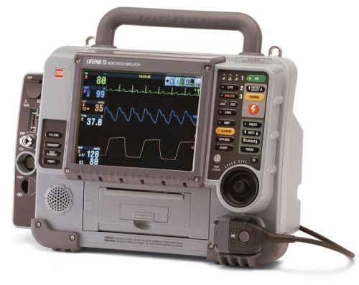
Transferring Patients Into The ED
For all patients, especially those who are intubated, provide a summary report. For any department whose monitors have summary capabilities, that summary report must be presented with the patient.
  Help to ensure adequate ventilation & oxygenation.
  Help to identify tube displacement during patient transfer.
  Print a summary report to include ETCO2 readings.
  Attach summary report to EMS run sheet.

Slide 4
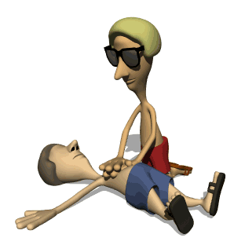
Resuscitation On Scene
Providers are expected to provide resuscitative care at the scene. The patient has the greatest chance for survival if resuscitation is performed at the scene, especially the efforts of CPR. In most cases, cardiac arrest patients should not be transported if the patient has failed to respond to Advanced Life Support.
Patients in asystole with confirmed correct tube placement & a capnography reading < 10 mm/Hg, which does not improve during resuscitative efforts [with good chest compressions], have essentially no probability of survival and field termination should be strongly considered.

Slide 5
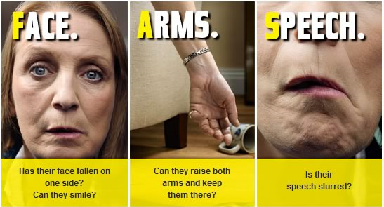
Changes with Stroke care
Deleted “Suspected Stroke Checklist”. Hospitals are not asking for this form.
Changed Interventional Facility to Comprehensive Stroke Center matching AHA definitions.
Several definitions were listed for stroke center destinations. The verbiage for calling a stroke alert and destinations were modified. This part of protocol was unclear in previous publishings.
  If patient’s symptoms occurred less than 4 hours ago transport to Telemedicine Stroke Facility, Primary Stroke Facility or Comprehensive Stroke Facility.
  If patient’s symptoms occurred more than 4 hours ago transport to Comprehensive Stroke Facility.

Slide 6
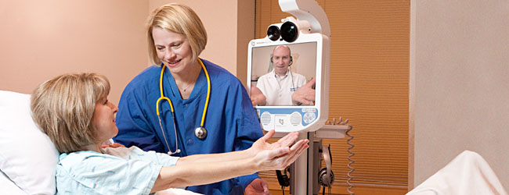
Hospital stroke capabilities
Comprehensive Stroke Center
Has TPA, 24/7 endovascular capabilities
Transport patients with last known normal 0-8 hours.
Facilities Included:
Kettering & Miami Valley Hospital
Telemedicine Stroke Center
Has TPA capabilities, & immediate access to a Neurologist via telemedicine.
Transport patients with last known normal 0-4 hours
Facilities Included:
Atrium, Fort Hamilton, Franklin, Good Sam, Good Sam North, Grandview, Greene, Huber, Jamestown, Kettering, Mason, Miami Valley, Miami Valley South, Preble, Reid, Springfield, Soin, Southview, Sycamore, Upper Valley, Urbana, Wayne, West Chester, Wilson
Primary Stroke Center
Has TPA capabilities, & also has an ICU that can see neuro patients. They can either admit the patient or transfer them to the Comprehensive Stroke Center.
Transport patients with last known normal 0-4 hours
Facilities Included:
Atrium, Fort Hamilton, Good Sam, Grandview, Soin, Southview, Sycamore
Notes:
Telemedicine Stroke Centers are known as a “drip & ship” because they start the patient on the TPA (“drip”) and then transfer (“ship”) them to a Primary or Comprehensive stroke center.
Telemedicine Stroke Center speak to the same neurologist that work at the Comprehensive Stroke Center.
Importance is having the patient receive a CT Scan quickly & to determine if they are a TPA candidate. The faster the TPA can be given will hopefully decrease the amount of disability from the stroke.

Slide 7

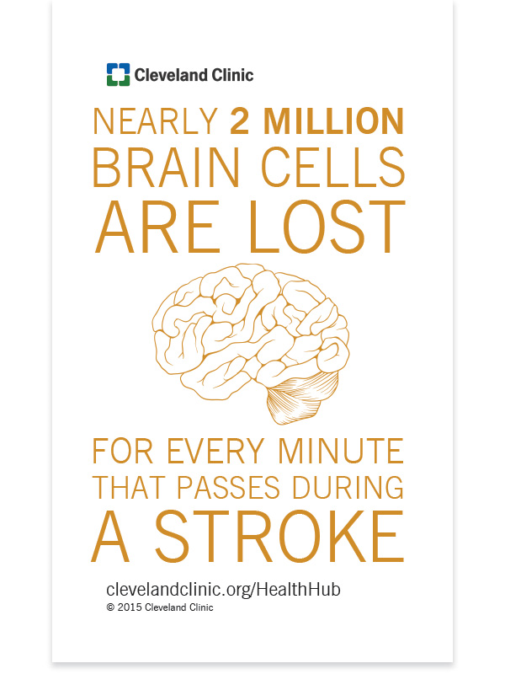
Stroke care
Remember the standard for stroke care as recommended by the AHA:
  If a patient presents with last known normal less than 4 hours, they need to get to the closest hospital where the patient can receive a head CT scan & TPA.
  If the last known normal is in between 0-4 hours it does not matter if the patient is transport to a Telestroke Facility, Primary Stroke Center or Comprehensive Stroke Center, because the initial treatment will be the same at all facilities.
  Rural departments may consider a helicopter for transport to help meet the time frame of 0-4 hours.

Slide 8
Hospital Capabilities Chart Updated
HOSPITAL CAPABILITIES CHART
RED = NO GREEN = YES | TRAUMA CENTER LEVEL A or P | BURN CENTER | CARDIAC Interventional Cath 24/7 | STROKE 0-4 Hours Telemedicine tPA Ready | STROKE 0-4 Hours Primary Center | STROKE 24/7 0-8 Hours Comprehensive Endovascular Interventional | L & D
HOSPITALS
Atrium | A 3
Children's | P 2
Fort Hamilton
Franklin Emer Ctr
Good Sam
GSH North
Grandview | A 3
Greene | A 3
Huber Emer Ctr
Jamestown
Kettering | A 2
Mason
McCullough-Hyde
Mercy - Urbana
Miami Valley | A 1
Miami Valley South
Preble Emer Ctr
Reid
Soin Medical | A 3
Southview
Springfield RMC
Sycamore
Upper Valley
VAMC
Wayne Healthcare
West Chester | A 3
Wilson Health
WPAFB
Notes: Comprehensive stroke centers have the capability of endovascular intervention 24/7. Primary stroke centers have CT and tPA capabilities and focus on evaluating patients for intravenous tPA. Telemedicine with tPA ready offers immediate access to a Neurologist.
Notes:
Adult & Pedi Trauma Column Combined, Separated Cardiac Cath Lab & Stroke into 2 separate columns, Stroke Telemedicine 0-4 hrs added, Primary Stroke 0-4 hrs added, Comprehensive Stroke added. West Chester added to Cardiac Cath.
Hospital phone numbers changed.
P. 142 Hospital capabilities chart was extensively modified.

Slide 9
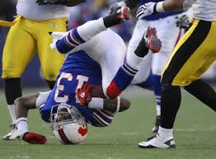
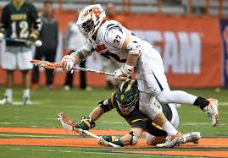

Spinal Motion Restriction
Spinal Immobilization Protocol has been changed to Spinal Motion Restriction
  Athletic equipment should be removed from the injured athlete prior to transport to any facility.
  This change is due to the most recent research.
  There is an additional PowerPoint located at the GMVEMSC website regarding this topic.
Notes:
There is also a power point covering athletic equipment removal

Slide 10
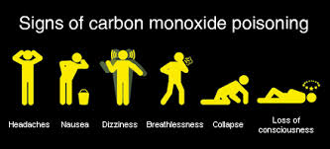
Carbon Monoxide poisoning
Consider Hyperbaric Oxygen treatment for the following patients with suspected CO exposure:
  Underlying cardiovascular disease or symptoms such as chest pain or shortness of breath
  > 60 years of age
  Obvious neurological symptoms (e.g., any interval of unconsciousness, loss of time, inability to perform simple motor tasks, or loss of memory)
  Smoke inhalation victims
  Pregnancy
  Not all patients will receive hyperbaric oxygen treatment
Contact MCP to discuss transport considerations.
  New statement was added: KMC has a 24/7 hyperbaric chamber. The patient must still be transported to an emergency facility and then treatment and destination decisions will be determined.
Notes:
Not all patients will

Slide 11
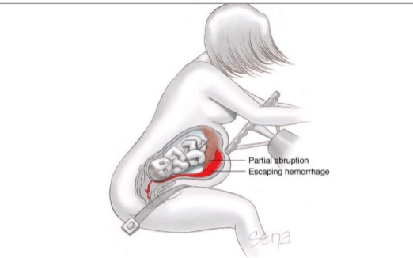
Trauma
Pregnant trauma patients must be transported to a facility that has labor and delivery capabilities. Not every trauma facility has OB services. This was a clarifying statement that was added.
“Repeat vitals on trauma patients every 5 minutes”, was added to protocol book.
Added Crush Syndrome as indication for Calcium Chloride.

Slide 12
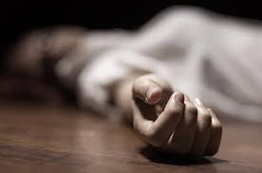
Unconscious Unknown
“Unconscious Unknown” has been removed from the protocol. These treatments are covered under other sections in the protocol.
  diabetic, overdose, cardiac, stroke

Slide 13
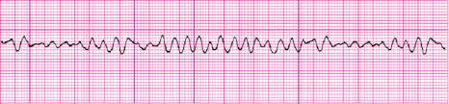
Arrest Protocol
Improved wording for V-FIB protocol: Repeat cycles of CPR - shock – drug.
Added wording for administration of Amiodarone to help clarify the time frame for the 2nd dose of Amiodarone: Repeat Amiodarone, IV or IO after approximately 10 minutes. Additionally, if a patient converts with ROSC from a ventricular arrhythmia and no anti-arrhythmic has been given, then administer Amiodarone 150 mg in 250 ml NS, IV over 10 minutes using 60 drop/ml tubing.

Slide 14
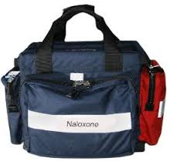
Medication Changes
All medication changes are clarifying changes. There are no new medications for 2016.
Reiterated adult Fentanyl that is given IN can be repeated after 30 minutes with MCP & the availability of a second drug bag.
Fentanyl for abdominal pain control in a pedi patient is a ♦ MCP order for AEMT & Paramedic
Deleted Lidocaine from Sedate to Intubate.
  No proven efficacy
IV is the preferred route for Glucagon for an anaphylaxis patient unresponsive to Epi, administer Glucagon 1mg IV. If no IV, Glucagon 1 mg IM.
Added pedi dose for Sodium Bicarb for tricyclic overdose.
Notes:
In Previous Protocol Glucagon for Anaphylaxis was an either or option (IV/IM), now it is preferred IV

Slide 15
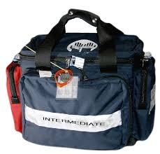
Medication Changes Continued
Added Nausea as an Indication for Zofran. Some were under the impression that you had to be actively vomiting.
Ketamine is no longer an optional drug.
Changed dosing of Ketamine because there were too many patients that were overly sedated when given 500 mg at once. Administer 250 mg IM in the leg, wait 2 minutes, if no effect repeat 250 mg IM in opposite leg. May repeat the process in 10 minutes.

Slide 16
Medication Changes Continued
Increase Norepinephrine 5 drops every 5 minutes
  If patient is hypotensive, begin Norepinephrine by adding 4 mg to 250 ml of Normal Saline. Infuse starting at 30 drops per minute ( max 44 drops) with 60 drop tubing and titrate to effect. Increase by 5 drops every 5 minutes.
There are NO medications to be given via ET tube. This was a practice that has been done for a long time, but does not improve patient outcomes.
Notes:
deleted all references to ETT administration of medications: cardiac arrest, asystole, bradycardia, newborn care, vasopressin, narcan, lidocaine

Slide 17
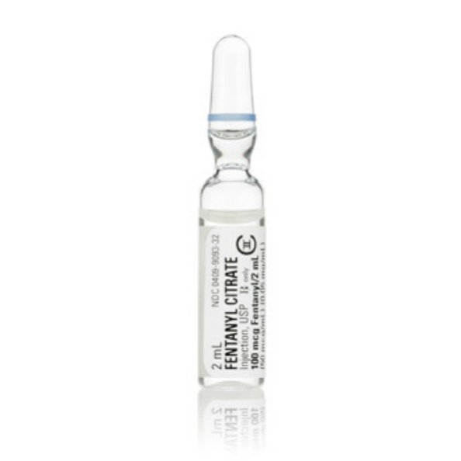
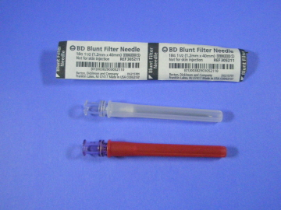
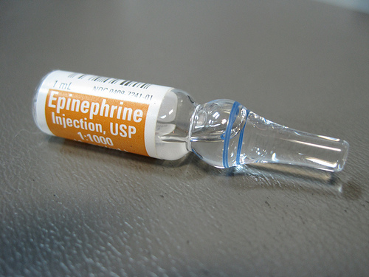
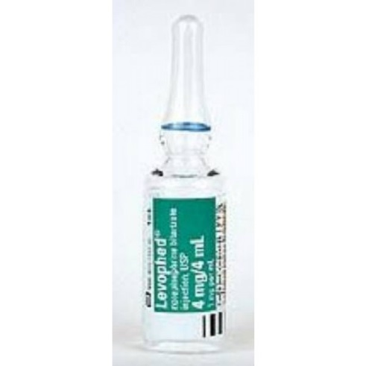
Glass Ampule
It is recommended to use filtered needles when drawing up medication from a glass ampule. If you do not use a filtered needle glass could potentially end up in the patients lungs/heart and cause damage.
  Filtered Needles will be provided by FD/EMS Department

Slide 18
Mental health protocol
Our region has inadequate psychiatric resources, including insufficient inpatient mental health/behavioral (MH/BH) beds. Few hospitals in our region have an inpatient MH/BH unit, and even in those that do, there may not be beds available. In many cases resulting from a general 9-1-1 call for MH/BH issues, the patient will be treated and released, and can adequately be cared for in any ED. Further, all of these patients require medical screening.
It is difficult for law enforcement or EMS to triage MH/BH patients who require inpatient treatment from those who don’t.
When patients have been seen on the same day by a MH/BH professional (e.g., Crisis Care, Eastway, etc.) who indicates to EMS that the patient will need inpatient hospitalization, the MH/BH professional should provide appropriate paperwork at the time of transport, and may indicate where the patient should be transported, with one option being the closest hospital.

Slide 19

Mental Health Cont.
In most cases transport a mental health patient to the facility where the individual has been previously treated since they will have the patient’s records.
In all other cases, patients should be transported to the closest ED.
Pediatric patients with mental health issues can be transported to Dayton Children’s Hospital

Slide 20

Mental Health Cont.
Exceptions to the above:
  It is medically necessary to transport the patient to the closest hospital for stabilization.
  It is unsafe to transport the patient to the preferred/recommended facility due to adverse weather or ground conditions or excessive transport time.
  Transporting the patient to the preferred/recommended facility would cause a critical shortage of local EMS resources.
  Patient requests transport to a different facility.

Slide 21
Optional Skills
“Therapeutic Hypothermia” for post arrest was moved to the Optional Skills Manual. Studies for prehospital are not showing the results they initially thought. However, cooling measures are still used in the hospital for post arrest patients.
Not all department use “Sedate To Intubate” protocol and was therefore moved to the Optional Skills Manual.
The “12 Lead Study Guide” was moved to the Optional Skills Manual because, not all departments have 12 lead capability, or necessity to interpret 12 leads. However, the capability to transmit 12 leads will be required by the State in the year 2021.

Slide 22
Quick review
If you bring in an intubated patient to the ER, what should you print off the cardiac monitor?
  Capnography readings, to confirm tube placement.
An EtCO2 reading of 10 mm/hg suggests what in an arrest patient?
  Check that you are doing good CPR. If you confirm good CPR, and EtCO2 does not rise above 10 mm/hg you should strongly consider field termination.
Where should you transport your patient if they have an onset of stroke symptoms less than 4 hours?
  Telestroke, Primary Stroke Center or Comprehensive Stroke Center
4. What are the closest Telestroke facilities/Primary Stroke Center to your agency?
  Answer will vary for each department. Refer to capabilities chart in previous slide.
True or False
Sports equipment will be removed prior to transport?
True!

Slide 23
Quick Review
Where should pregnant trauma patients be transported to?
Trauma Center that also has OB! Atrium, Kettering, Miami Valley, Soin, West Chester
True or False
AEMT & PM must call for orders for Fentanyl for abdominal pain in pediatric patients?
True!
Where should you transport a mental health patient?
Hospital where patient has previously been with MH/BH issues or closet hospital.
What should you use with a glass ampule?
Filter Needle
10. You have a combative patient that you are going to give Ketamine. What is your initial IM dose?
250 mg IM, wait 2 mins to see if you get desired affect. If you did not then give additional 250 mg IM in opposite leg.
11. What is the dose of Epi for ETT administration?
None! No longer allowed to give medications via ETT.

Slide 24

Questions?

Slide 25
Thank You for Your Service & Dedication!
GMVEMSC is now on Facebook!

