Slide 1


Slide 2
COVID-19
Running Statistics
Thru
18-Mar-2020

Slide 3

Updated: 18-Mar
COVID-19
Progress Through Ohio
Total Cases: 88
* Recoveries Not Reported At This Time
Source: Ohio Department of Health

Slide 4

Updated: 18-Mar
COVID-19
Progress Through the USA
Total Cases: 7,038
* Recoveries Not Reported At This Time
Source: Mon-Fri – Centers for Disease Control
Weekends – CNN Estimates

Slide 5

Updated: 17-Mar
DID NOT UPDATE
COVID-19
Progress Through China
Total Cases: 81,116
Sources: WHO Situation Report
* Recoveries Not Reported At This Time

Slide 6

Updated: 18-Mar
COVID-19
Progress Through Italy
Total Cases: 35,713
Sources: Italy’s Ministry of Health

Slide 7

Updated: 18-Mar
COVID-19
Progress Through Iran
Total Cases: 16,169
Sources: WHO Situation Report
* Recoveries Not Reported At This Time

Slide 8
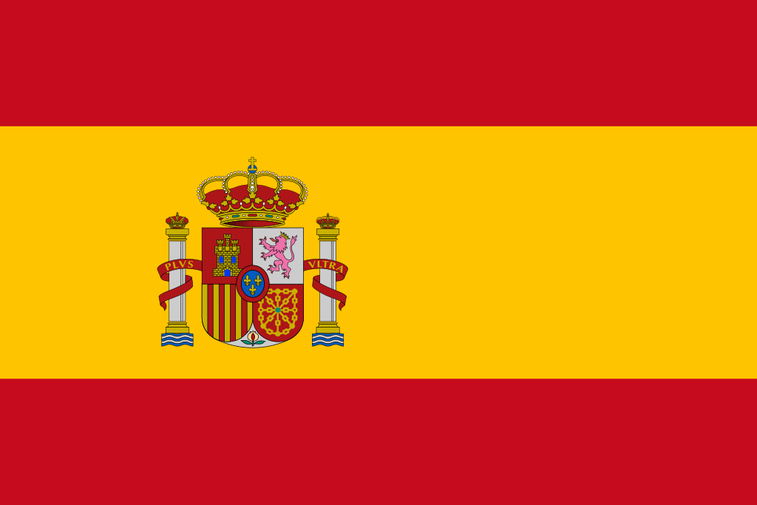
Updated: 18-Mar
COVID-19
Progress Through Spain
Total Cases: 13,716
Sources: Spain’s Ministry of Health
* Recoveries Not Reported At This Time

Slide 9

Updated: 18-Mar
COVID-19
Progress Through South Korea
Total Cases: 8,413
Sources: South Korea’s Ministry of Health and Wellfare

Slide 10

Updated: 18-Mar
COVID-19
Progress Through the World
(Countries Reporting Over 10,000 Cases)
China
81,116*
Italy
35,713
Iran
16,169
Spain
13,716
Rest of the World
51,158
Total Cases
197,827
Total Deaths
7,807
International Mortality
3.95%
* Did not report
Source: WHO Situation Report or Nations National Health Service
NOTE: Some Counts are Delayed at Least One Day

Slide 11
Updated: 18-Mar
Current Disease Prevalence and Estimated Mortality – Countries Over 500 Cases
Country | Population | Confirmed Cases | Recovered | Recovery Percentage | Deaths | Mortality Estimate | Contact Percentage
China *** | 1,439,323,776 | 81,116 | Not Reported | Not Reported | 3,231 | 3.9832% | 0.005636%
Italy * | 60,461,826 | 35,713 | 4,025 | 11.27% | 2,978 | 8.3387% | 0.059067%
Iran | 83,992,949 | 16,169 | Not Reported | Not Reported | 988 | 6.1105% | 0.019250%
Spain * | 46,754,778 | 13,716 | Not Reported | Not Reported | 598 | 4.3599% | 0.029336%
South Korea * | 51,269,185 | 8,413 | 1,540 | 18.31% | 84 | 0.9985% | 0.016409%
France * | 65,273,511 | 9,134 | Not Reported | Not Reported | 264 | 2.8903% | 0.013993%
Germany | 83,783,942 | 7,156 | Not Reported | Not Reported | 13 | 0.1817% | 0.008541%
USA ** | 331,002,651 | 7,038 | Not Reported | Not Reported | 97 | 1.3782% | 0.002126%
Switzerland | 8,654,622 | 2,650 | Not Reported | Not Reported | 14 | 0.5283% | 0.030619%
United Kingdom | 67,886,011 | 1,954 | Not Reported | Not Reported | 55 | 2.8147% | 0.002878%
Netherlands | 17,134,872 | 1,705 | Not Reported | Not Reported | 43 | 2.5220% | 0.009950%
Norway | 5,421,241 | 1,308 | Not Reported | Not Reported | 3 | 0.2294% | 0.024127%
Austria | 9,006,398 | 1,332 | Not Reported | Not Reported | 3 | 0.2252% | 0.014789%
Belgium | 11,589,623 | 1,486 | Not Reported | Not Reported | 14 | 0.9421% | 0.012822%
Sweden | 10,099,265 | 1,167 | Not Reported | Not Reported | 3 | 0.2571% | 0.011555%
Denmark | 5,792,202 | 977 | Not Reported | Not Reported | 4 | 0.4094% | 0.016868%
Japan | 126,476,461 | 826 | Not Reported | Not Reported | 28 | 3.3898% | 0.000653%
Malaysia | 32,365,999 | 553 | Not Reported | Not Reported | 0 | 0.0000% | 0.001709%
Totals/Averages | 2,456,289,312 | 192,413 | Not Available |  | 8,420 | 4.3760% | 0.007833%
Sources: WHO Situation Report (Delayed One Day)
* Reported from the Countries National Health Organization
** Reported by the CDC or CNN Estimates
*** Did not report

Slide 12
Updated: 18-Mar
EMS Unit Utilization – Last 30 Days
(Includes Known Mutual Aid)

