Slide 1




Dawn of a New Day
Full Scale Exercise
Sunday, April 30th, 2023
GREENE Memorial Hospital
Presented by:
David Gerstner
Dayton MMRS Coordinator

Slide 2

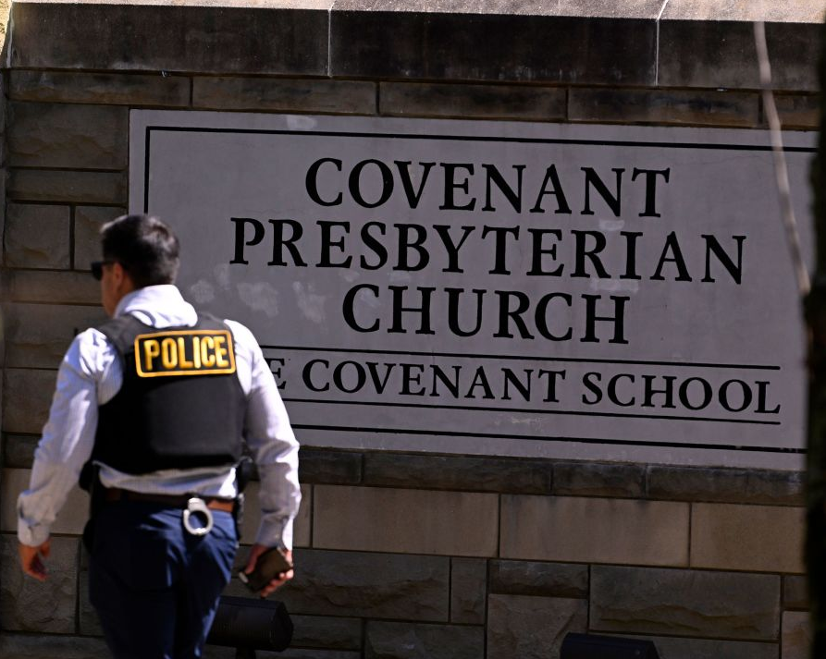
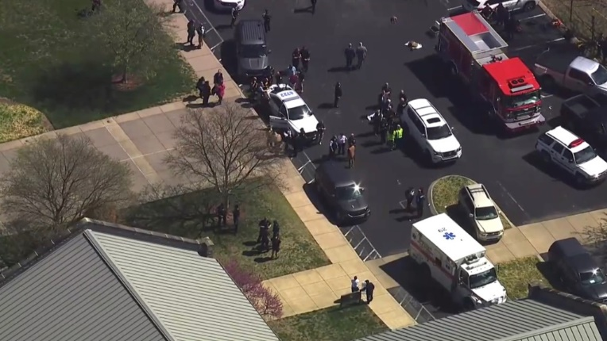
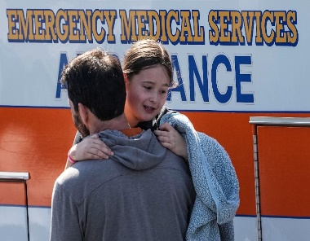


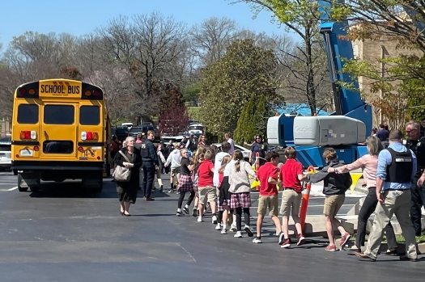
March 27, 2023
6 Dead, Multiple Injured
Covenant School Shooting, Nashville, TN

Slide 3
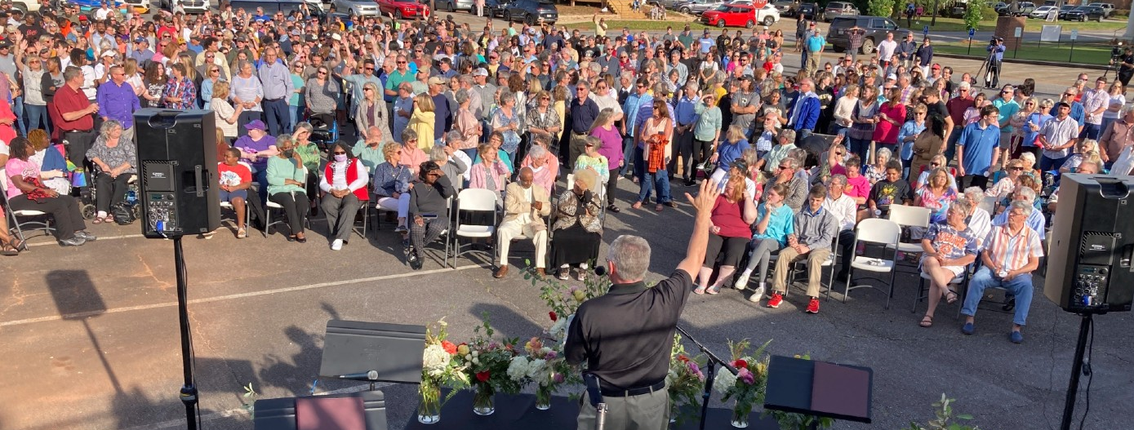
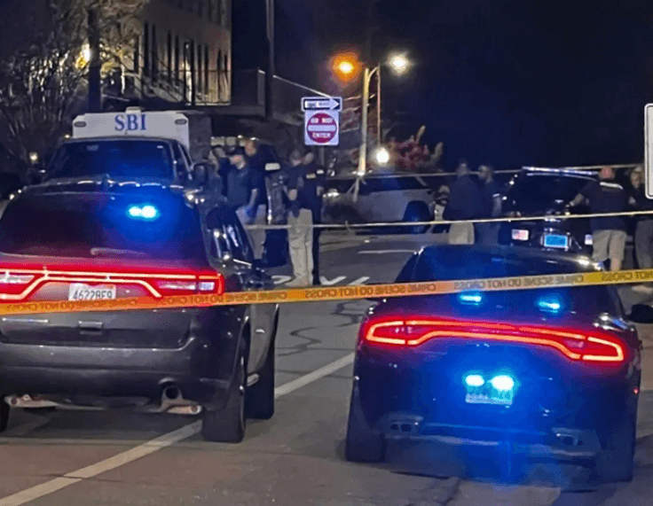
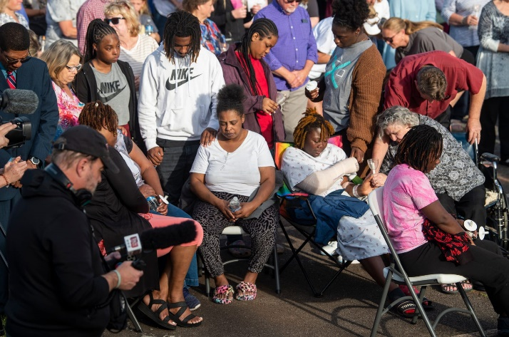

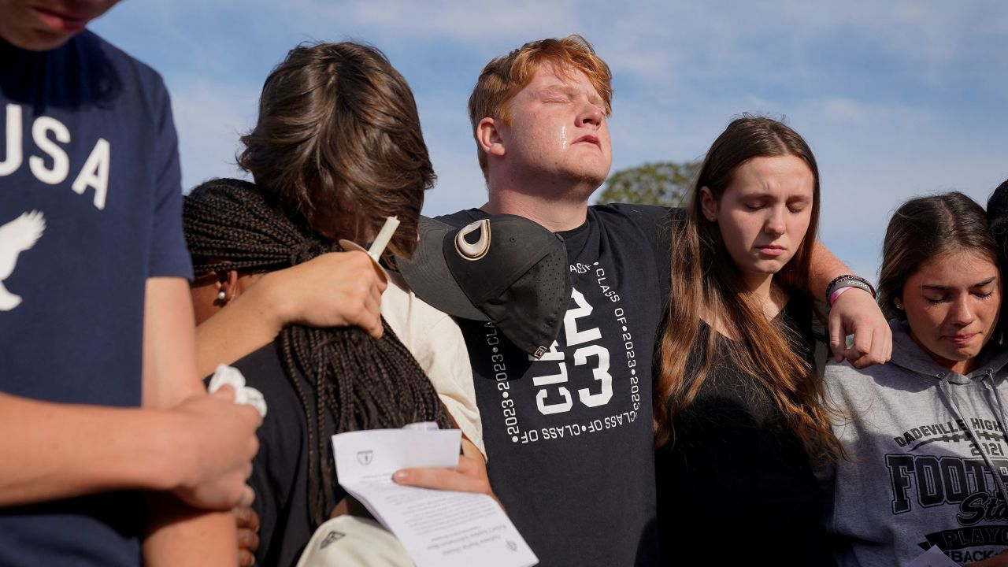
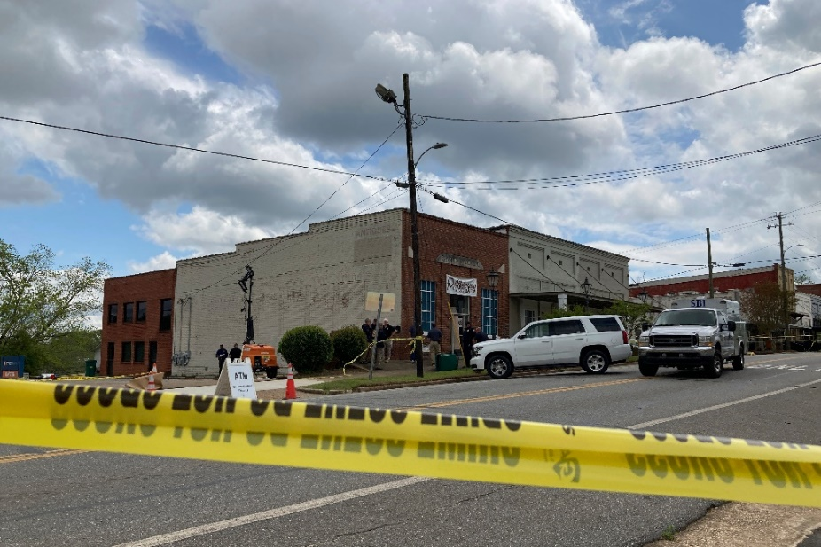
Dadeville, AL Sweet 16 Shooting
April 15, 2023
4 dead, 28 injured (15 with GSWs)

Slide 4
Hospital Player Pre-brief
Dawn of a New Day Full Scale Exercise
Sunday, April 30th, 2023
GREENE Memorial Hospital
Presented by:
David Gerstner
Dayton MMRS Coordinator

Slide 5

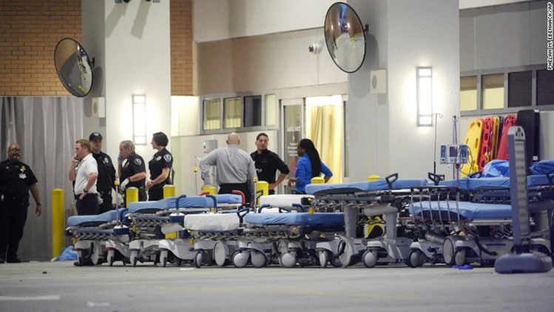
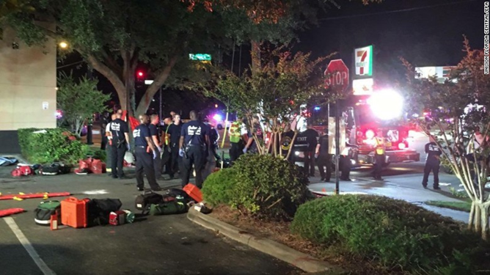
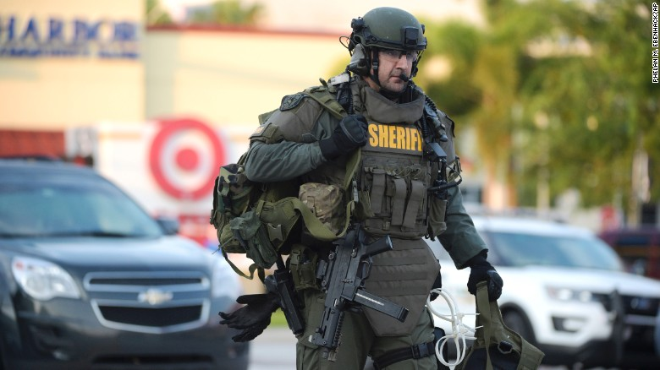
Orlando Response

Slide 6
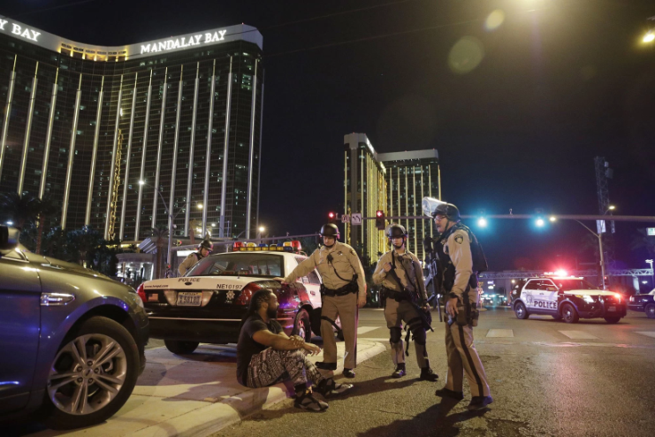
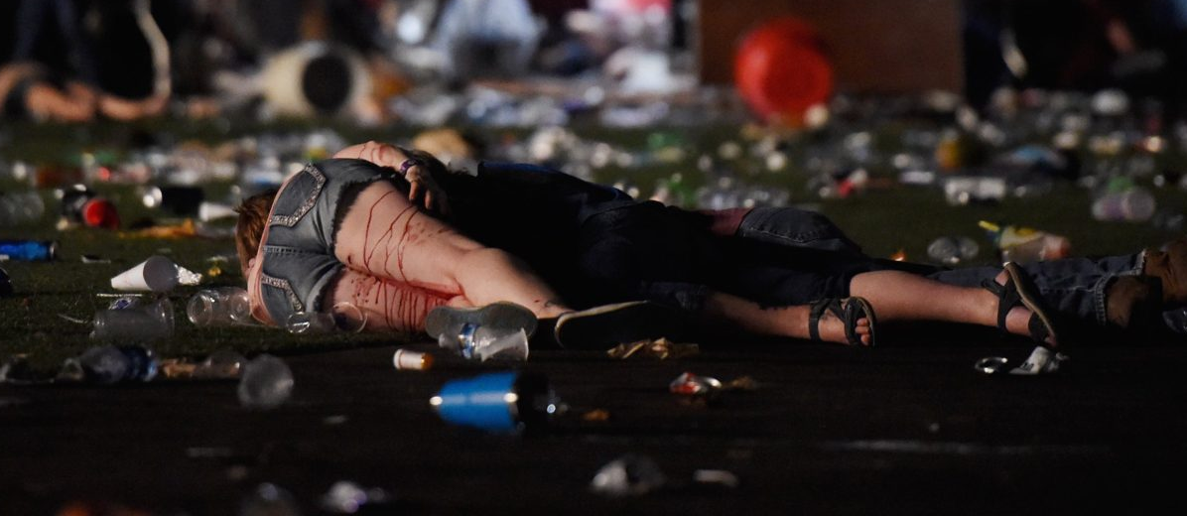

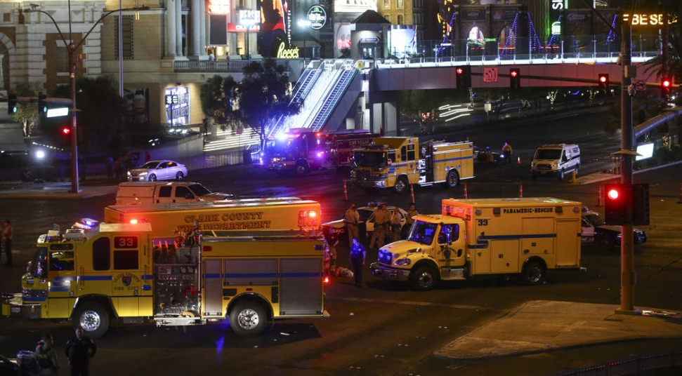
Las Vegas Response

Slide 7
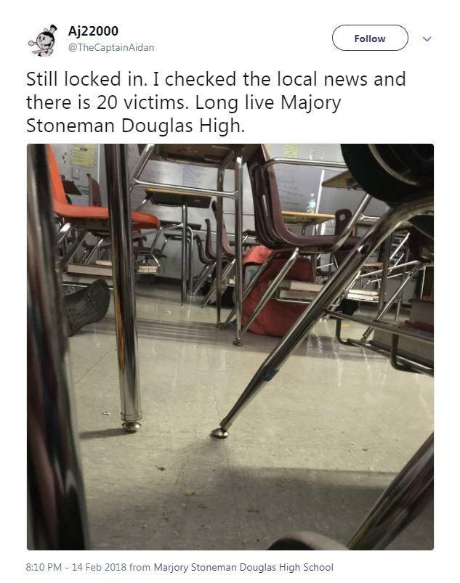
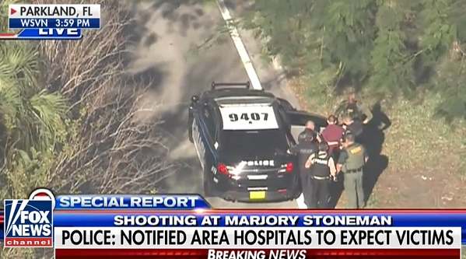
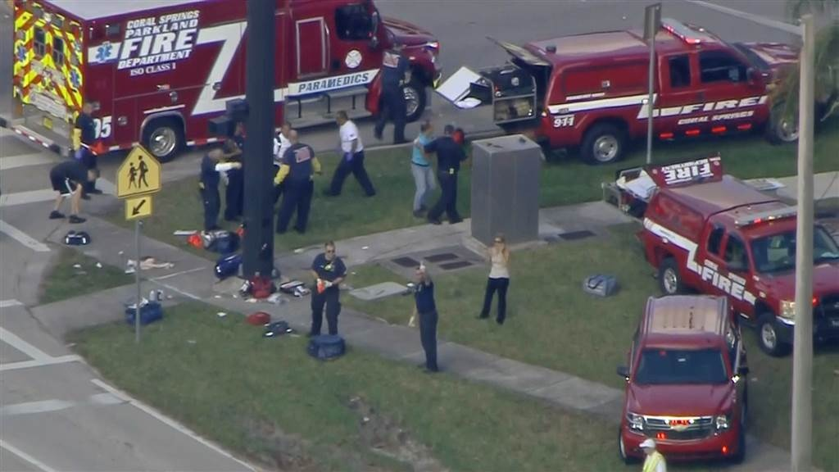
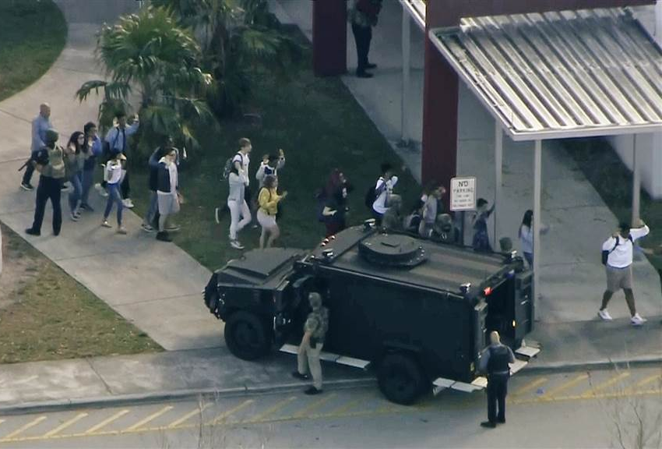
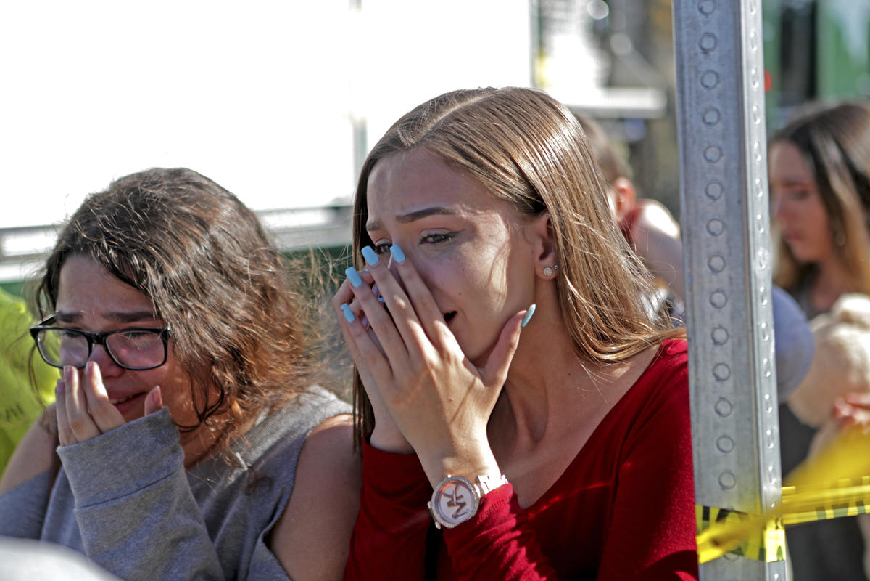
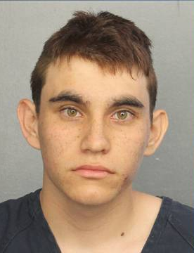
Marjory Stoneman Douglas High School Parkland, FL – February 14, 2018

Slide 8
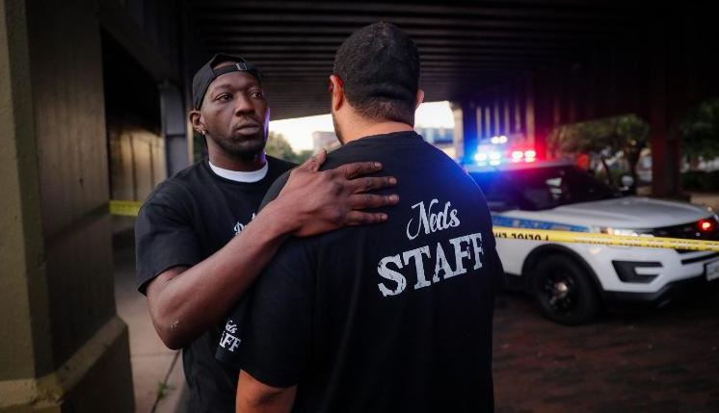
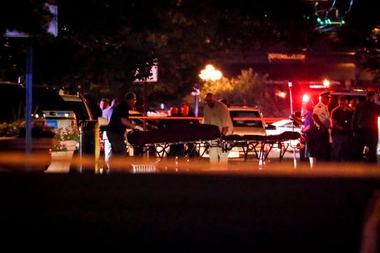
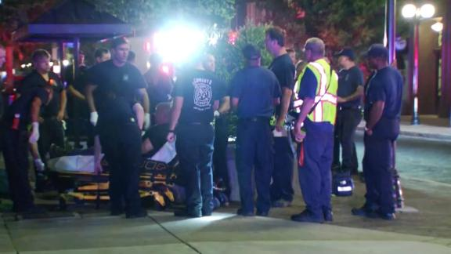
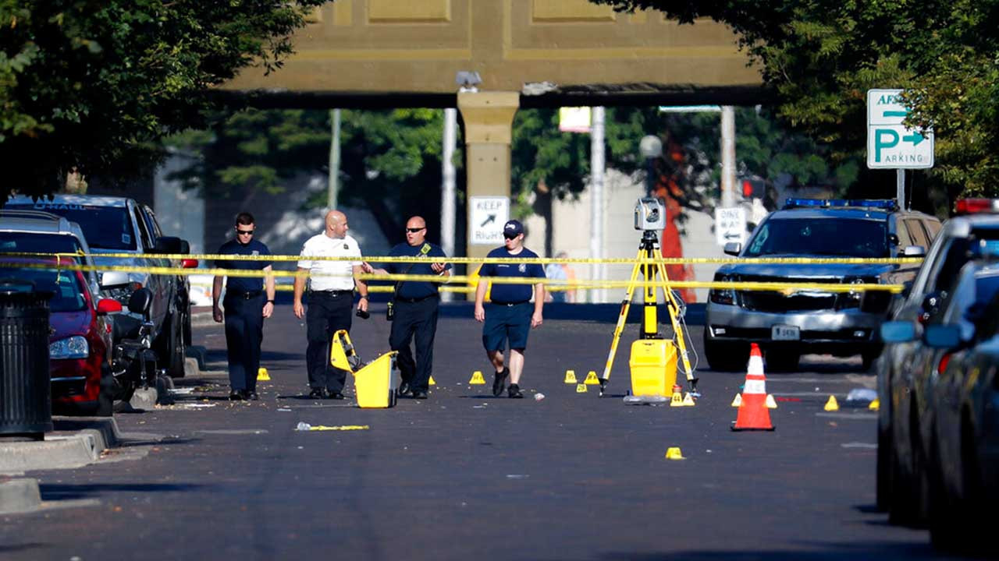
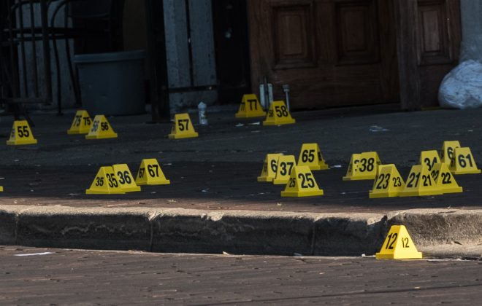
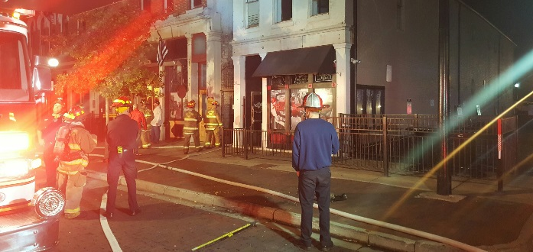
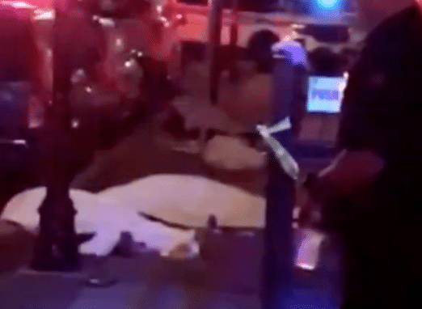
August 5th, 2019

Slide 9
Exercise Scope
Full Scale and Functional
State, County, and Local participation
Duration – Approximately four hours
Locations –
  Clark State Community College
    Greene Center
  Soin Medical Center
  Greene Memorial Hospital

Slide 10
Important Concerns
The exercise is as real as you make it!
Have a sense of urgency!
This is a large scale exercise
  Some areas or actions have to be simulated
Use ALL appropriate communications and redundant communications
Actually call and use all players
  Response may vary

Slide 11
Capabilities and Objectives
 | HPP Capabilities Addressed
 | Foundation for Health Care and Medical Readiness
 | Health Care and Medical Response Coordination
 | Continuity and Health Care Service Delivery
 | Medical Surge
Table 1. Exercise Objectives and Associated Core Capabilities

Slide 12
Exercise Parameters
Multiple organizations participating
Exercise date is Sunday, April 30th
Exercise will run from approximately 11:30 AM – 3:30 PM
Exercise play will begin at 1 PM
Half-hour Hot Wash following
Lead-in scenario provided on Thursday, April 27th via e-mail

Slide 13
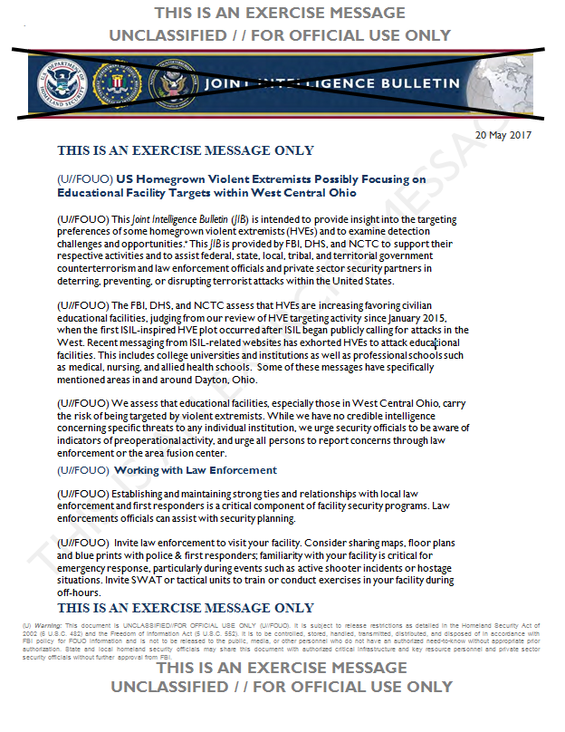
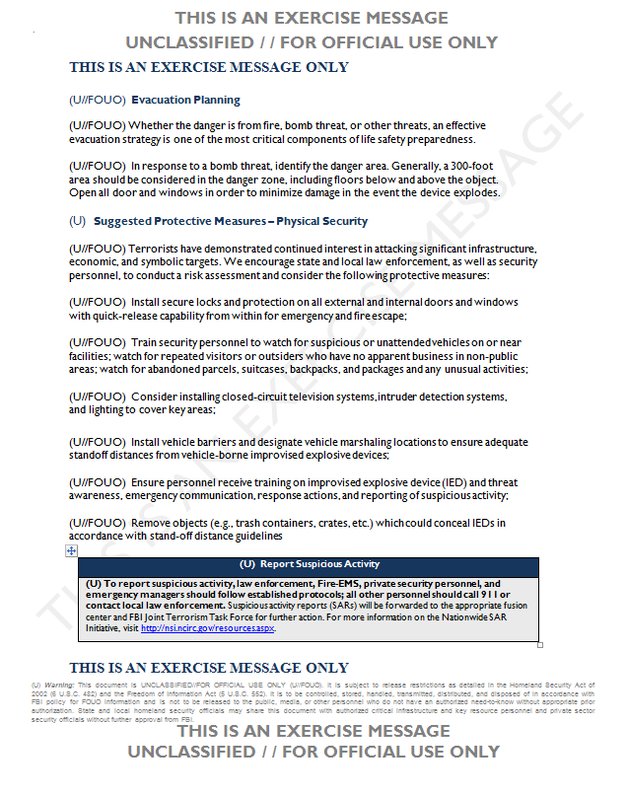
THIS IS AN EXERCISE MESSAGE: Simulated Joint Intelligence Bulletin

Slide 14
Exercise Parameters
Participants should be on location at least 30 minutes prior to start of exercise
Hospitals will receive multiple patients
EMS and hospitals will use Drill Triage Tags provided for exercise
Hospital will track patients with OHTrac
  Need to create OHTrac incident
    May use the 800 number for the ERS
  Update GDAHA Surgenet MCI Page and Juvare EMResource Page

Slide 15
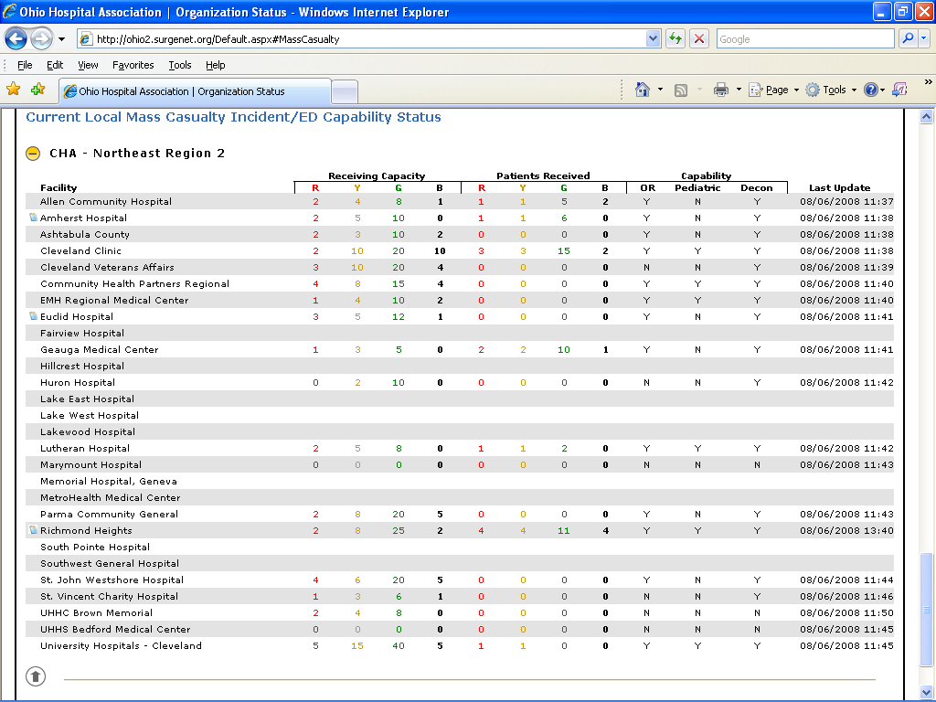
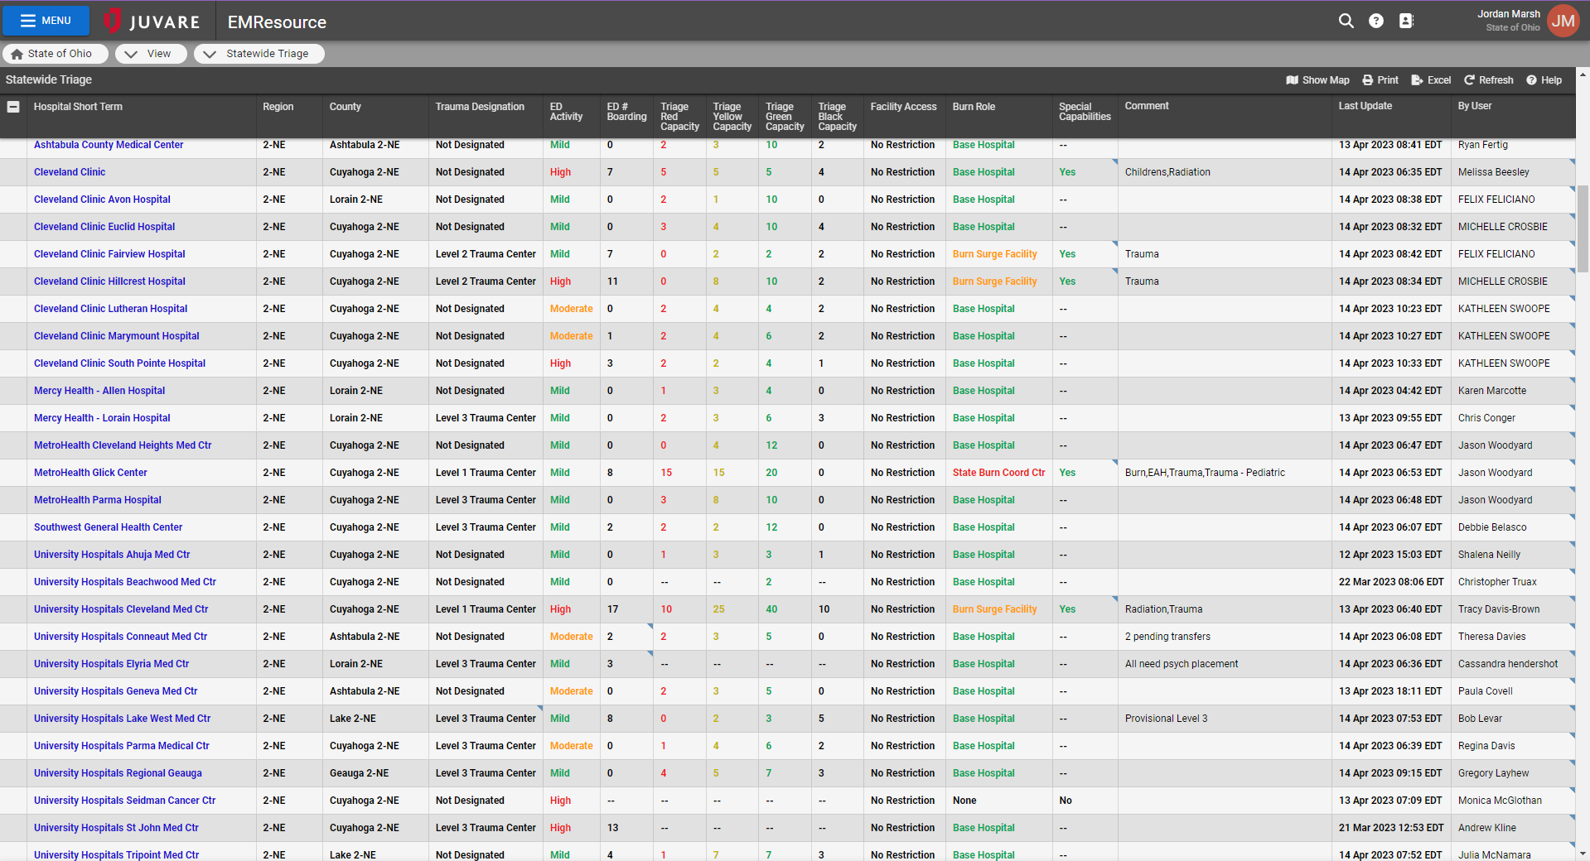

Slide 16
SAFETY!
Most important concern
Safety Officer will conduct weapons check
Other than specific training weapons, no weapons of any kind are allowed in CSCC exercise area
  Includes firearms, ammunition, impact weapons, chemical spray, knives, and electrical weapons (i.e., Tasers)
Every participant in exercise area will be searched for unauthorized weapons

Slide 17
Exercise Assumptions
No-fault learning environment
  Systems and processes evaluated, not individuals
Scenario is plausible, and events occur as presented
Players: react information, simulations, and situations as if they were real
Only departments, facilities, and agencies listed in the Player Directory (and their personnel) may be contacted during the exercise
SimCell for others

Slide 18
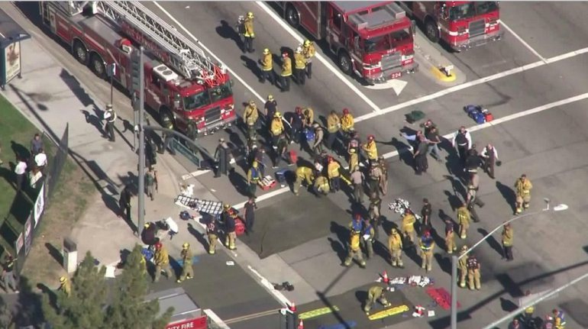
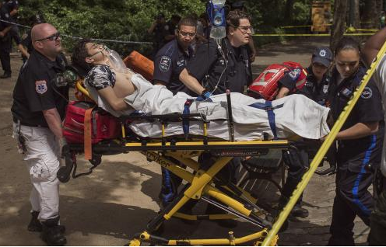
Full-scale versus Functional
Multiple simulations
Most areas will feel like a full-scale exercise (Scene, ED, OR, etc.)
Sometimes, you will play only to the level of a functional exercise

Slide 19
What is a Functional Exercise?
A functional exercise simulates a disaster but without moving people and equipment
Example:
  Calling off-duty personnel and asking how long it would take them to respond, vs. actually having them come in
    Document the answer!
  Calling other hospitals to ask for resources or ask if they can accept patients

Slide 20

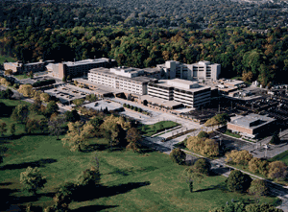

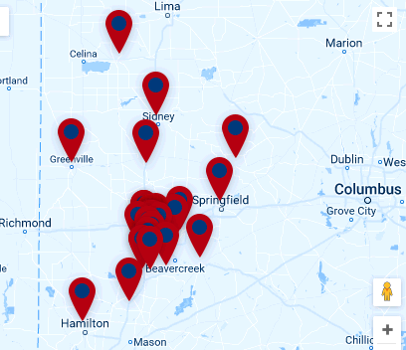
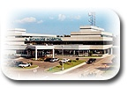

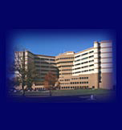


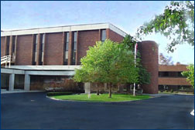
  Calling hospitals who are playing at the functional level (or via Simcell) is crucial:
  A major MCI is a community and REGIONAL event!
  Get out of your silos!
  (But don’t be surprised if they’re overwhelmed, too)

Slide 21
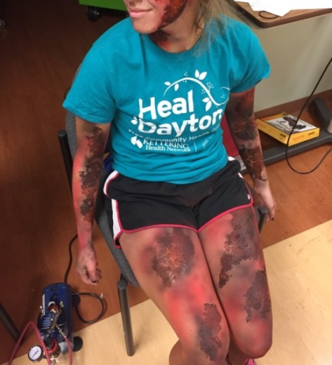
Exercise Assumptions
Use your agency’s plans, policies, processes, and procedures as well as individual judgments in determining how to respond
To the greatest degree feasible, respond as you would during an actual event
Participating agencies may need to balance exercise play with real-world emergencies. Real-world emergencies take priority
Exercise simulation will be as realistic and plausible as possible in the exercise

Slide 22
Exercise Assumptions
Send patients to playing areas!
Make all phone calls necessary for this exercise
DO NOT simulate phone calls! If you need something make the call!
Virtually all areas of Soin and GMH are playing
  Use the SimCell for anyone else!
Personnel called at home should be asked how long it would take to respond
  but TOLD NOT TO ACTUALLY COME TO WORK unless directed by their supervisor
If you are uncertain about anything, ask your supervisor, a Controller, or the SimCell

Slide 23
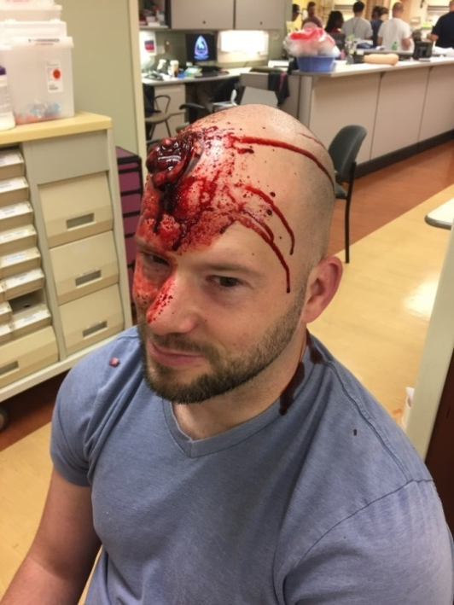
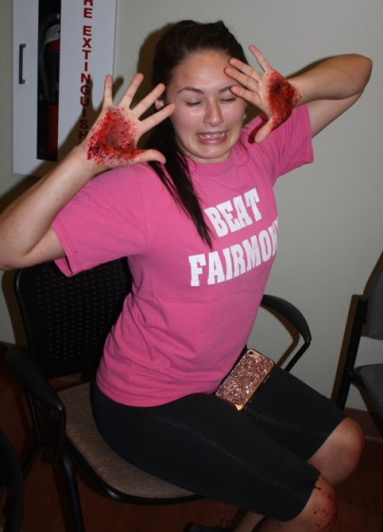
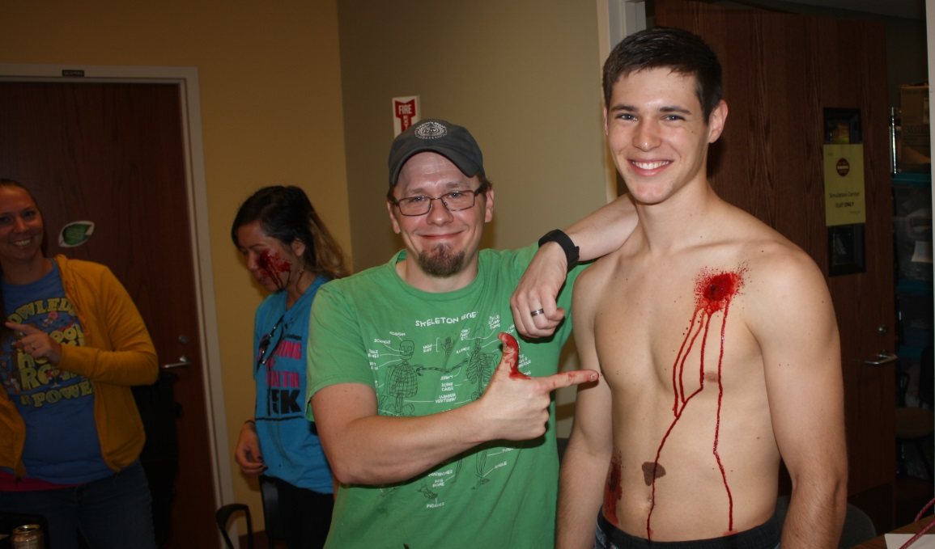
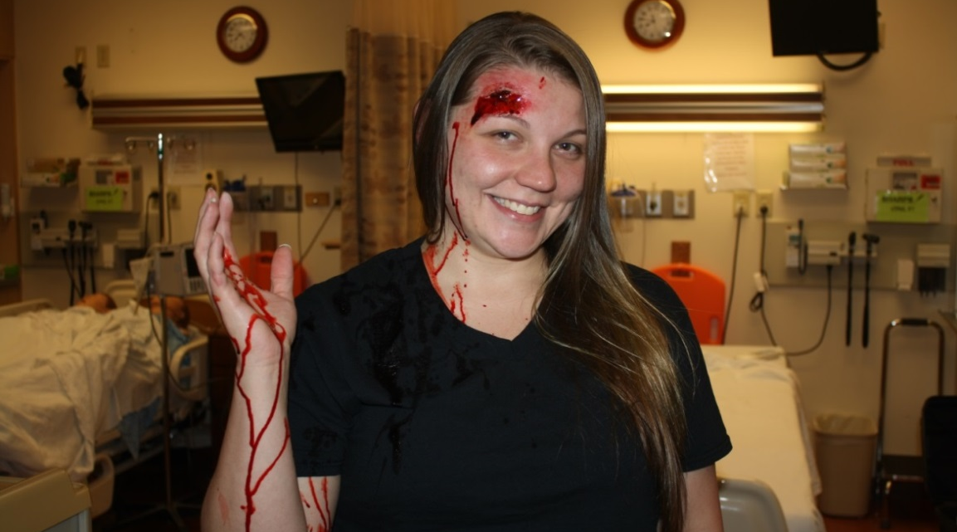
Exercise Assumptions
There will be moulaged actors as injured victims
  Treat them!
  But NO INVASIVE PROCEDURES (IVs, airway adjuncts, radiological examinations, etc.)

Slide 24
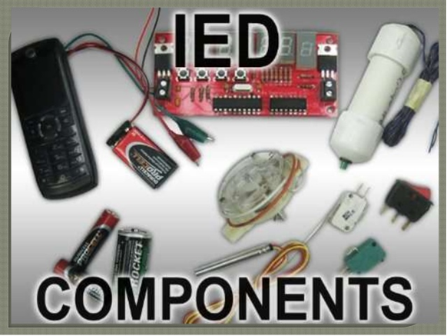
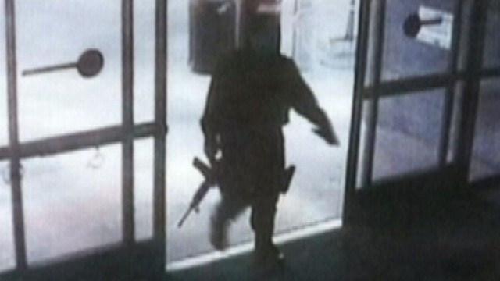
Scenario
Man enters CSCC and begins shooting visitors and faculty
An IED explodes
Numerous victims with some fatalities

Slide 25
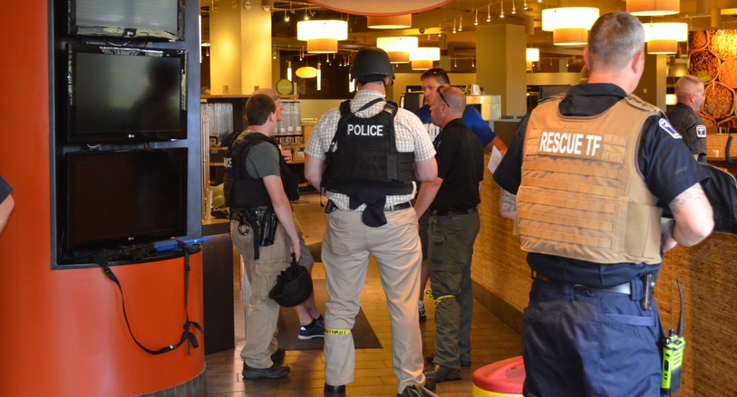
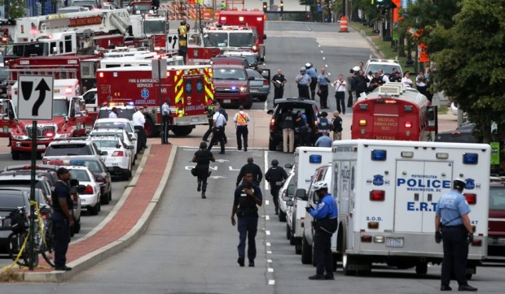
Law Enforcement Agency Activities:
Likely first of the first responders to arrive on the “scene”
Locate and stop perpetrator(s)
Participate with EMS in Unified Command structure

Slide 26
KH Soin and GMH Activities:
Command structure
Triage patients
  Expect walk-ins as well as transports from EMS

Slide 27
Areas of Play & Command Issues
Command Key Points
Follow ICS/HICS structure
Avoid tunnel vision
Be proactive not reactive
Communicate with organizational partners

Slide 28
KH Facilities’ Activities:
Treat patients
  Patients should actually be moved to all playing areas of the hospital as necessary
  Moulaged actors as injured victims;
    NO INVASIVE PROCEDURES (IVs, airway adjuncts, radiological examinations, etc.)
May also be actors simulating other roles (e.g., family members, press, etc.)
As practical, Players and Controllers should say out loud “This is an exercise message.”

Slide 29
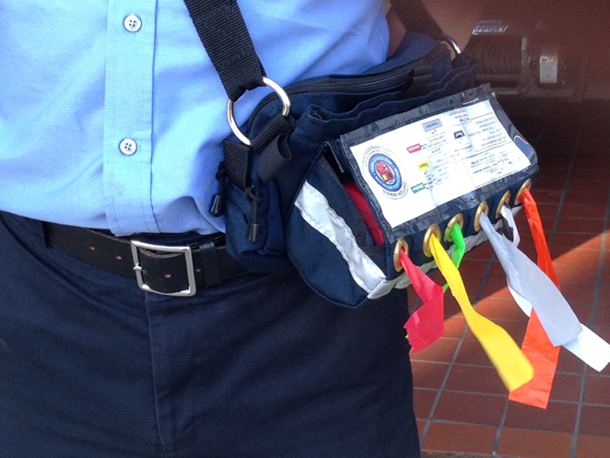
Dayton MMRS Triage Ribbon Kit
Triage Ribbon is principal indication of the patient’s category
Use Ribbons to attach the Tags
If Triage Category changes:
  change the ribbon!
But keep the same Tag

Slide 30
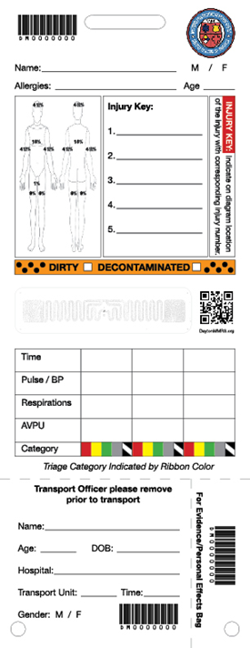
Dayton MMRS Triage Materials
Multiple versions of Triage Treatment Tags:
  “Live” tags are White
    Synthetic paper
    Bar codes, numbers, & RFID tags
  Only for “real world” use:
    Actual MCIs

Slide 31



Slide 32



Slide 33

Victim Envelopes
Simulated victims will carry envelopes
  Inside envelopes is more information on patient condition
Envelopes will be color-coded based and labeled
Envelopes must NOT be opened until the time and location indicated

Slide 34
Victim Envelopes
    Purple
    Green
    Pink
    Yellow
    Orange
Victim envelopes will be labeled, e.g.:
  Do not open until after 20 minutes in ED
  Do not open until patient is in OR

Slide 35


Labs and Imaging

Slide 36
OR Cards
[Patient Name] [Reference #] The purpose of this card is to help you realistically think through issues involved, including timelines, personnel availability, equipment availability, and clinical decision-making needed in a large MCI. P:____ BP: ____/____ R:____ SpO₂:____ GCS – E: ___ M:___ V:___ [Victim Condition] Priority of this patient for surgery (circle one): High Moderate Low Time surgery started: ___________________ Estimated surgical end time: _____________ What would you anticipate is the optimal surgical procedures if this were a single victim incident: __________________________________________________________ __________________________________________________________ What surgical procedures would you opt for instead for this patient in a major mass casualty incident (MCI) with limited resources? __________________________________________________________ __________________________________________________________ Any personnel not on site should be called. The time of the call for each, and the estimated time of arrival (make sure to say, “This is an exercise” and tell them NOT to actually come to work!) should both be listed on the opposite side. | [Patient Name] [Reference #] SURGICAL RESOURCES OR #:____ Anesthesiologist/Anesthetist Name: ______________________ Onsite or Called in? (Circle) If called in, time called/ETA given: ____ /____ Surgeon Name: ______________________ Onsite or Called in? (Circle) If called in, time called/ETA given: ____ /____ Specialty Surgeon Name & Specialty Name: ______________________ Onsite or Called in? (Circle) If called in, time called/ETA given: ____ /____ Specialty: ______________________ Additional surgeon/physician Name: ______________________ Onsite or Called in? (Circle) If called in, time called/ETA given: ____ /____ Specialty: ______________________ RN1 Name: ______________________ Onsite or Called in? (Circle) If called in, time called/ETA given: ____ /____ RN2 Name: ______________________ Onsite or Called in? (Circle) If called in, time called/ETA given: ____ /____ PA/APRN Name: __________________ Onsite or Called in? (Circle) If called in, time called/ETA given: ____ /____ Other personnel: _________________ Onsite or Called in? (Circle) If called in, time called/ETA given: ____ /____ Anesthesia Machine: __________ Major Procedure Tray: __________ Vascular Surgical Tray: ____________

Slide 37


Surge Forms

Slide 38
Participants
Players
  Actively involved
Controller/Evaluators
  Initiate play/monitor response
  Identified with vests or badges
Actors/Volunteers
  Role play patients
Observers
Simulation Cell (SimCell)
  Injects information
  Responds to player requests
  Role plays for non-playing entities

Slide 39
Participating Organizations
Kettering Health
Soin Medical Center
Greene Memorial Hospital
Beavercreek Township Fire Department and other EMS agencies
Beavercreek PD and other Law Enforcement agencies
Regional MMRS Rescue Task Force
Beavercreek Dispatch
Montgomery County Regional Dispatch (RDC) and others
Other hospitals as functional players

Slide 40


Communications Plan

Slide 41
Communications Plan
approved for usage during the Dawn of a New Day MCI exercise:
Cell Phones
Landlines
RHNS (Regional Hospital Notification System)
MARCS (Multi-Agency Radio Communications System)
Other radio systems
GDAHA Surgenet MCI web page
Juvare EMResource Page
OHTrac
Satellite phones

Slide 42
Exercise Assumptions
Systems such as Emergin, GDAHA Surgenet, and Juvare EMResource are available for use during the exercise
OHTrac Regional Hospital Notification System are available
  Create OHTrac Incident and use RHNS
All internal communications (e.g., paging and notification systems)
  Match MD, Vocera, Rave Alert, overhead pages, etc.

Slide 43
All Communications:
Begin with “This is an Exercise Message”
To include:
  Phones (landline and cellphones)
  Radios
  E-mail
  Faxes
  Even in person when within the hospital!

Slide 44
All Communications
As practical, Players, Victims and Controllers should say out loud “This is an exercise message.”

Slide 45
Communications
  Visitors
  Staff
  Patients!

Slide 46


Communications:
Signage
Announcements
Explanations
  Explain sights and sounds and reassure that it’s just a training exercise

Slide 47
Communications
KH Media Liaison

Slide 48
Suspending or Terminating Exercise
In the event of a real emergency the player will inform the controller/evaluator with the phrase
“REAL WORLD EMERGENCY”
The controller/evaluator will forward the information to the Senior Controller, the Exercise Director, and the SIMCELL

Slide 49
Player Hot Wash
Immediately following end of play (ENDEX):
Complete a player hot wash
Controller/Evaluator will facilitate group discussion
What went well/needs improvement
Controller/Evaluator will document discussion on group feedback form
Participant Feedback forms will be circulated and collected

Slide 50
Important Wrap Up
Inject messages from Controllers, victims, by phone, radio, or other means
Respond to exercise events and information as if the emergency were real
Send patients to playing areas! Use all communications tools!
Make all the phone calls! DO NOT simulate phone calls!

Slide 51
Important Wrap Up
If you need something make the call!
Use Player Directory for participating organizations and SIMCELL for ANYONE else!
“This is an Exercise Message” vs. “Real World”
If uncertain about something, ask your supervisor, a Controller, or the SimCell

Slide 52
Player Reference Items
EXPLAN
Player Guide
Player “Phone Book” with Communications Plan

Slide 53
QUESTIONS?
Email: david.gerstner@daytonohio.gov jordan.marsh@daytonohio.gov william.rose@daytonohio.gov

Slide 54
THANK YOU FOR PARTICIPATING!
PLEASE COMPLETE THE FEEDBACK FORMS AFTER THE EXERCISE!

