Slide 1
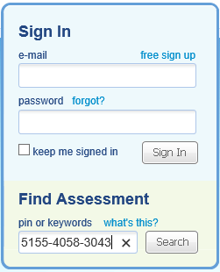
The CBT will no longer be used with the “Secure Browser”. To administer the CBT you must go to https://www.questbase.com/
Type the PIN of the CBT you wish to administer where it says “Find Assessment”. Make sure to include the dashes.

Slide 2
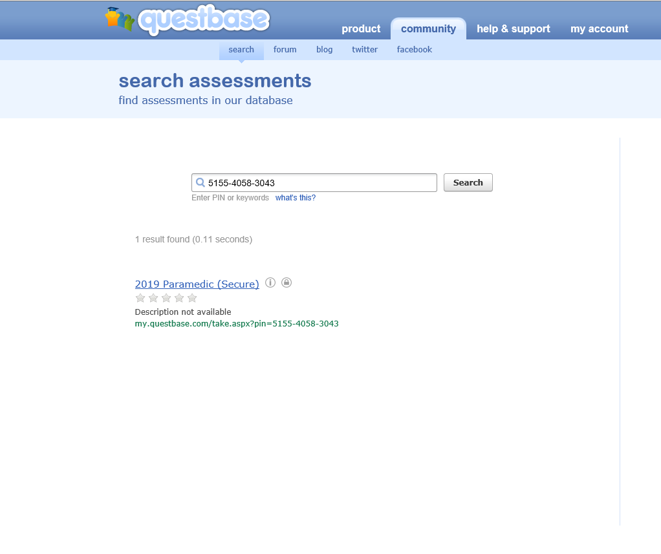
The CBT will populate here. Select it and you will be asked to type in your Access Code.

Slide 3
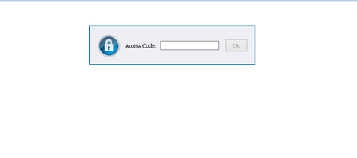
123-456-789
Enter your personal Access Code.
Note: the dashes DO NOT automatically populate

Slide 4
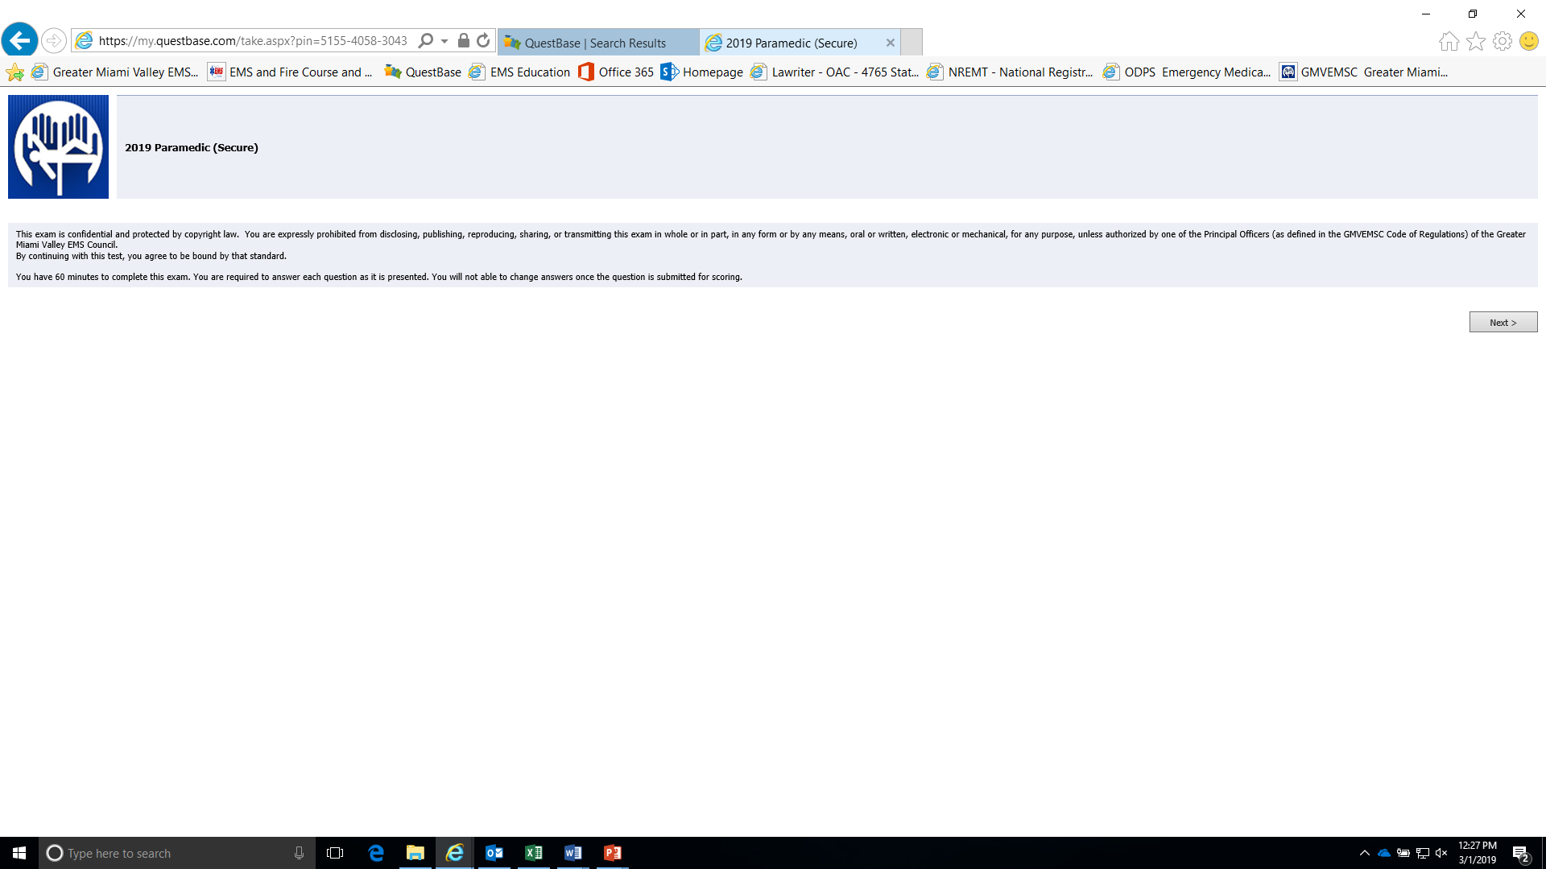
Confirm this is the test you wish to Proctor. Have them read the notes and then click next.

Slide 5
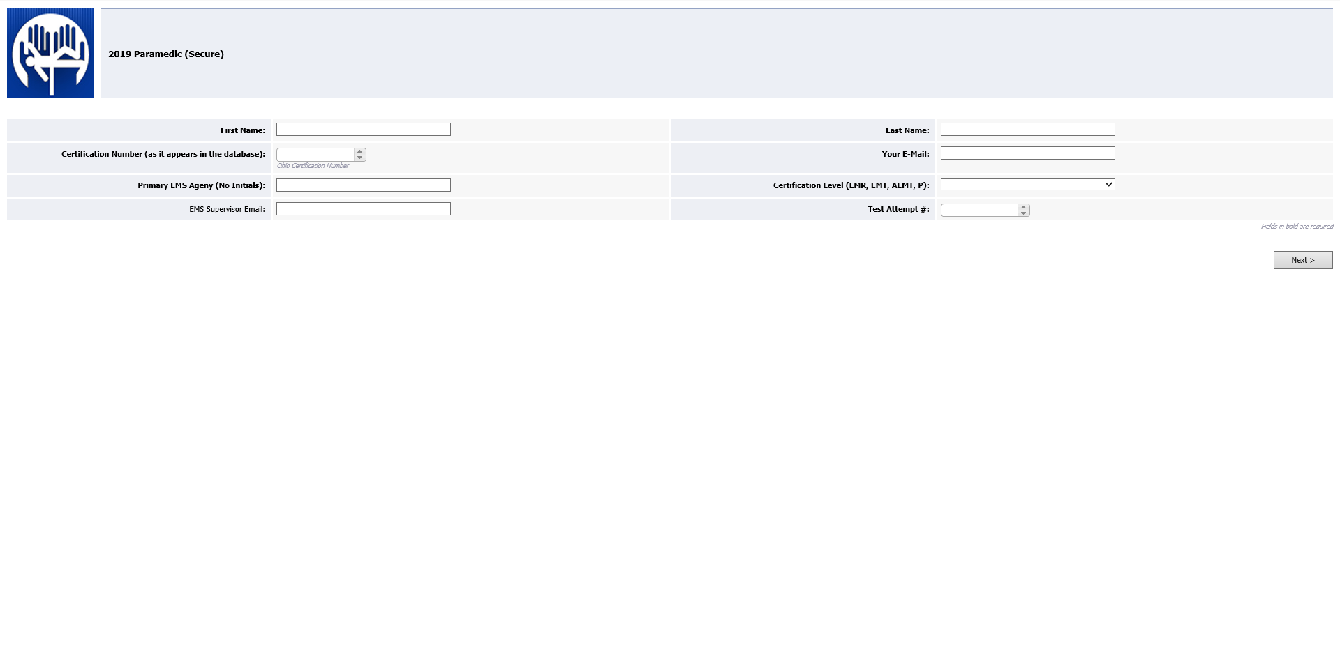
Test taker’s First and Last name.

Slide 6
Test taker’s State of Ohio Certification number

Slide 7
Test taker’s email and The EMS Supervisors email address. This is where the CE will be sent following the test.

Slide 8
Test taker’s Department and Certification level

Slide 9
If you have any additional questions please contact Chris Freeze crfreeze@premierhealth.com
Or, John Russel JRussell@hhoh.org

