Slide 1


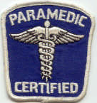

Quarterly Triage Day & Mci communications for EMS

Slide 2
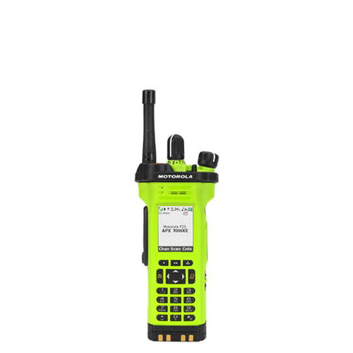
Regional MCI Communications!
Quarterly Triage Drill Days & Real-World MCIs
MCI MARCS Radios
Regional Hospital Notification System
  RHNS
Juvare EMResource (if available)
Juvare EMTrack (if available)

Slide 3
“HSR3 MCI” MARCS Radio Talk group
“MCI MARCS” - additional ED radio used solely in MCIs or Exercises
Used to:
  Notify each ED of patients they will receive
  Provide ALL hospitals with a “common operating picture” simultaneously
  EDs can ask questions about incident over HSR3-MCI Radio Talk Group (TG)
HSR6-MCI has same uses for EDs in Region 6
  Talk Groups can be patched together

Slide 4
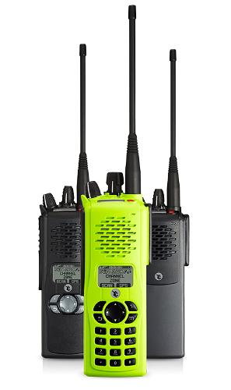

Regional MCI Communications!
Radios vs. cell phones
  You wouldn’t consider using cell phones for a structure fire
  Don’t plan to use cell phones for hospital comms during MCIs (or QTDs)
HSR3 MCI MARCS Radio Talk Group (and HSR6) in your radio template
DO YOU KNOW WHERE TO FIND MCI TG IN YOUR RADIO?
  Do you know which Zones have the MCI TGs?
  Are you comfortable changing Zones?

Slide 5
HSR3 MCI-MARCS Radio Tg
During an event, EDs turn on MCI TG
  Should monitor MCI radio following any MCI notification
  Reminder to monitor MCI TG included with Regional Hospital Notification System (RHNS) messages
During QTDs, EDs should turn on and monitor the MCI TG

Slide 6
HSR3 MCI-MARCS Radio Tg
No alerts on MCI TGs!
Hospitals monitor MCI Radio during MCI and QTD, but…
  EDs are noisy!
  EMS must clearly identify which ED is being called
  EMS must carefully confirm which ED answered
  EDs should listen to be sure the call on the MCI TG is for them
  EDs should clearly state which ED is answering

Slide 7
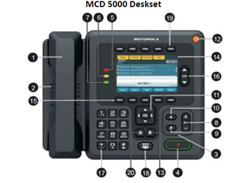
MCI-style reports on QTDs
During QTDs, make BRIEF, MCI-style reports to the ED on the MCI Talk Group
Make a report for every patient during ENTIRE 24 HOURS of QTD (2000 hours – 2000 hours).
During an actual MCI, individual EMS Units DO NOT “CALL-IN” to ED with REPORT!
    ONLY the TRANSPORT Officer/Aide makes those calls
    MCI-style reports during QTDs are an opportunity to practice as if YOU are the Transport Officer
MCI Reports are DIFFERENT!
  When you have 40 patients, you canNOT do the typical report!
  No vital signs, no EKG findings, no medical hx
  Short, sweet, to the point!
  Example: “Wayne Hospital, this is Greenville Medic 591 enroute with one Yellow, possible fractured ankle.”

Slide 8
REGIONAL HOSPITAL
NOTIFICATION SYSTEM (RHNS)
One number for EMS, hospitals, and EMAs to call:
  937-333-USAR (8727)
Rapid, simultaneous notifications during MCI or other major emergency
Use whenever incident could involve a significant number of region’s hospitals
  Also used to indicate no need for action
Montgomery County RDC puts out computerized message for region

Slide 9
MCI Job Aid for RHNS
Sent to all agencies, hospitals, and EDs in region
Transport Officer Clipboard on each apparatus should have a copy of the job aid
  Should also have a copy on Command Vehicles
Job Aid provides personnel with everything needed to activate RHNS
Download from GDAHA or Dayton MMRS website

Slide 10
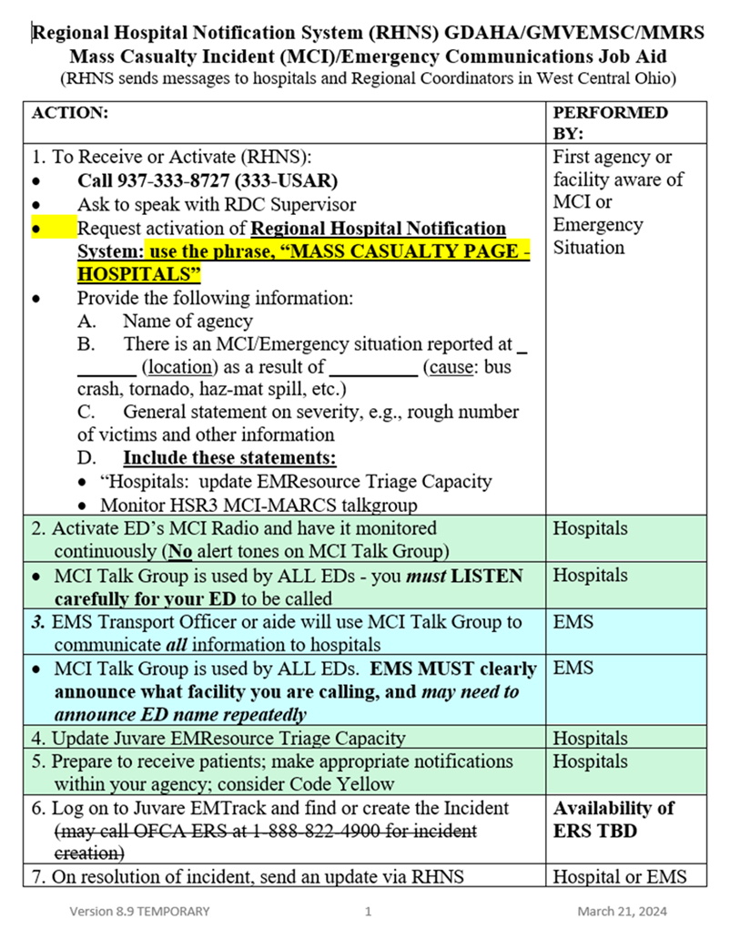

Slide 11
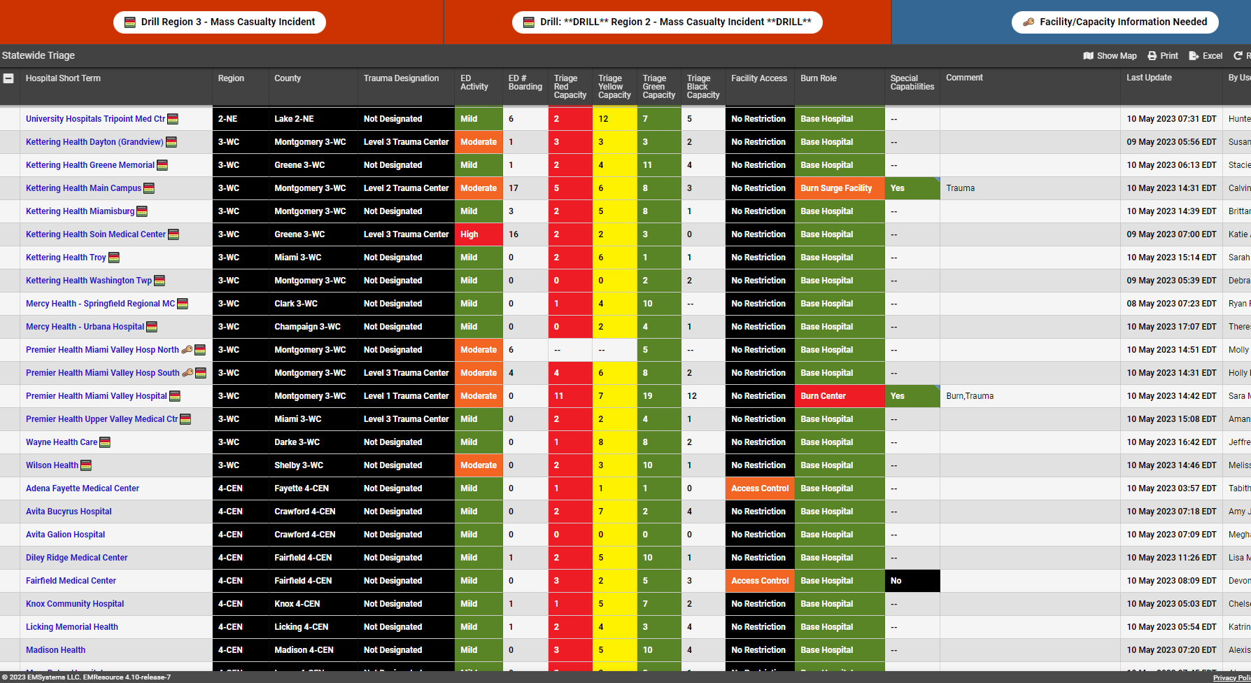
EMS and Dispatch Centers can monitor Juvare EMResource during an MCI to see capacity by triage categories
Check it out during each QTD

Slide 12
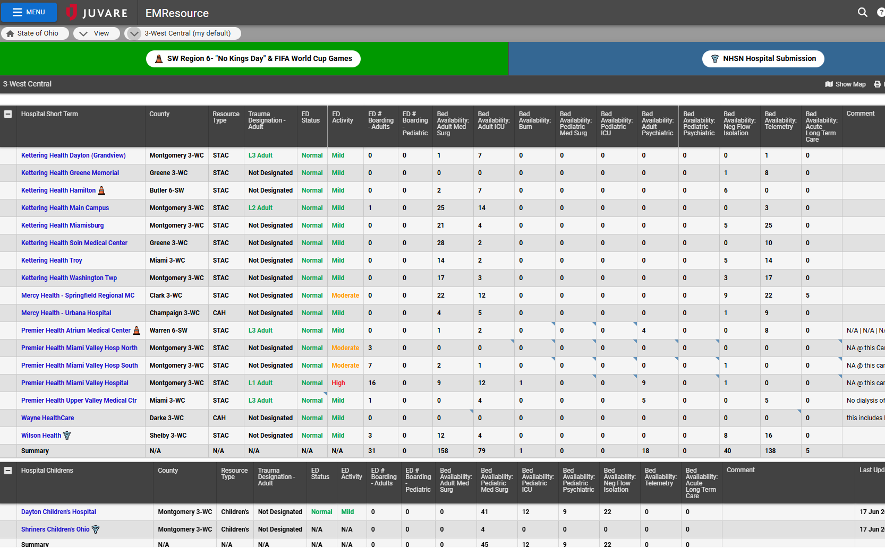
Juvare is same system used to monitor hospital diversion

Slide 13
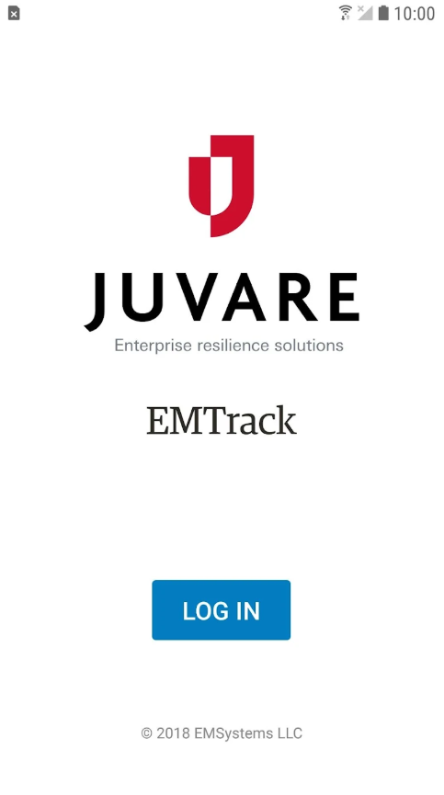
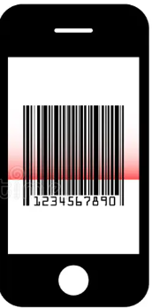
EMTracK Entry
Scan this:
If you have access to Juvare EMTrack:
Scan and enter each Tag
  Use Barcode NOT QR Code
Not that:

