Slide 1




Dawn of a New Day
Full Scale Exercise
Sunday, April 30th, 2023
GREENE Memorial Hospital
Presented by:
David Gerstner
Dayton MMRS Coordinator

Slide 2
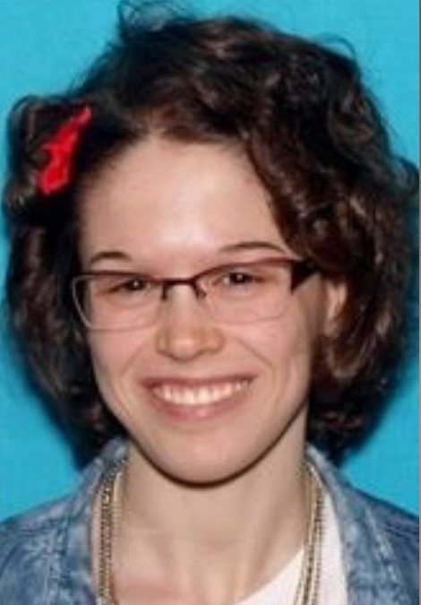
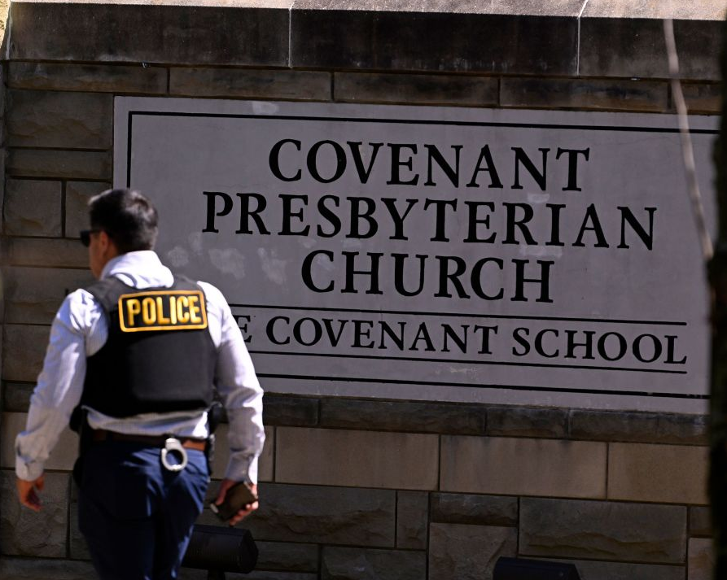
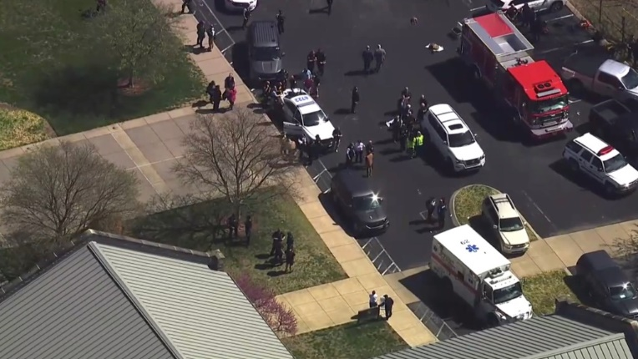
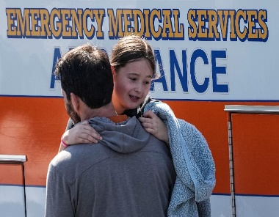
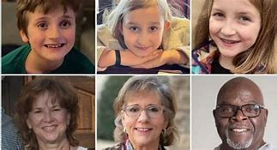
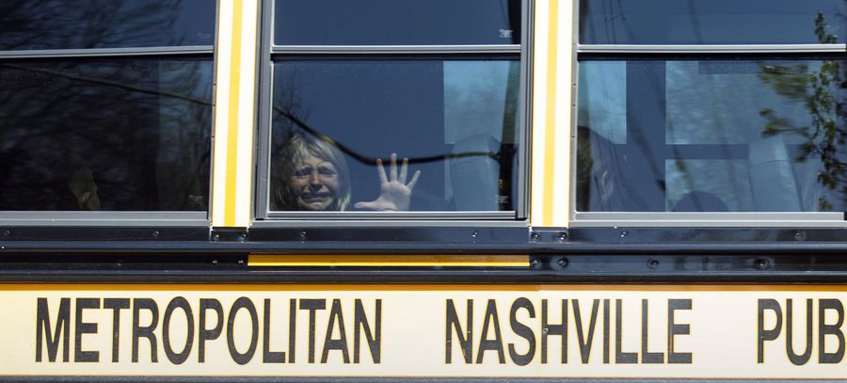
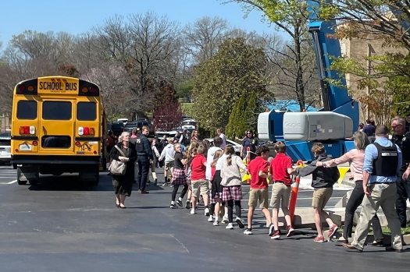
March 27, 2023
6 Dead, Multiple Injured
Covenant School Shooting, Nashville, TN

Slide 3
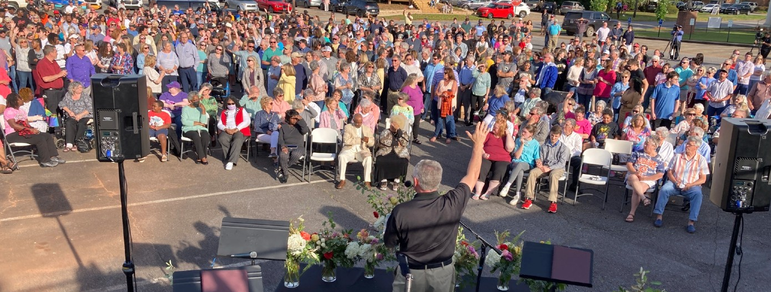
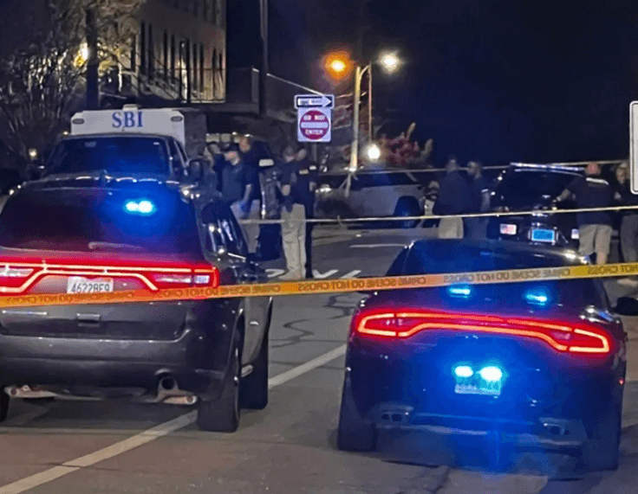
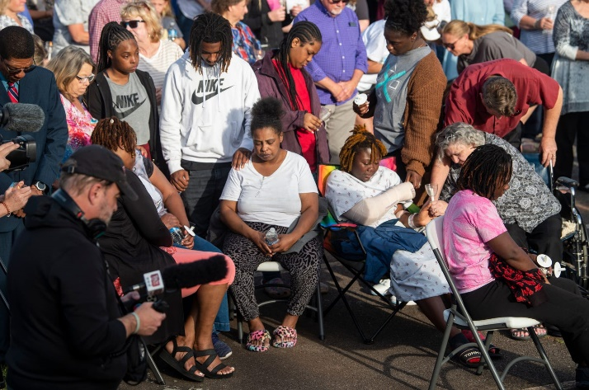
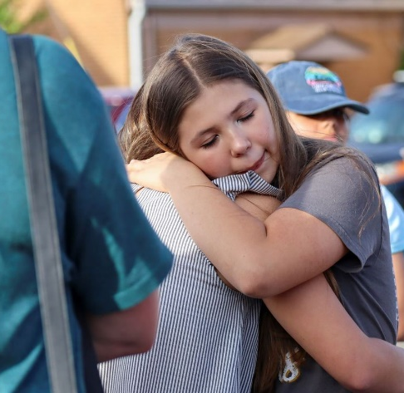
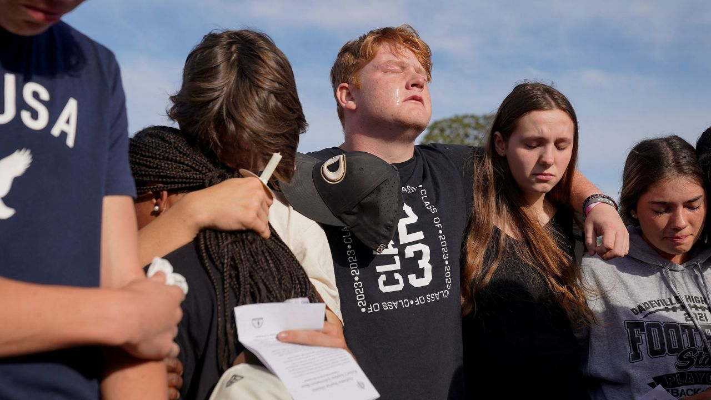
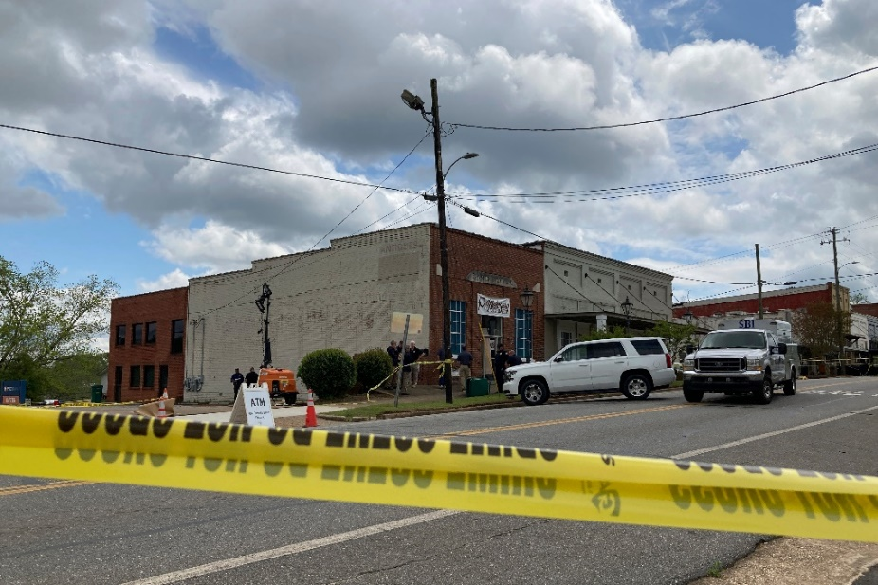
Dadeville, AL Sweet 16 Shooting
April 15, 2023
4 dead, 28 injured (15 with GSWs)

Slide 4
Victims, Moulagers, and Victim Controllers Pre-brief
Dawn of a New Day Full Scale Exercise
Sunday, April 30th, 2023
GREENE Memorial Hospital
Presented by:
David Gerstner
Dayton MMRS Coordinator

Slide 5

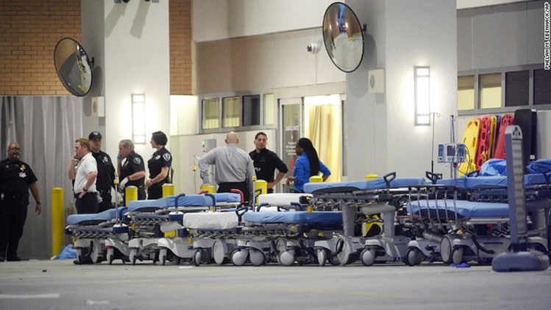
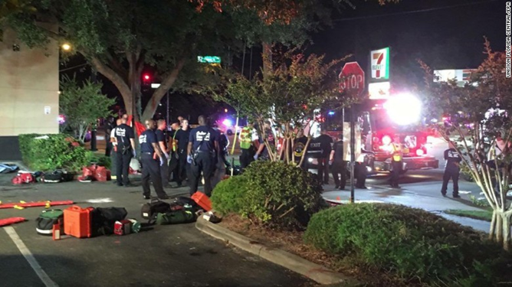
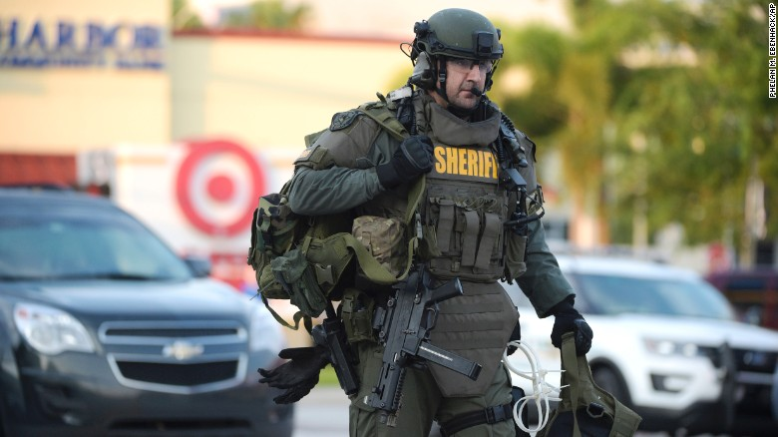
Orlando Response

Slide 6
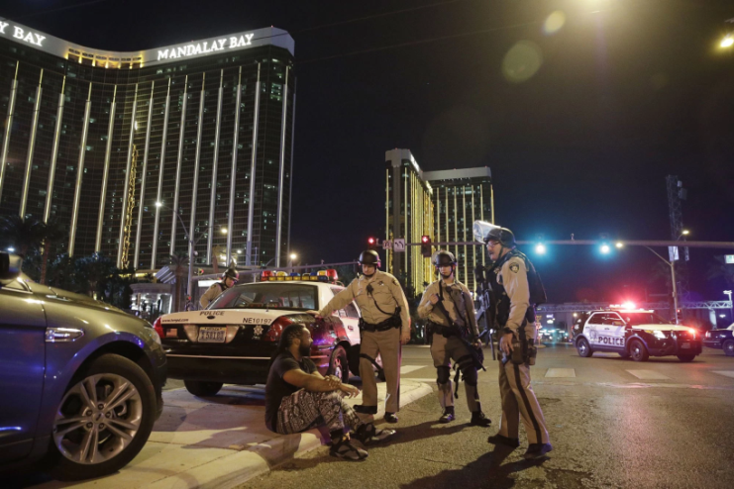
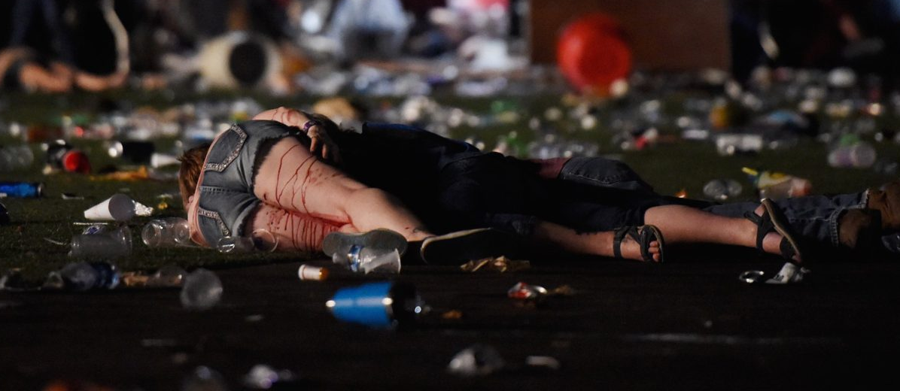
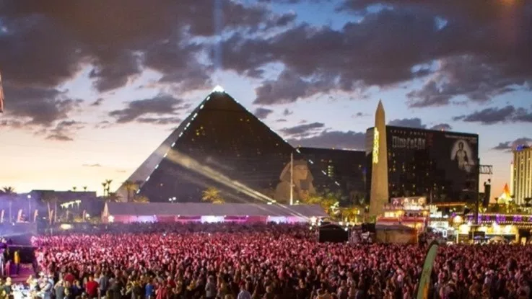
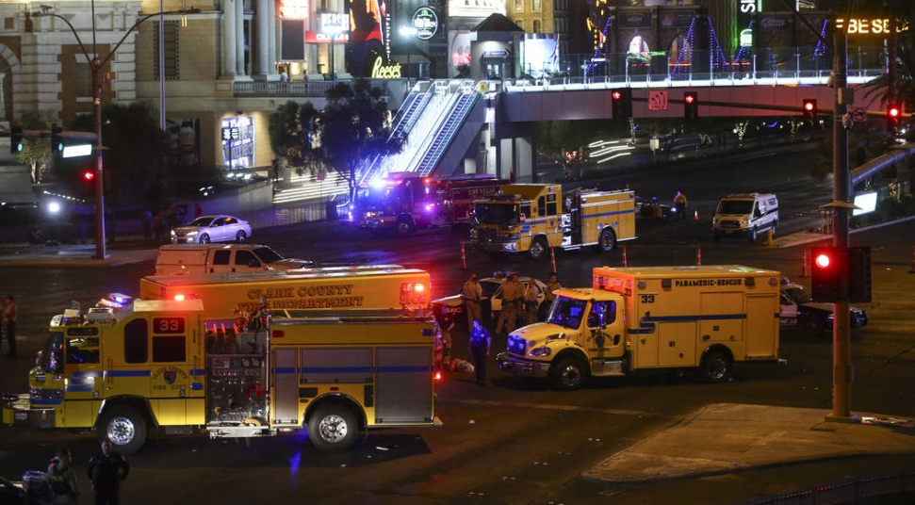
Las Vegas Response

Slide 7
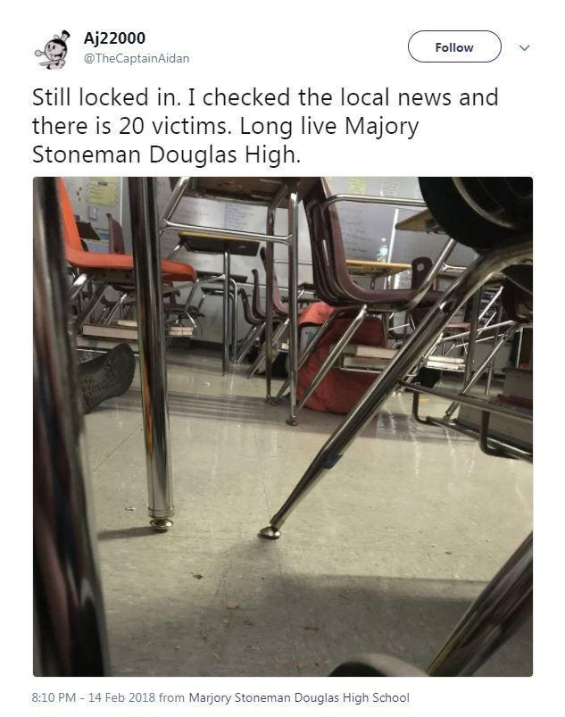
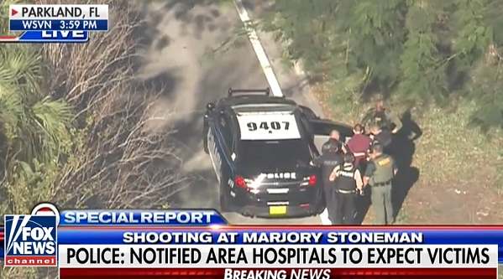
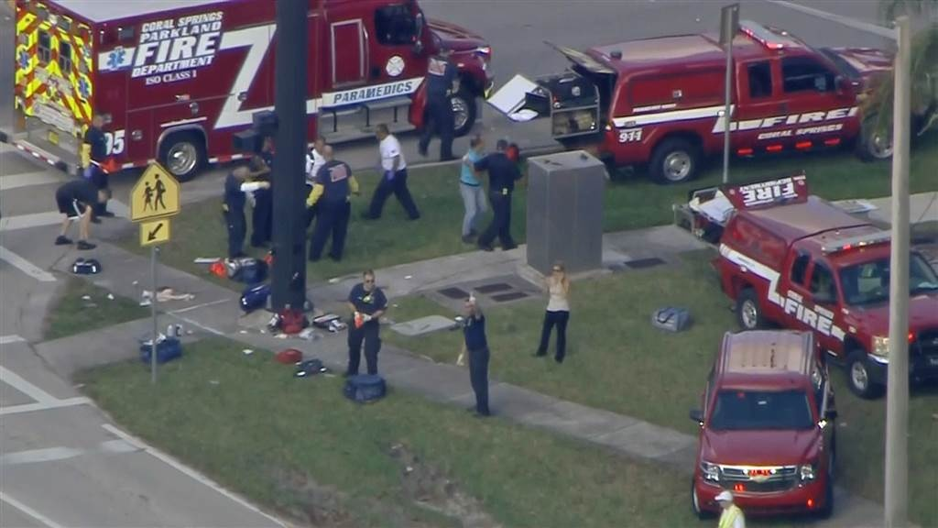
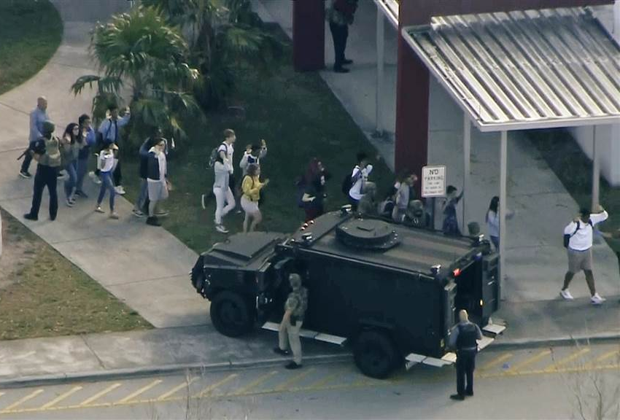
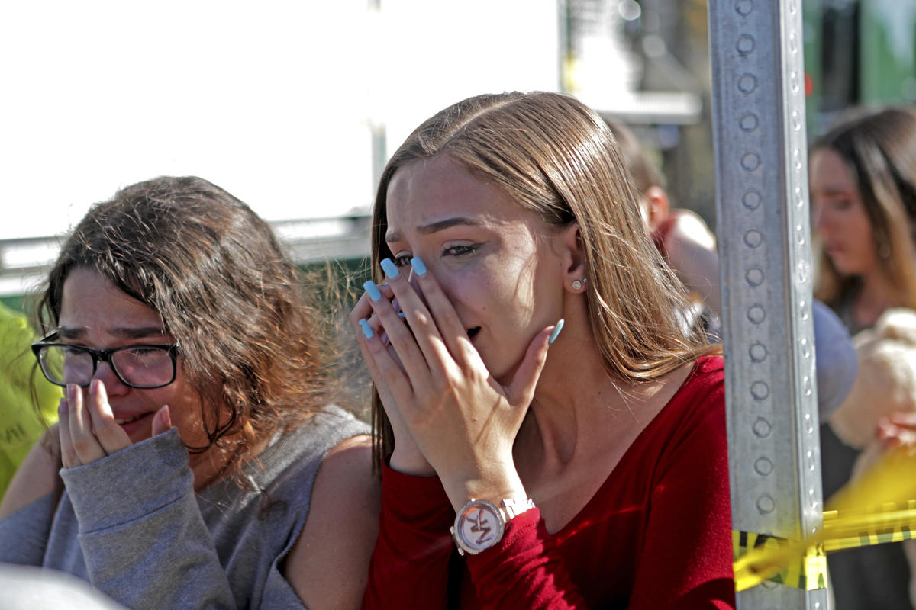
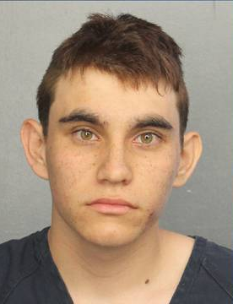
Marjory Stoneman Douglas High School Parkland, FL – February 14, 2018

Slide 8
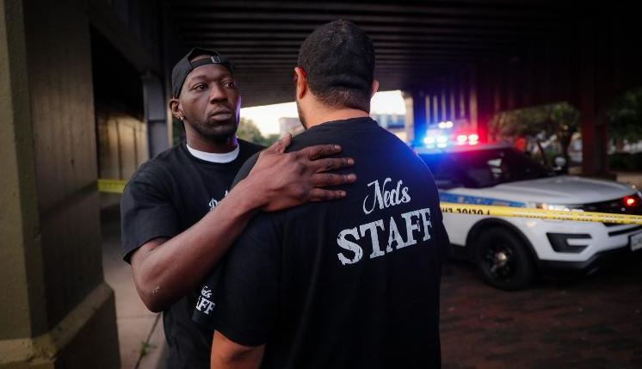
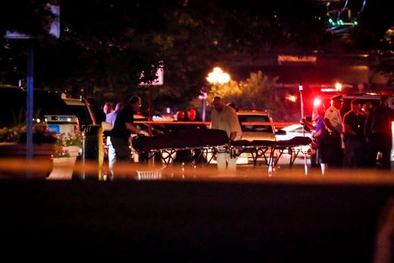
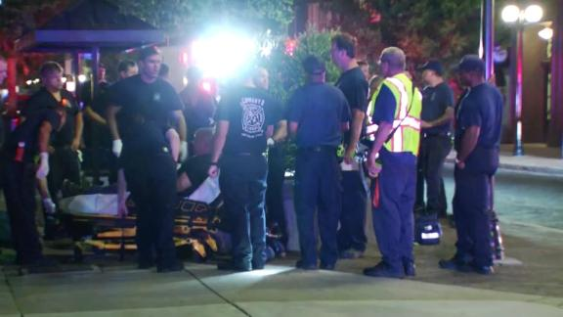
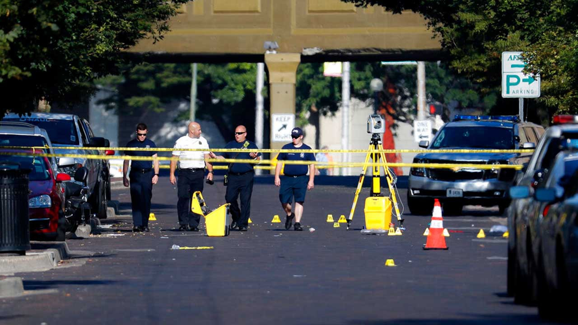
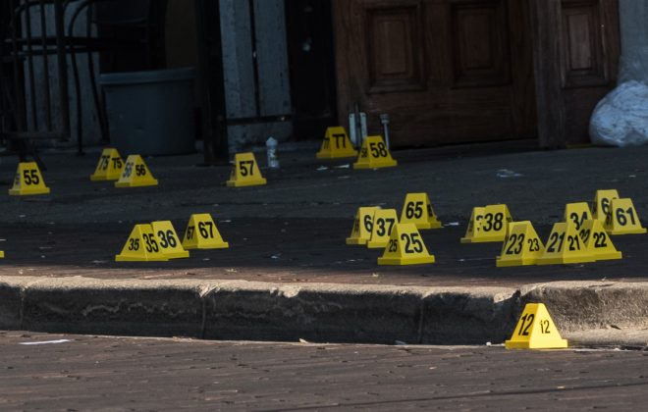
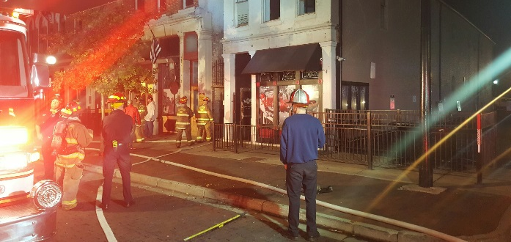
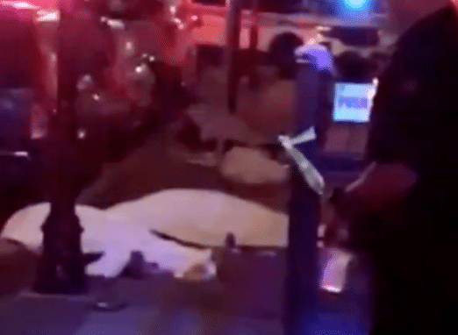
August 5th, 2019

Slide 9
Exercise Scope
Full Scale and Functional
State, County, and Local participation
Duration – Approximately four hours
Locations –
  Clark State Community College
    Greene Center
  Soin Medical Center
  Greene Memorial Hospital

Slide 10
Important Concerns
The exercise is as real as you make it!
Have a sense of urgency!
This is a large scale exercise
  Some areas or actions have to be simulated
Use ALL appropriate communications and redundant communications
Actually call and use all players
  Response may vary

Slide 11
Exercise Parameters
Multiple organizations participating
Exercise date is Sunday, April 30th
Exercise will run from approximately 11:30 AM – 3:30 PM
Exercise play will begin at 1 PM
Half-hour Hot Wash following
Lead-in scenario provided on Thursday, April 27th via e-mail

Slide 12
Exercise Parameters
Participants should be on location at least 30 minutes prior to start of exercise
Hospitals will receive multiple patients
EMS and hospitals will use Drill Triage Tags provided for exercise
Hospital will track patients with OHTrac
  Need to create OHTrac incident
    May use the 800 number for the ERS
  Update GDAHA Surgenet MCI Page and Juvare EMResource Page

Slide 13
SAFETY!
Most important concern
Safety Officer will conduct weapons check
Other than specific training weapons, no weapons of any kind are allowed in CSCC exercise area
  Includes firearms, ammunition, impact weapons, chemical spray, knives, and electrical weapons (i.e., Tasers)
Every participant in exercise area will be searched for unauthorized weapons

Slide 14
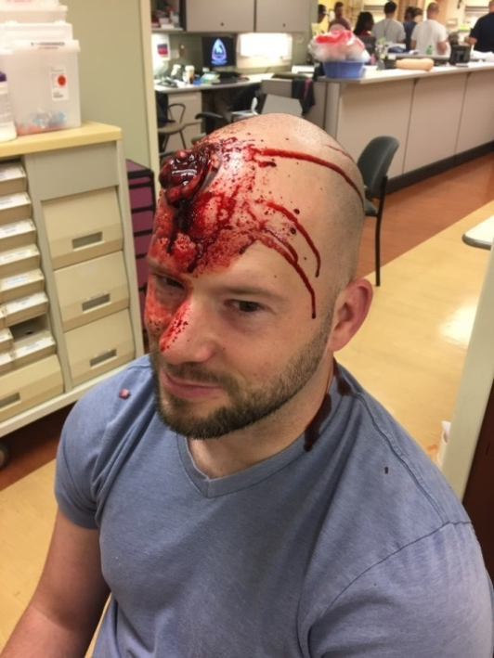
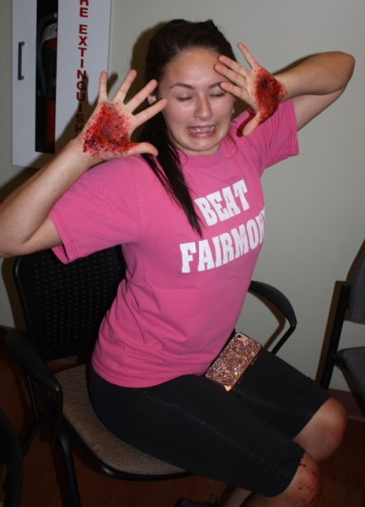
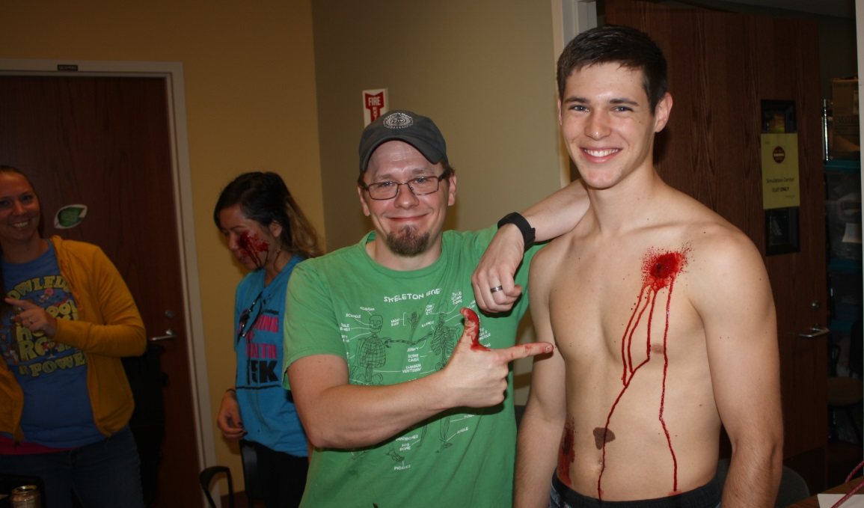
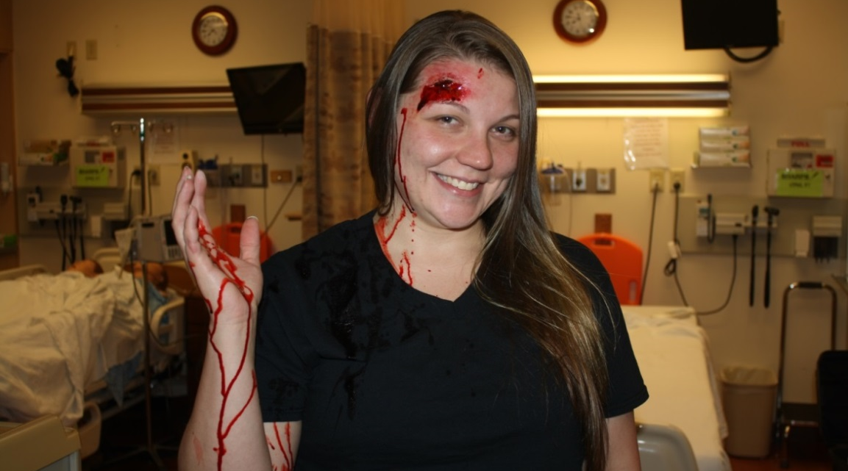
Exercise Assumptions
There will be moulaged actors as injured victims
  Treat them!
  But NO INVASIVE PROCEDURES (IVs, airway adjuncts, radiological examinations, etc.)

Slide 15

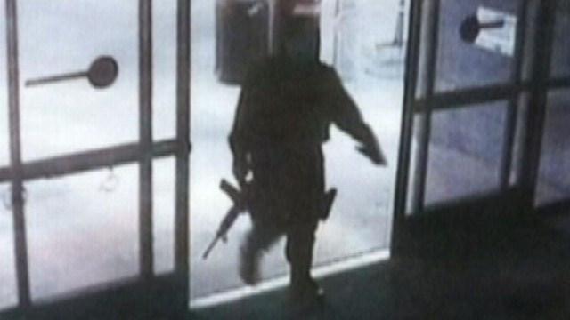
Scenario
Man enters CSCC and begins shooting visitors and faculty
An IED explodes
Numerous victims with some fatalities

Slide 16
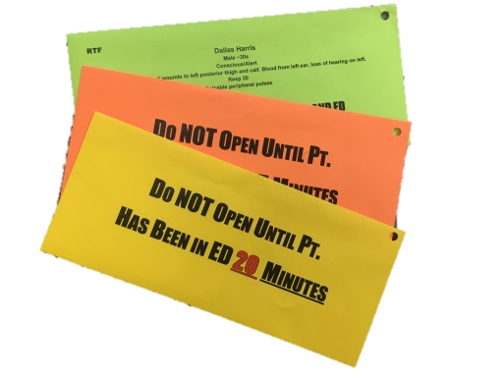
Victim Envelopes
Simulated victims will carry envelopes
  Inside envelopes is more information on patient condition
Envelopes will be color-coded based and labeled
Envelopes must NOT be opened until the time and location indicated

Slide 17
Victim Envelopes
    Purple
    Green
    Pink
    Yellow
    Orange
Victim envelopes will be labeled, e.g.:
  Do not open until after 20 minutes in ED
  Do not open until patient is in OR

Slide 18
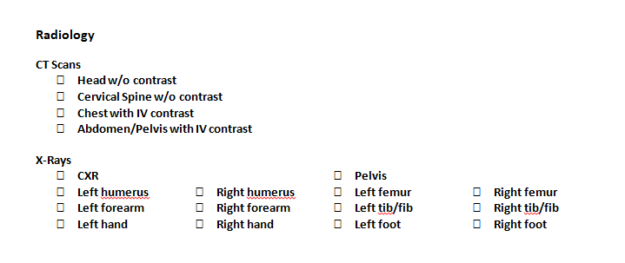
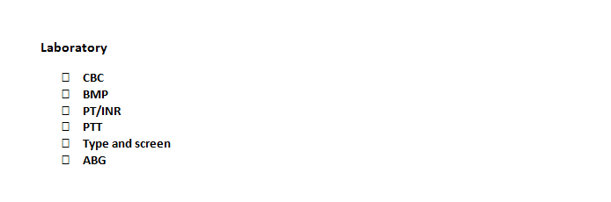
Labs and Imaging

Slide 19
Participants
Players
  Actively involved
Controller/Evaluators
  Initiate play/monitor response
  Identified with vests or badges
Actors/Volunteers
  Role play patients
Observers
Simulation Cell (SimCell)
  Injects information
  Responds to player requests
  Role plays for non-playing entities

Slide 20
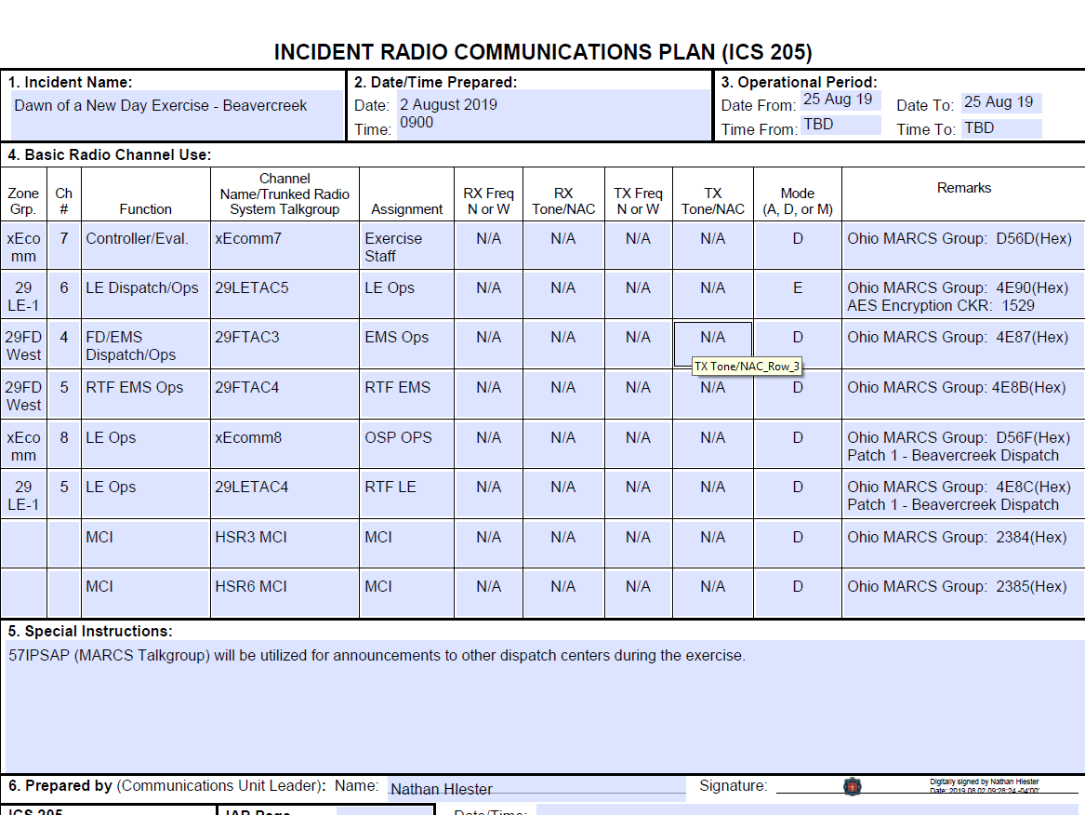
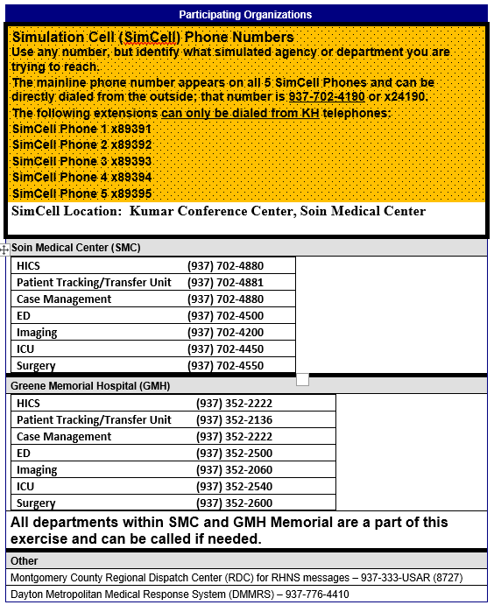
Communications Plan

Slide 21
All Communications
As practical, Players, Victims, and Controllers should say out loud “This is an exercise message.”

Slide 22
Communications
  Visitors
  Staff
  Patients!

Slide 23
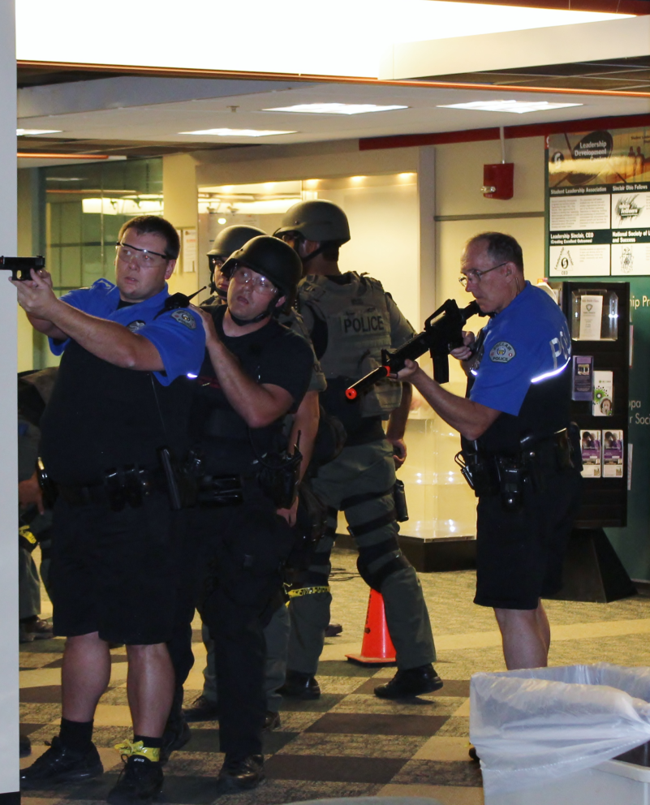
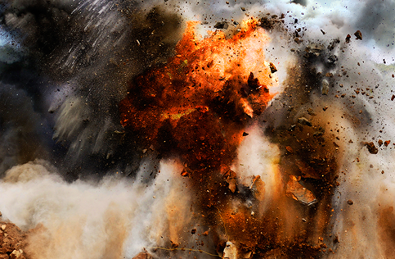
Communications:
Signage
Announcements
Explanations
  Explain sights and sounds and reassure that it’s just a training exercise

Slide 24
Communications
KH Media Liaison

Slide 25
Suspending or Terminating Exercise
In the event of a real emergency the player will inform the controller/evaluator with the phrase
“REAL WORLD EMERGENCY”
The controller/evaluator will forward the information to the Senior Controller, the Exercise Director, and the SIMCELL

Slide 26
Player Hot Wash
Immediately following end of play (ENDEX):
Complete a player hot wash
Controller/Evaluator will facilitate group discussion
What went well/needs improvement
Controller/Evaluator will document discussion on group feedback form
Participant Feedback forms will be circulated and collected

Slide 27
Player Reference Items
EXPLAN
Player Guide
Player “Phone Book” with Communications Plan

Slide 28
QUESTIONS?
Email: david.gerstner@daytonohio.gov jordan.marsh@daytonohio.gov william.rose@daytonohio.gov

Slide 29
THANK YOU FOR PARTICIPATING!
PLEASE COMPLETE THE FEEDBACK FORMS AFTER THE EXERCISE!

