Slide 1
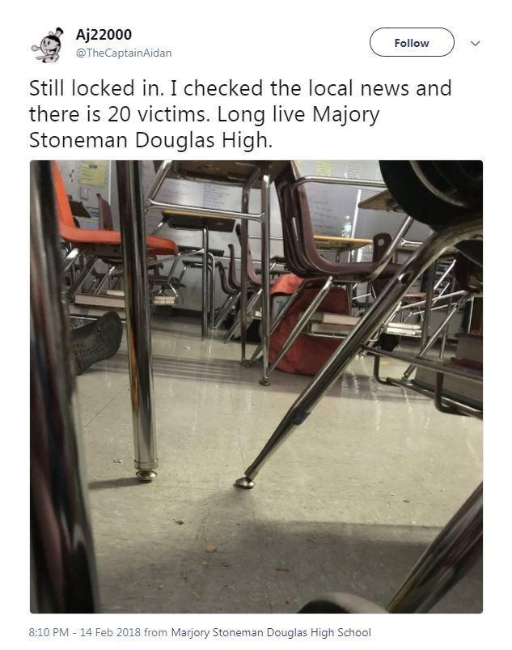
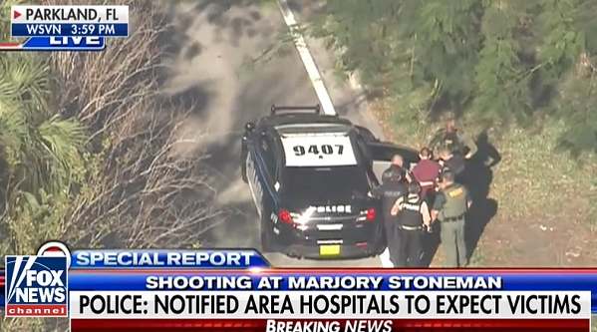
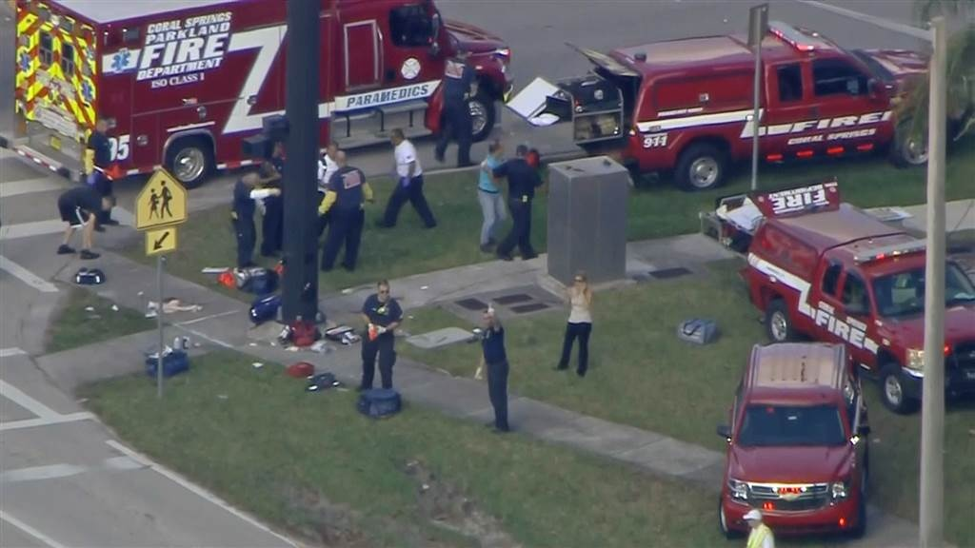
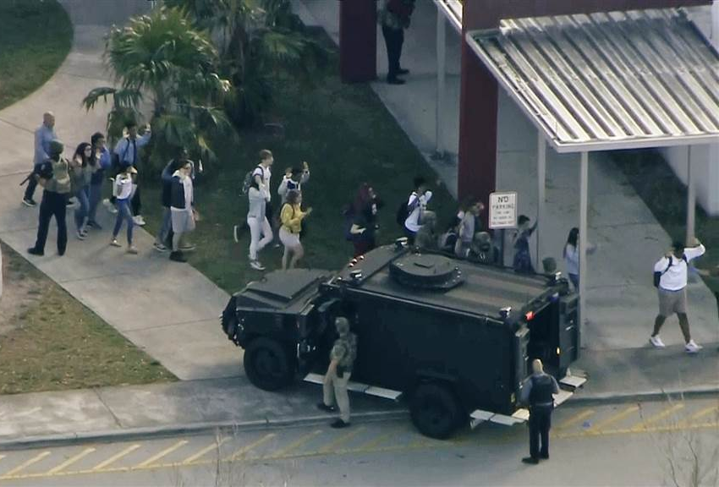
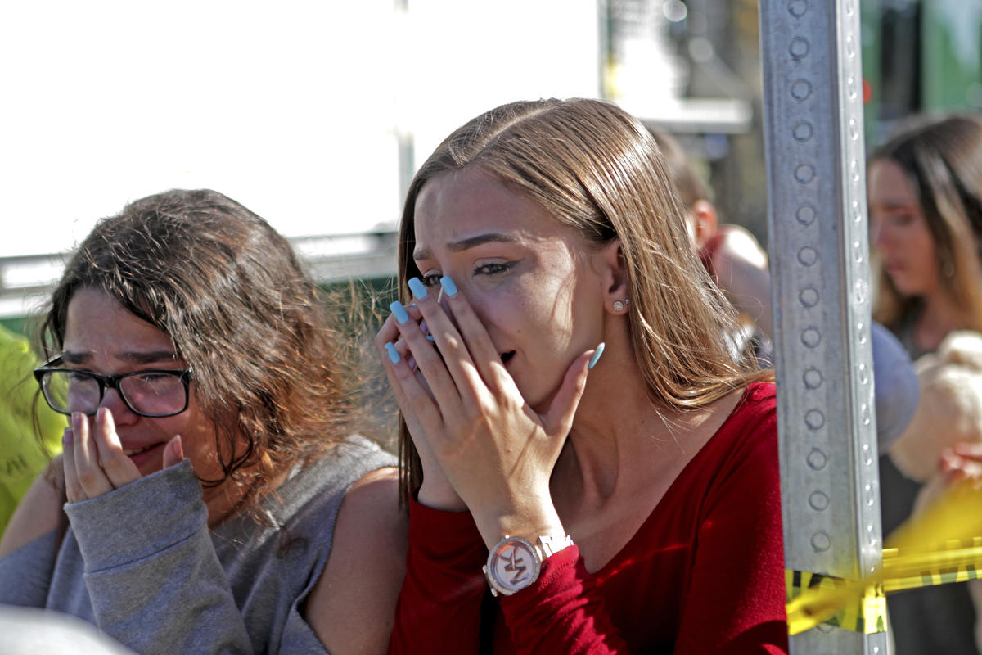
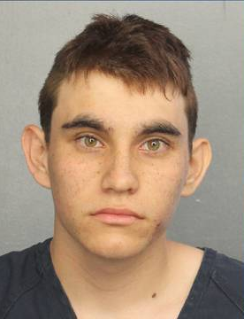

Marjory Stoneman Douglas High School Parkland, FL – February 14, 2018

Slide 2
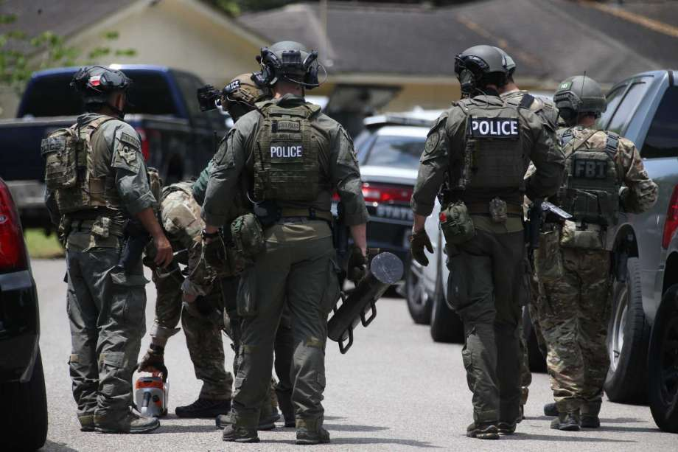
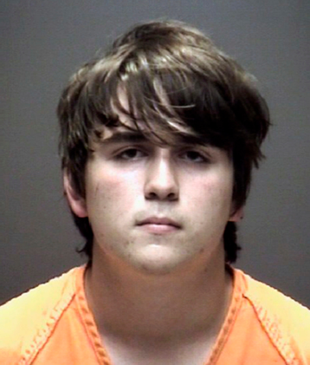
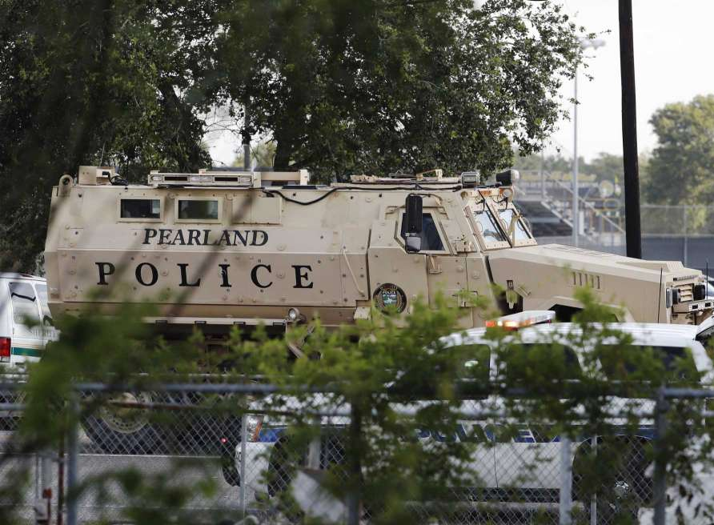
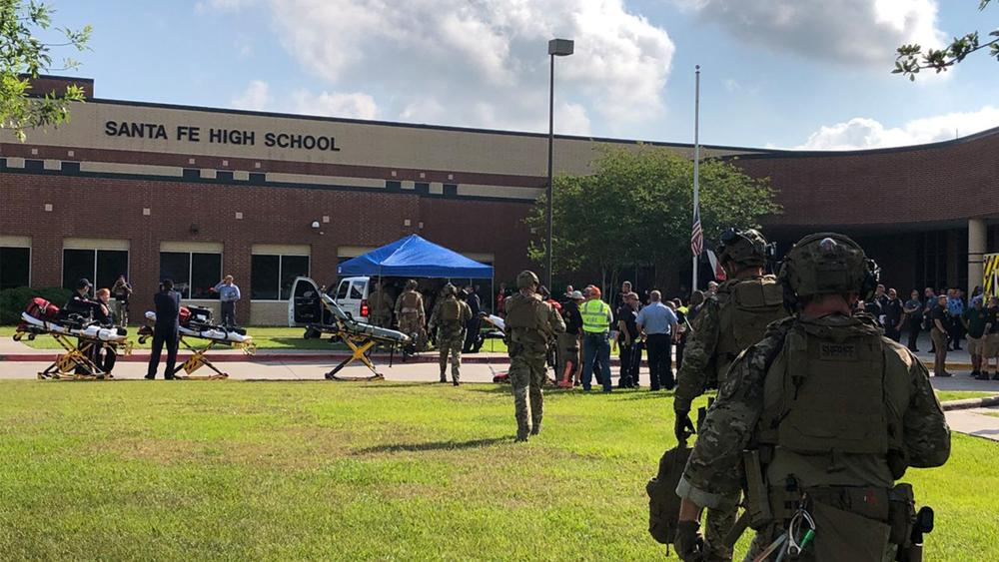
Santa Fe
High School
Santa Fe, TX
May 18, 2018
Notes:
Sante Fe shooter

Slide 3

Cincinnati, OH
September 6th, 2018

Slide 4
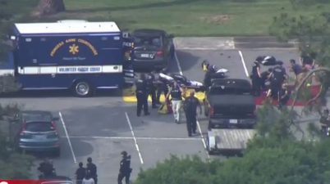
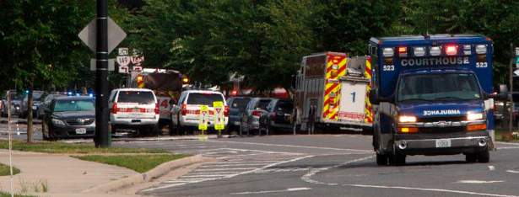
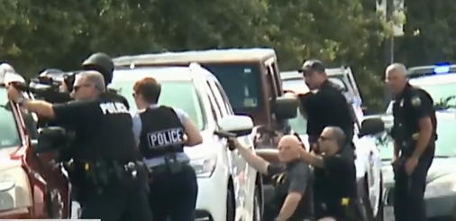
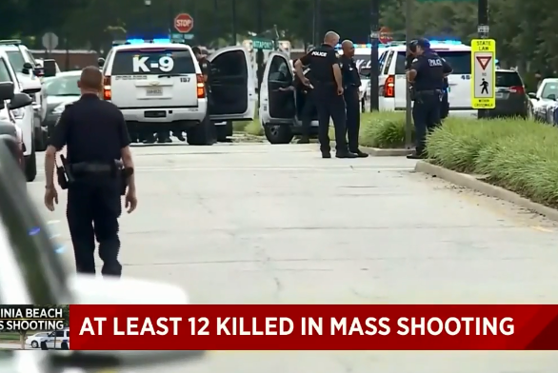
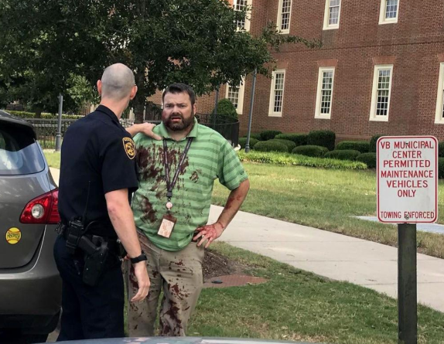
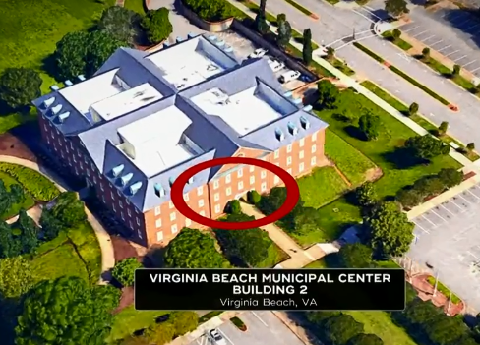
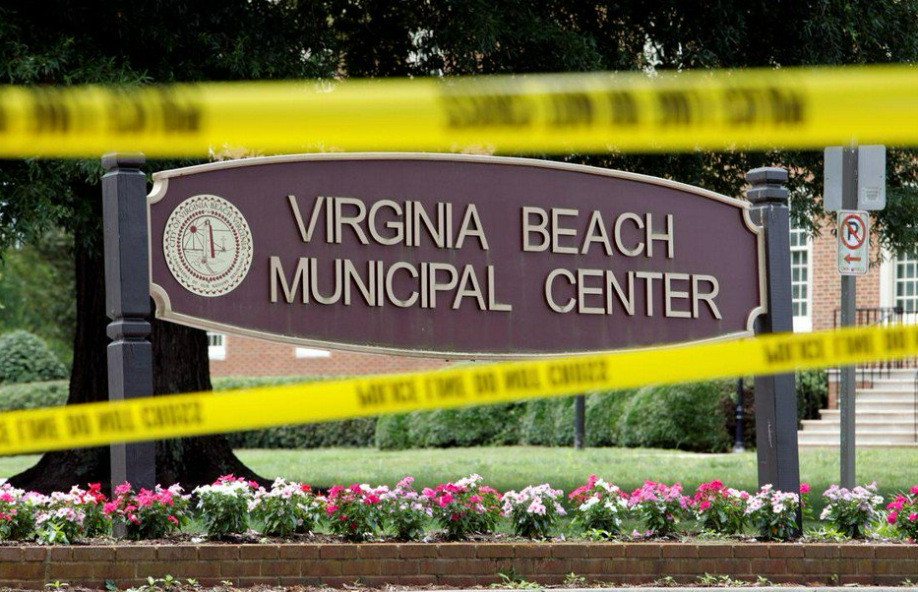
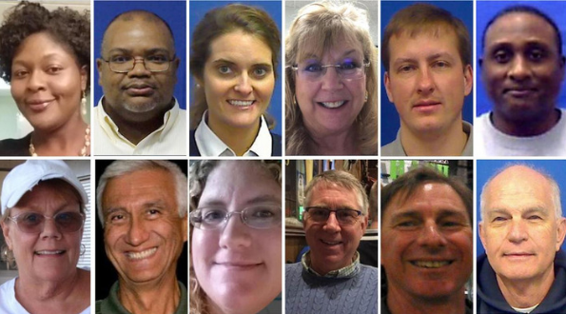
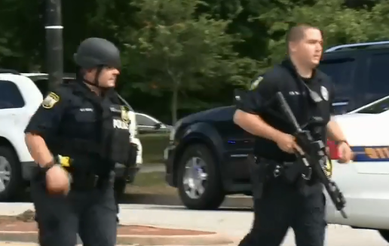

May 31st, 2019

Slide 5


Dawn of a New Day Player Pre-brief
Full Scale Exercise
Saturday, June 8th, 2019, 8:00AM-12:00PM
City of Sidney
Presented by:
David Gerstner
Dayton MMRS Coordinator

Slide 6
OVERVIEW:
Exercise Parameters
Exercise Objectives
Participants
Rules of Conduct
Full-scale vs. Functional
Communications (Who and How)
Suspending or Terminating Exercise
Player Hot-wash/Debrief
This is a non-funded exercise.

Slide 7

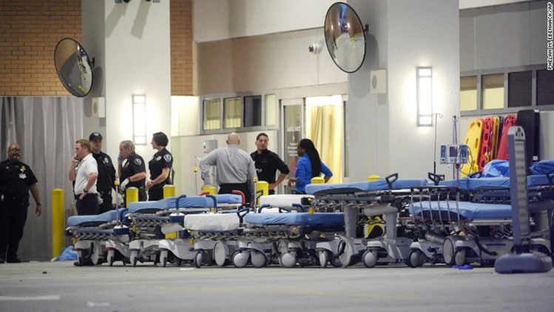
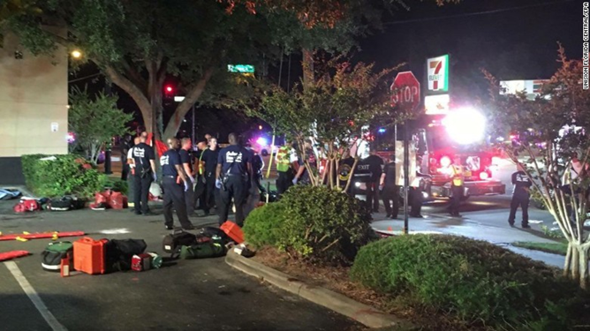
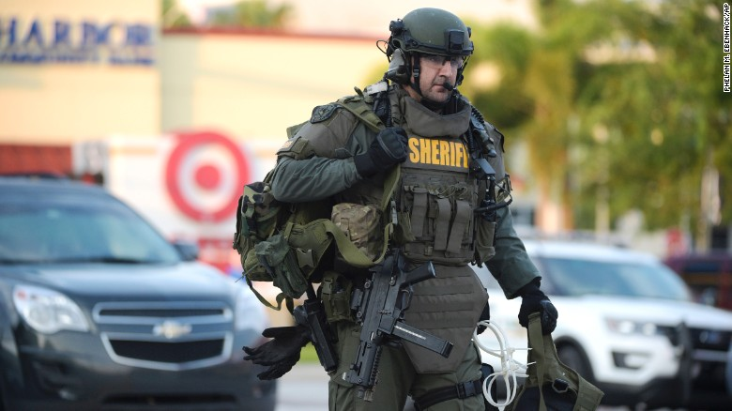
Orlando Response

Slide 8
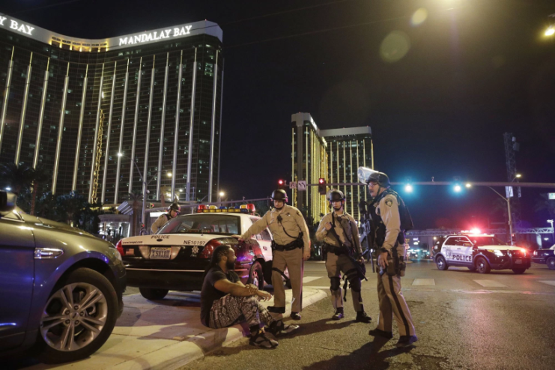
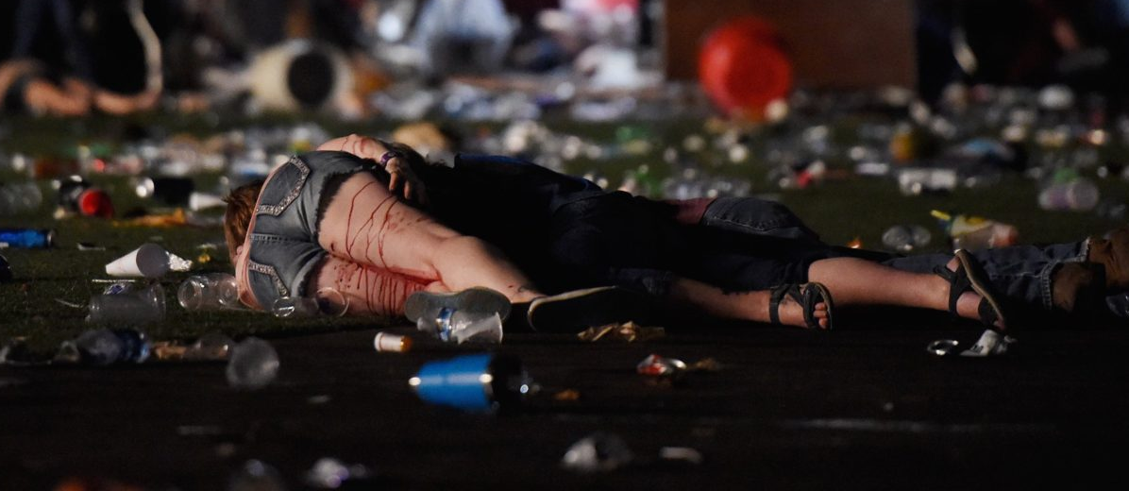

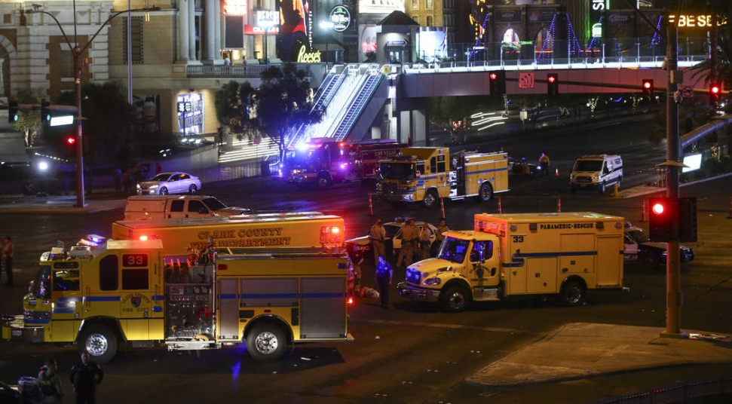
Las Vegas Response

Slide 9
Exercise Scope
Exercise type – Full Scale and Functional
Participation level – State, County, and Local
Exercise duration – Approximately three hours
Exercise locations –
  Sidney-Shelby County Health Department
  Wilson Memorial Hospital

Slide 10
Important Concerns
The exercise is as real as you make it
Have a sense of urgency
This is a large scale exercise
Some items have to be simulated
Use appropriate communications and redundant communications
Actually call and use all players
  Response may vary

Slide 11
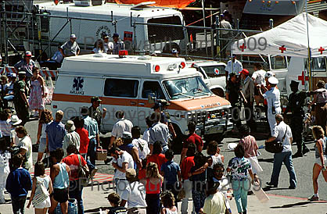
Exercise Capabilities &Objectives

Slide 12
Capabilities and Objectives
Objective | HPP Capabilities Addressed | Target Capabilities
Assess plans and capabilities governing on-scene command, the Hospital Command Center (HCC), and Unified Command (UC). Determine capabilities to coordinate and integrate diverse response resources, establish adequate medical surge, and effectively track patients. Assess the ability to establish and maintain both internal and multiagency communications in response to an active shooter, terrorist, or other major mass casualty incident (MCI). Identify critical issues and potential solutions. | Foundation for Health Care and Medical Readiness | Planning Communications Community Preparedness and Participation On-Site Incident Management
Asses the activation and utilization of plans and coordination through effective communication: on scene, from scene to hospital, within the hospital, and with other personnel, hospitals, and agencies. Examine the ability of the staff to activate and monitor all hospital response systems. Assess the ability of the hospital to effectively triage, and coordinate appropriate medical and surgical care. Determine the ability of the hospital to mobilize resources and staff to any necessary location. Utilize tools that allow for effective patient tracking. Assess management of patient lab/imaging results. Ensure effective security measures are taken within the hospital. Determine that potential evidence of the incident would be preserved for law enforcement. Identify critical issues and potential solutions to those issues. | Health Care and Medical Response Coordination | Communications Responder Safety and Health Triage and Pre-Hospital Treatment
Assess logistics, emergency procurement, and distribution of critical resources, and the impacts of delays. Examine procedures to assist patients after discharge and policies regarding communication with families. Determine the ability to manage deceased victims. Determine shortcomings in local medical and surgical capabilities to treat casualties resulting from a terrorist incident. Assess the capability of a Health Record to effectively track patients. Identify critical issues and potential solutions. | Continuity and Health Care Service Delivery | Responder Safety and Health Emergency Public Safety and Security Medical Surge
Assess the ability to implement surge plans. Assess strategies used to enhance capacity in a stressed environment. Assess allocation of resources for expectant patients. Identify critical issues and potential solutions to those issues. | Medical Surge | Planning Medical Surge
Table 1. Exercise Objectives and Associated Core Capabilities

Slide 13
Exercise
Parameters

Slide 14
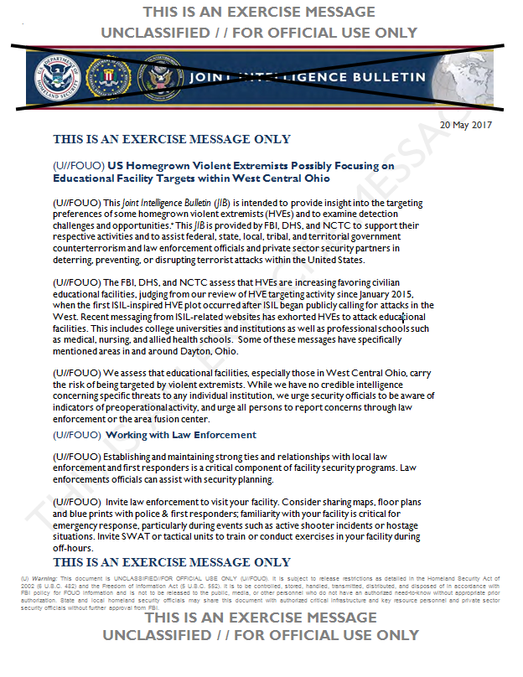
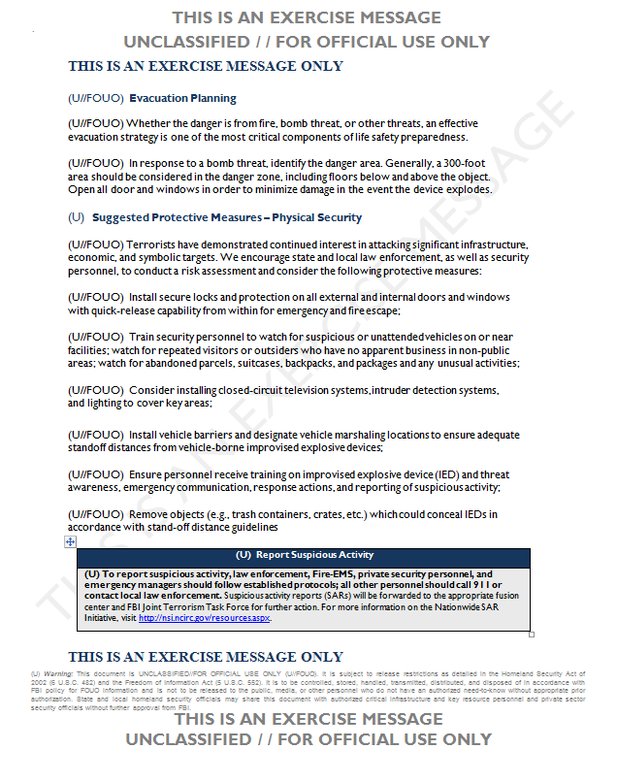
THIS IS AN EXERCISE MESSAGE: Simulated Joint Intelligence Bulletin

Slide 15
Exercise Parameters
Multiple organizations participating
Lead-in scenario provided on Wednesday, June 5th via e-mail
Exercise date is Saturday, June 8th
Exercise will run from approximately 8:00 AM – 11:30 AM
Hospital play will begin at ~9 AM
Half-hour Hot Wash following

Slide 16
Exercise Parameters (continued)
Participants should be on location 30 minutes prior to start of exercise
Hospital will receive multiple patients
EMS and Hospital will use Drill Triage Tags provided for exercise
Hospital will track patients with OHTrac
  Need to create OHTrac incident
  Update GDAHA Surgenet MCI Page

Slide 17
Player Rules of Conduct

Slide 18
SAFETY!
Most important concern
Safety Officer will conduct weapons check
Other than specific training weapons no weapons of any kind are allowed in Sidney-Shelby County Health Department exercise area
  Includes firearms, ammunition, impact weapons, chemical spray, knives, and electrical weapons (Tasers)
Approved training weapons may include blanks, simulated firearms, guns rendered inoperable or inert blue guns
Every participant in Testing Center exercise area will be searched for unauthorized weapons

Slide 19
Exercise Assumptions
The exercise will be conducted in a no-fault learning environment wherein systems and processes, not individuals, will be evaluated
The exercise scenario is plausible, and events occur as they are presented
Exercise simulation contains sufficient detail to allow players to react to information and situations as they are presented as if the simulated incident were real
Only those agencies listed in the Player Directory (and their personnel) may be contacted during the exercise
All departments and personnel at Wilson Hospital, including HICS, may be called at any time
Use the SimCell for all others

Slide 20
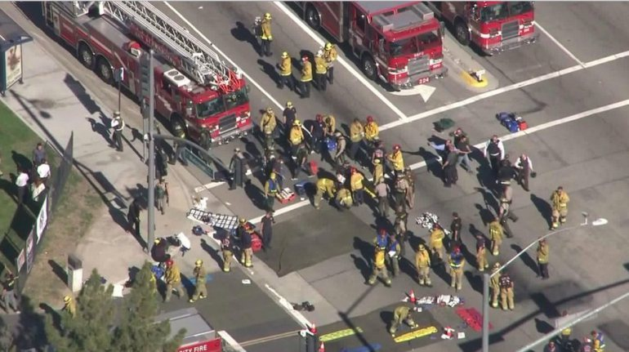
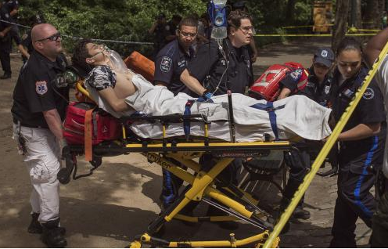
Full-scale versus Functional
Based on the scale of the exercise there will be multiple simulations
Most areas will feel like a full-scale exercise (Scene, ED, OR, etc.)
Sometimes, you will play only to the level of a functional exercise

Slide 21
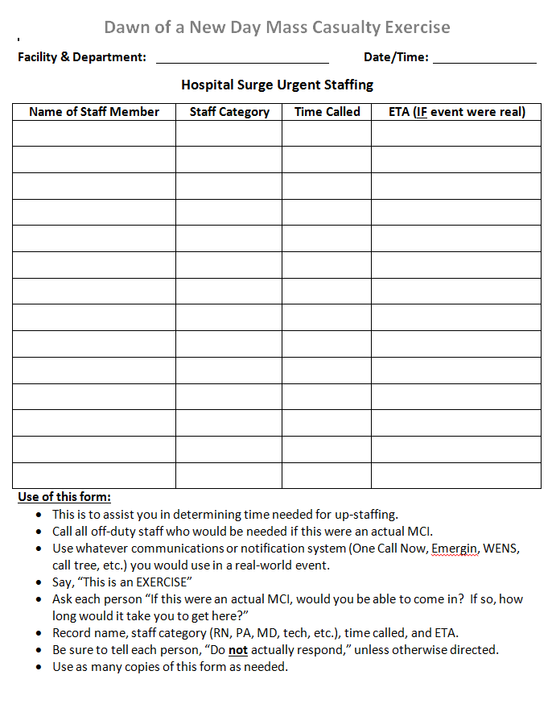
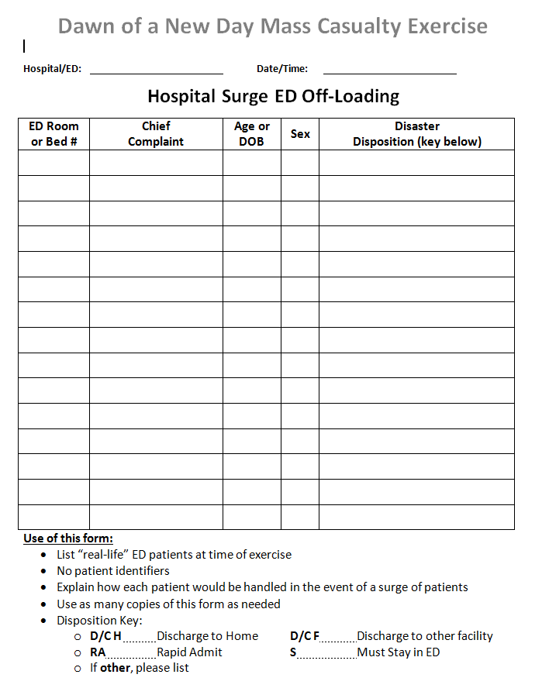
Surge Forms

Slide 22
What is a Functional Exercise?
A functional exercise simulates a disaster in the most realistic manner possible, short of moving real people and equipment to a real site, e.g.:
  Calling off-duty personnel and asking how long it would take them to respond, vs. actually having them come in
    Document the answer!
  Calling other hospitals to ask for resources or ask if they can accept patients

Slide 23

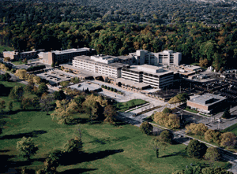

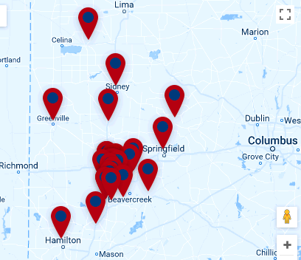





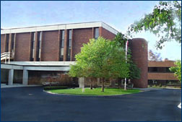
  Calling hospitals who are playing at the functional level is crucial:
  A major MCI is a community and REGIONAL event!
  Get out of your silos!
  (But don’t be surprised if they’re overwhelmed, too)

Slide 24
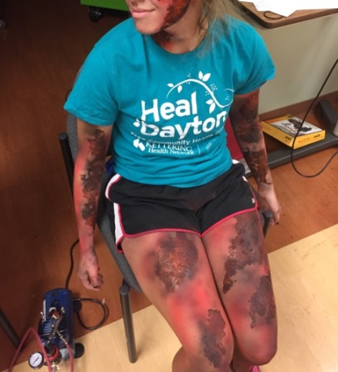
Exercise Assumptions
Use your agency’s plans, policies, processes, and procedures as well as individual judgments in determining how to respond
To the greatest degree feasible, respond as you would during an actual event
Participating agencies may need to balance exercise play with real-world emergencies. Real-world emergencies take priority
Simulation will be used at times during the exercise
Exercise simulation will be as realistic and plausible as possible in the exercise

Slide 25
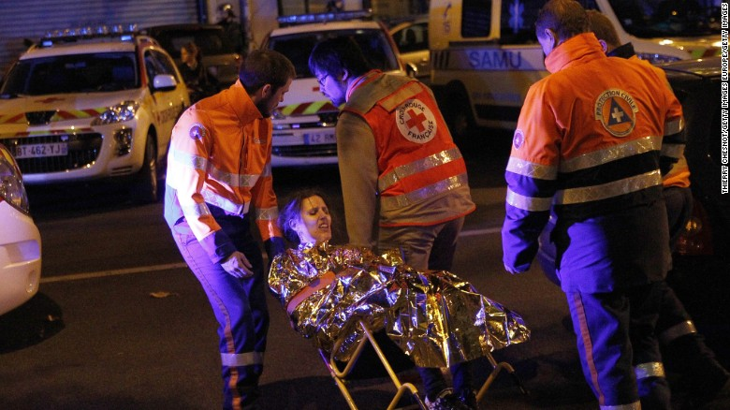
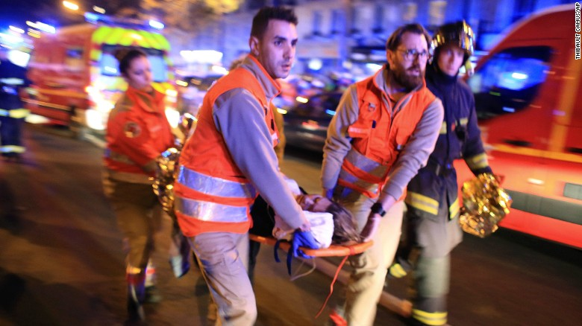
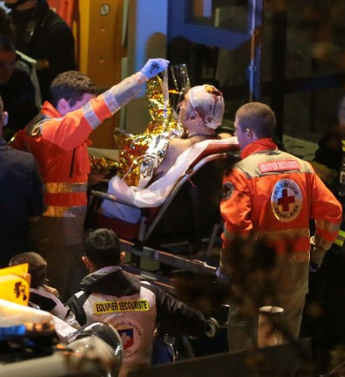
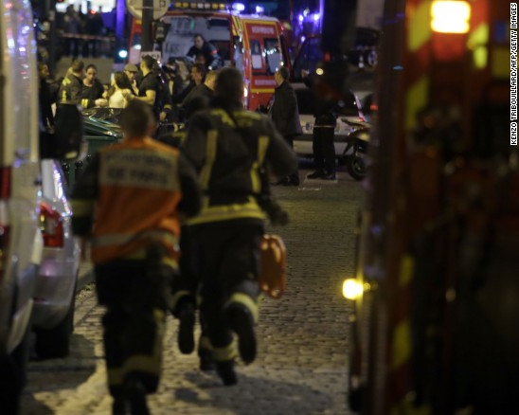
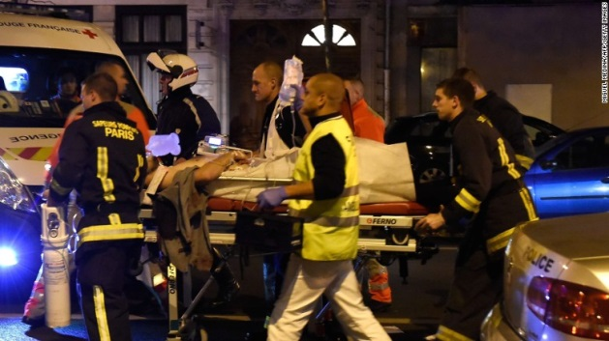
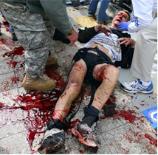
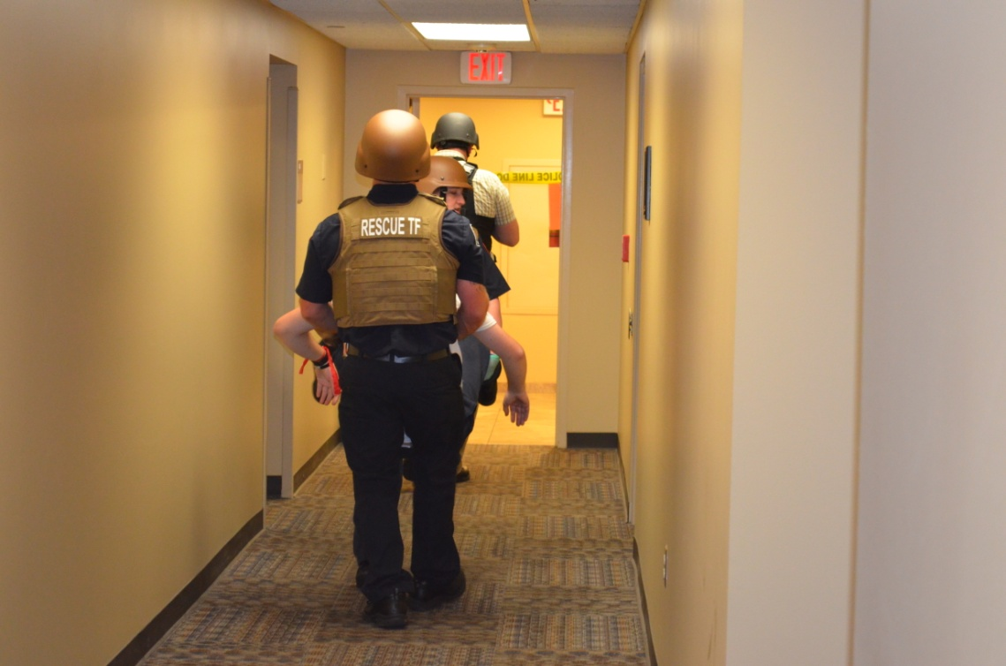
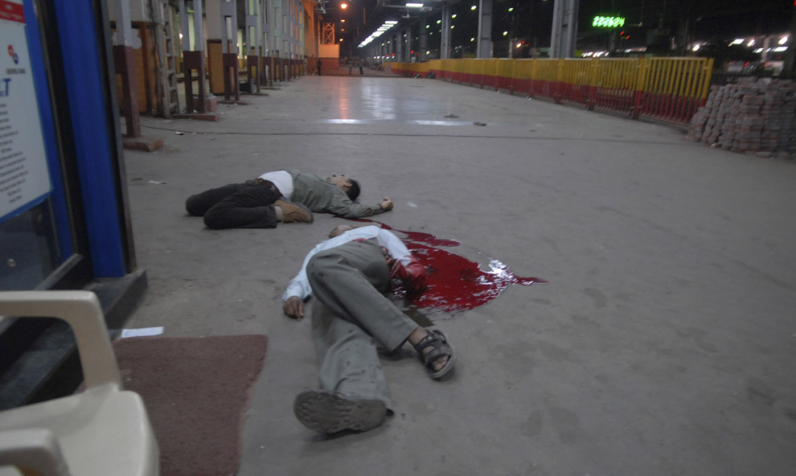

Slide 26
Exercise Assumptions
Players will actually send patients to playing areas!
Players must make all phone calls necessary for this exercise.
DO NOT simulate phone calls! If you need something make the call!
Virtually all areas of the hospital are playing, and you should use the SimCell for anyone else!
Personnel called at home should be asked how long it would take to respond, but TOLD NOT TO ACTUALLY COME TO THE HOSPITAL unless directed by their supervisor
If you are uncertain about something, ask your supervisor, a Controller, or the SimCell.

Slide 27
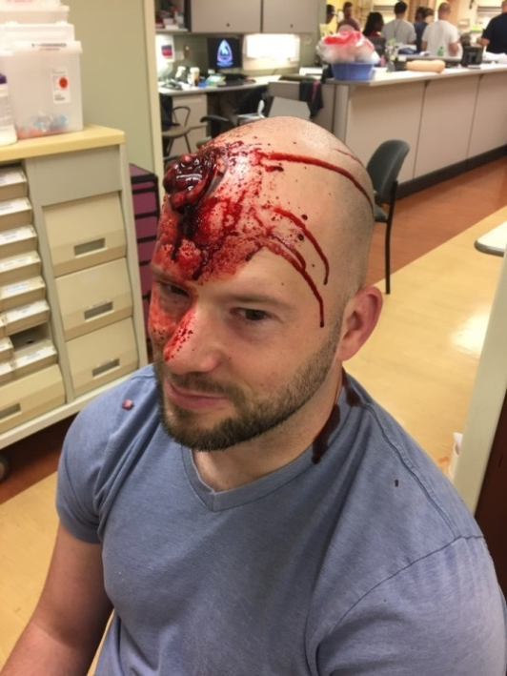
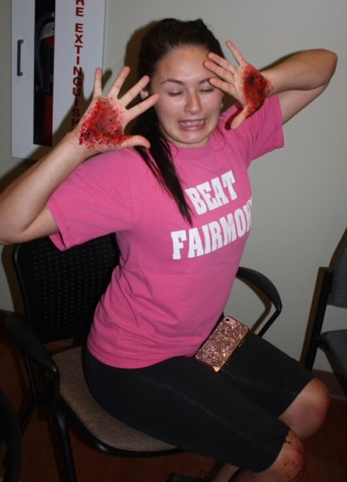
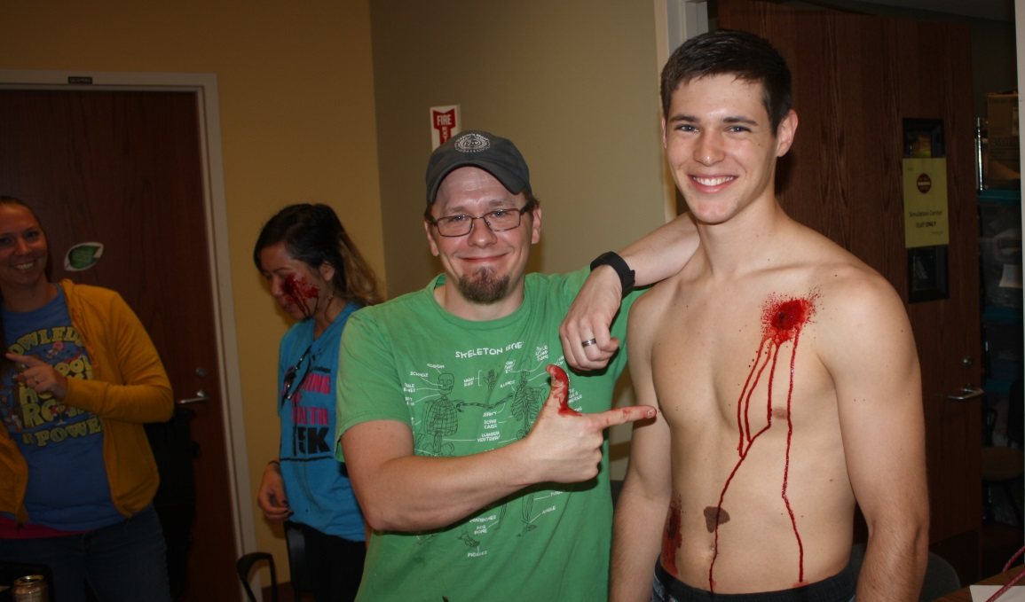
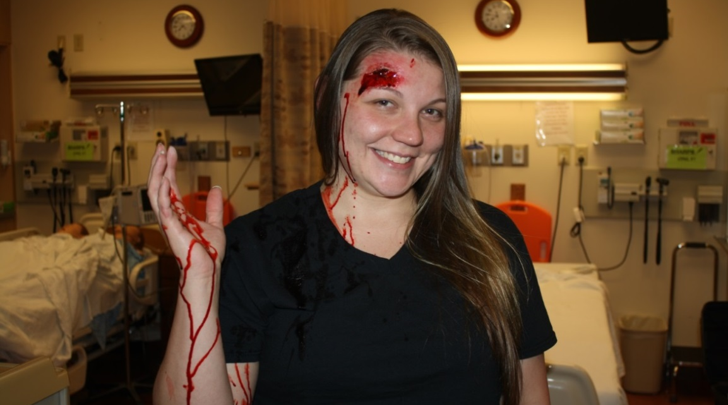
Exercise Assumptions
There will be moulaged actors as injured victims
  Treat them!
  But NO INVASIVE PROCEDURES (IVs, airway adjuncts, radiological examinations, etc.)

Slide 28

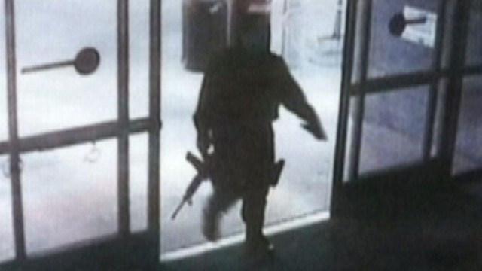
Scenario
Man enters a building and begins shooting visitors and faculty
An IED explodes
Numerous victims with some fatalities

Slide 29
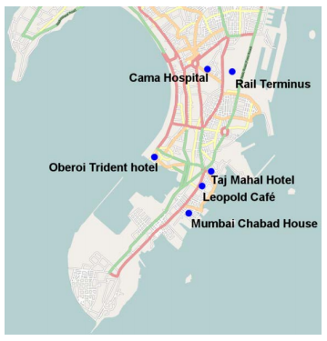
Scenario
This attack is part of a Complex Coordinated Terrorist Attack (CCTA)
  Opportunities to transfer patients to other hospitals may be limited
Sites of the Mumbai 2008 CCTA

Slide 30


Law Enforcement Agency Activities:
Likely first of the first responders to arrive on the “scene”
Locate and stop perpetrator(s)
Participate with EMS in Unified Command structure

Slide 31


Law Enforcement Agency Activities:
Command structure
Traffic control
Site and perimeter security
Protection for other responders
Communications structure and interoperability plan

Slide 32
Fire and EMS Agency Activities:
Command structure
  Participate with Law Enforcement and others as Unified Command Develops
Rescue Task Force
  Warm Zone triage and patient care (LSIs)
Communications structure and interoperability plan

Slide 33
Fire and EMS Agency Activities:
Simulate determinations of where patients are to be transported
  For EMS on scene, ALL Victim-Actors will go ONLY to Wilson Memorial However, Transport Officer and aide:
  Will use MCI Talk Group to determine hospital capabilities
    Limited to hospitals listed in Player Phone Book
    Use Sim Cell for all others – radio call SimCell & Hospital Name
  Act as if ALL hospitals are available
  Simulate appropriate patient distribution
  *There will be a Sidney SWAT van to transport 5-6 “walking wounded” victims to WMH to act as walk-ins to the ED.

Slide 34
Fire and EMS Agency Activities:
Regional Hospital Notification System
Triage patients
Transport patients
  Green Drill Triage Tags will be used for the exercise, and will be provided

Slide 35
Wilson Hospital Activities:
Command structure
Triage patients
  Expect walk-ins as well as transports from EMS

Slide 36
Areas of Play & Command Issues
Command Key Points
Follow ICS/HICS structure
Avoid tunnel vision
Be proactive not reactive
Communicate with organizational partners

Slide 37
Wilson Hospital and EMS Activities:
Treat patients
  Patients should actually move to all playing areas of the hospital as necessary
    Player Directory
  Moulaged actors as injured victims;
    NO INVASIVE PROCEDURES (IVs, airway adjuncts, radiological examinations, etc.)
May also be actors simulating other roles (e.g., family members, press, etc.)
As practical, Players and Controllers should say out loud “This is an exercise message.”

Slide 38

Dayton MMRS Triage Ribbon Kit
Triage Ribbon is principal indication of the patient’s category
Use Ribbons to attach the Tags
If Triage Category changes:
  change the ribbon!
But keep the same Tag

Slide 39

Dayton MMRS Triage Materials
Multiple versions of Triage Tags:
  “Live” tags are White
    Synthetic paper
    Bar codes, numbers, & RFID tags
  Only for “real world” use:
    Actual MCIs

Slide 40



Slide 41



Slide 42

Victim Envelopes
Simulated victims will carry envelopes
  Inside envelopes is more information on patient condition
Envelopes will be color-coded based and labeled
Envelopes must NOT be opened until the time and location indicated

Slide 43
Victim Envelopes
    Purple
    Green
    Pink
    Yellow
    Orange
Victim envelopes will be labeled, e.g.:
  Do not open until after 20 minutes in ED
  Do not open until patient is in OR

Slide 44


Labs and Imaging

Slide 45



Labelling
Dawn of a New Day
Pt. Name
Pt. #
Tourniquet
Time:________
FAST Exam
Time:________
IV Start
Time:________
Chest Tube
Time:________
Packed RBCs
Time:________

Slide 46
OR Cards
[Patient Name] [Reference #] The purpose of this card is to help you realistically think through issues involved, including timelines, personnel availability, equipment availability, and clinical decision-making needed in a large MCI. P:____ BP: ____/____ R:____ SpO₂:____ GCS – E: ___ M:___ V:___ [Victim Condition] Priority of this patient for surgery (circle one): High Moderate Low Time surgery started: ___________________ Estimated surgical end time: _____________ What would you anticipate is the optimal surgical procedures if this were a single victim incident: __________________________________________________________ __________________________________________________________ What surgical procedures would you opt for instead for this patient in a major mass casualty incident (MCI) with limited resources? __________________________________________________________ __________________________________________________________ Any personnel not on site should be called. The time of the call for each, and the estimated time of arrival (make sure to say, “This is an exercise” and tell them NOT to actually come to work!) should both be listed on the opposite side. | [Patient Name] [Reference #] SURGICAL RESOURCES OR #:____ Anesthesiologist/Anesthetist Name: ______________________ Onsite or Called in? (Circle) If called in, time called/ETA given: ____ /____ Surgeon Name: ______________________ Onsite or Called in? (Circle) If called in, time called/ETA given: ____ /____ Specialty Surgeon Name & Specialty Name: ______________________ Onsite or Called in? (Circle) If called in, time called/ETA given: ____ /____ Specialty: ______________________ Additional surgeon/physician Name: ______________________ Onsite or Called in? (Circle) If called in, time called/ETA given: ____ /____ Specialty: ______________________ RN1 Name: ______________________ Onsite or Called in? (Circle) If called in, time called/ETA given: ____ /____ RN2 Name: ______________________ Onsite or Called in? (Circle) If called in, time called/ETA given: ____ /____ PA/APRN Name: __________________ Onsite or Called in? (Circle) If called in, time called/ETA given: ____ /____ Other personnel: _________________ Onsite or Called in? (Circle) If called in, time called/ETA given: ____ /____ Anesthesia Machine: __________ Major Procedure Tray: __________ Vascular Surgical Tray: ____________

Slide 47
Participants

Slide 48
Participants
Players
  Actively involved
Controller/Evaluators
  Initiate play/monitor response
  Identified with vests or badges
Actors/Volunteers
  Role play patients
Observers
Simulation Cell (SimCell)
  Injects information
  Responds to player requests
  Role plays for non-playing entities

Slide 49
Participating Organizations
Wilson Memorial Hospital
City of Sidney
Sidney Fire and Rescue
Sidney PD
Shelby County Sheriff’s Office and other law enforcement agencies
Regional MMRS Rescue Task Force
Montgomery County Regional Dispatch (RDC) and others
Other hospitals as functional players (via SimCell)

Slide 50

Communications Plan

Slide 51
Communications Plan
Methods below are approved for usage during the Dawn of a New Day MCI exercise:
  Cell Phones
  Landlines
  RHNS (Regional Hospital Notification System)
  MARCS (Multi-Agency Radio Communications System)
  Other radio systems
  GDAHA Surgenet MCI web page
  OHTrac
  Satellite phones
  All internal communications (e.g. paging and notification systems)

Slide 52
Exercise Assumptions
All systems such as OHTrac, the Communicator, GDAHA Surgenet, the Regional Hospital Notification System, and any and all hospital communications systems are available for use during the exercise

Slide 53
All Communications:
Begin with “This is an Exercise Message”
To include:
  Phones (landline and cellphones)
  Radios
  E-mail
  Faxes
  Even in person when within the hospital!

Slide 54
All Communications
As practical, Players and Controllers should say out loud “This is an exercise message.”

Slide 55
Communications &
  Visitors
  Staff
  Patients!

Slide 56


Communications:
Signage
Announcements
Explanations
  Explain sights and sounds and reassure that it’s just a training exercise

Slide 57
Communications
Wilson Hospital Media Liaison

Slide 58
Suspending or Terminating Exercise

Slide 59
Suspending or Terminating Exercise
In the event of a real emergency the player will inform the controller/evaluator with the phrase
“REAL WORLD EMERGENCY”
The controller/evaluator will forward the information to the Senior Controller and the SIMCELL

Slide 60

Player
Hot Wash
Debrief

Slide 61
Player Hot Wash
Immediately following end of play (ENDEX):
Complete a player hot wash
Controller/Evaluator will facilitate group discussion
What went well/needs improvement
Controller/Evaluator will document discussion on group feedback form
Participant Feedback forms will be circulated and collected

Slide 62
Important Wrap Up
Inject messages from Controllers, victims, by phone, radio, or other means
Respond to exercise events and information as if the emergency were real
Send patients to playing areas! Use all communications tools!
Make all the phone calls! DO NOT simulate phone calls!
Use Player Directory for participating organizations and SIMCELL for ANYONE else!
If you need something make the call!
“This is an Exercise Message” vs. “Real World”
If uncertain about something, ask your supervisor, a Controller, or the SimCell

Slide 63
Player Reference Items
EXPLAN
Player Guide
Player “Phone Book” with Communications Plan

Slide 64
QUESTIONS?
Email to david.gerstner@daytonohio.gov

Slide 65
THANK YOU FOR PARTICIPATING!
PLEASE COMPLETE THE EVALUATION FORMS AFTER THE EXERCISE!

