Slide 1
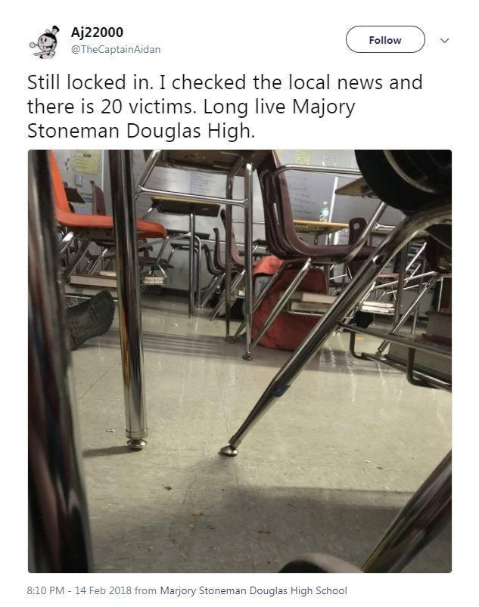
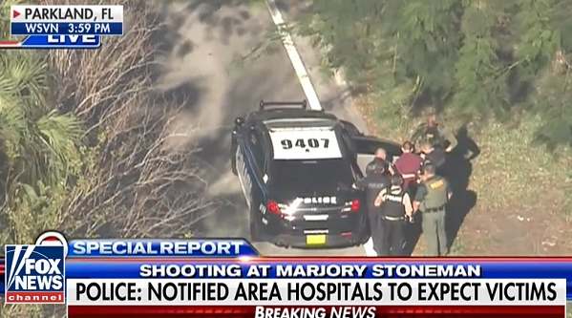
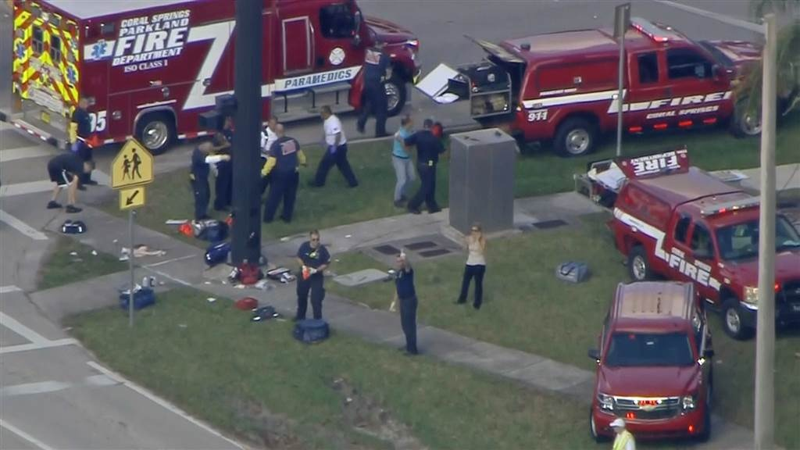
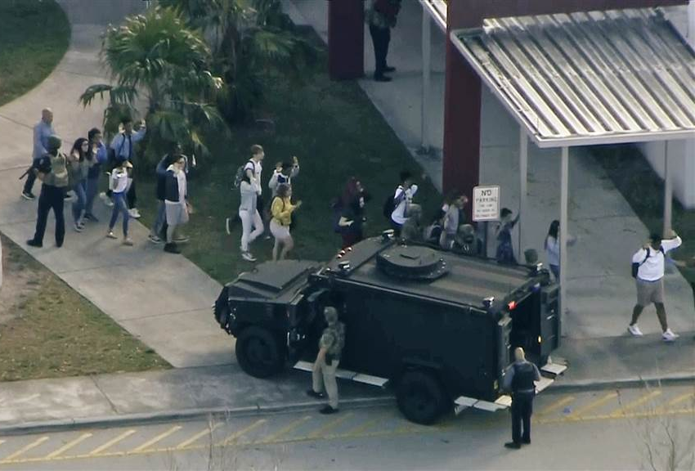
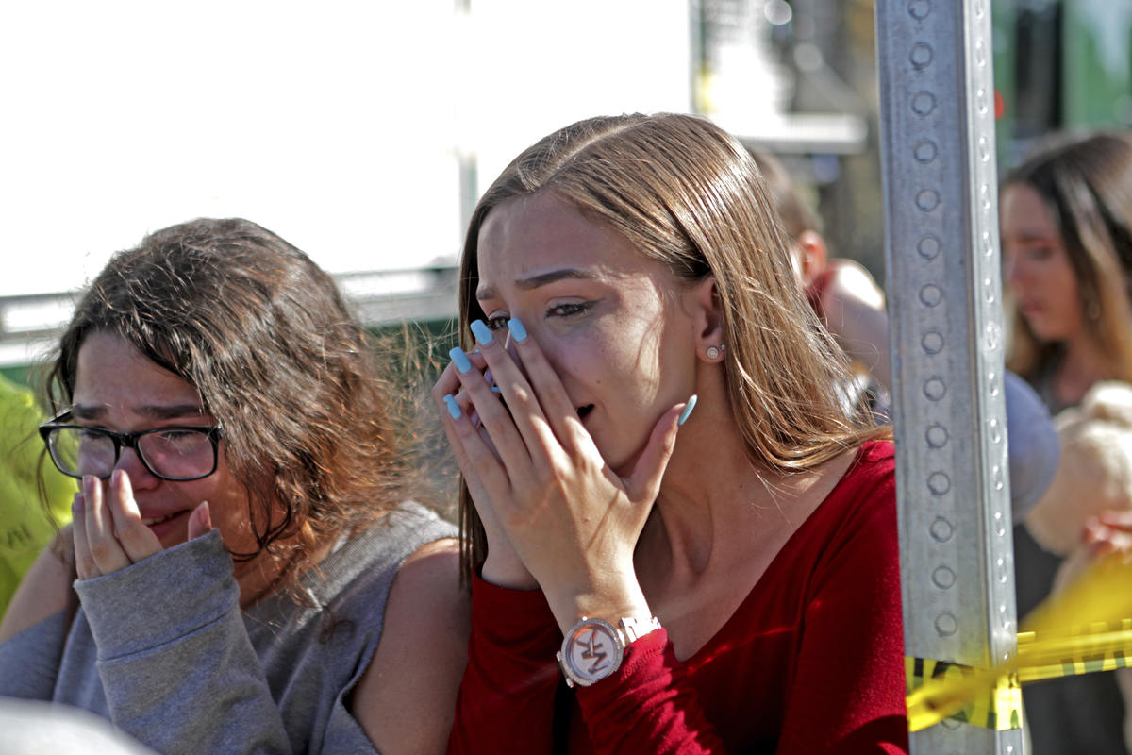
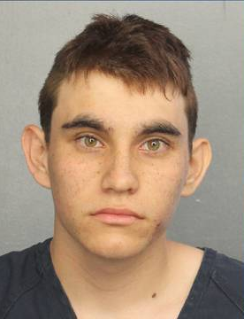

Marjory Stoneman Douglas High School Parkland, FL – February 14, 2018

Slide 2
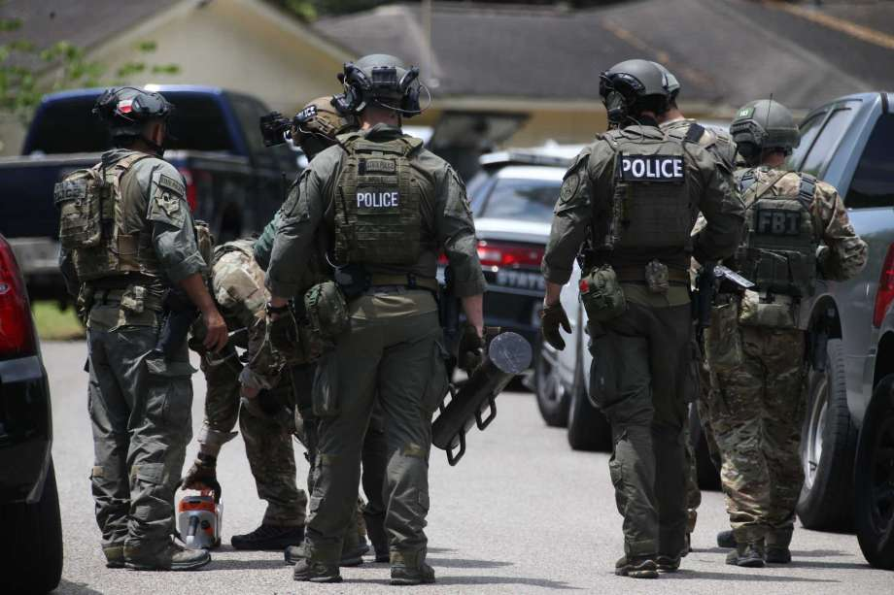
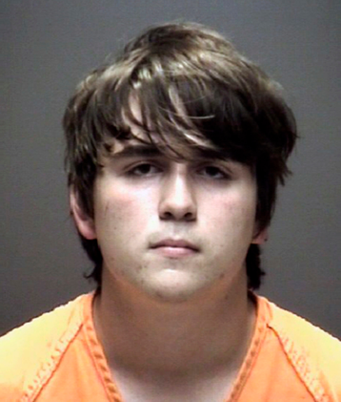
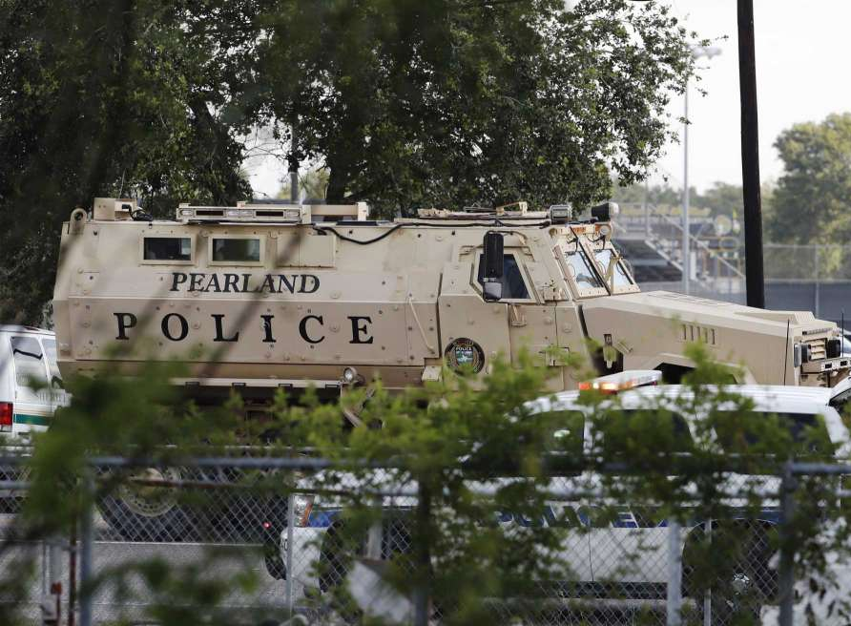
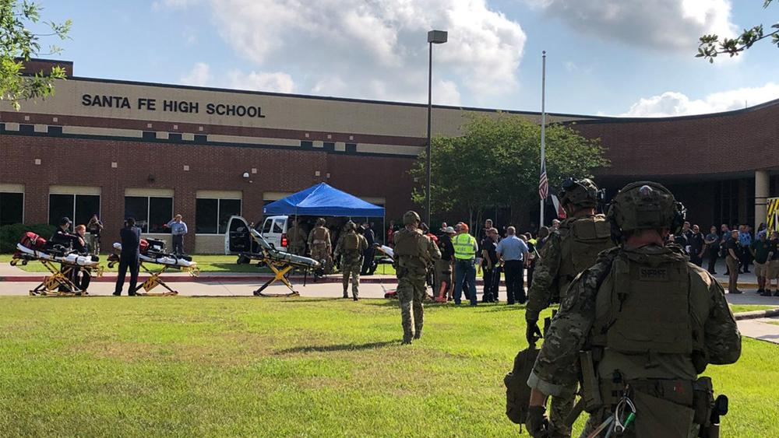
Santa Fe
High School
Santa Fe, TX
May 18, 2018
Notes:
Sante Fe shooter

Slide 3

Cincinnati, OH
September 6th, 2018

Slide 4
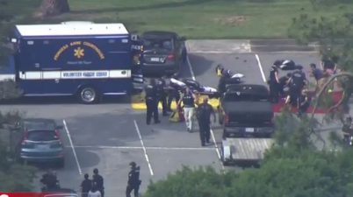
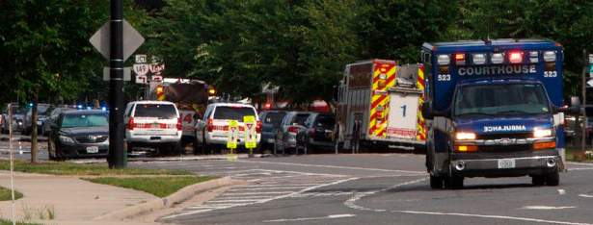
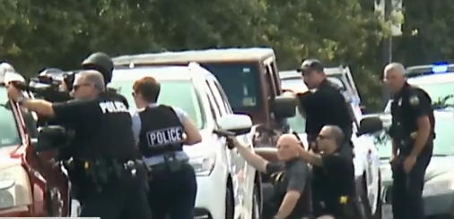
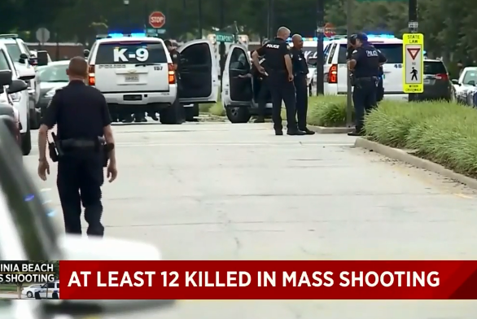
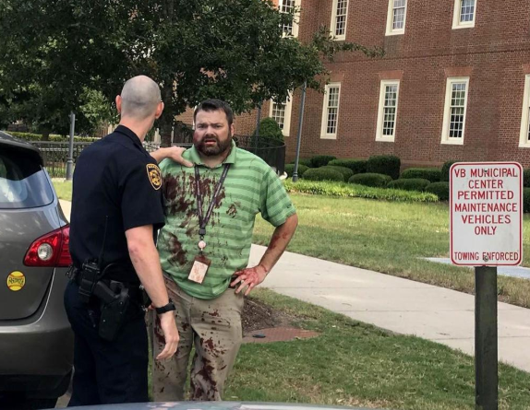
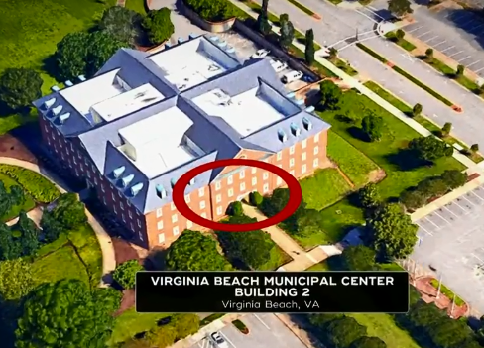
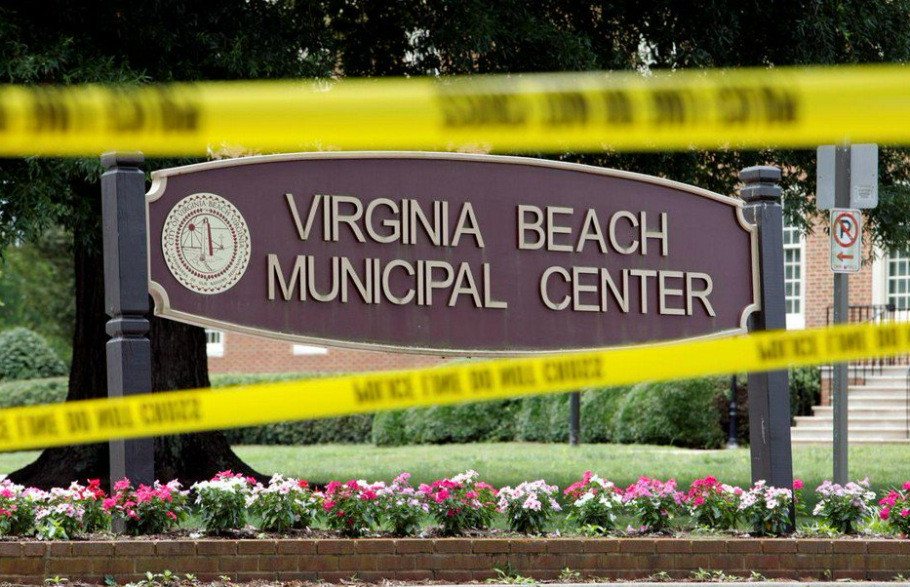
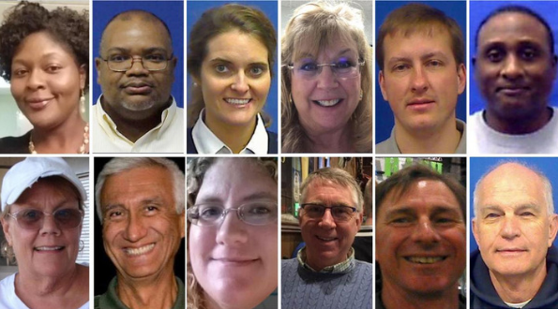
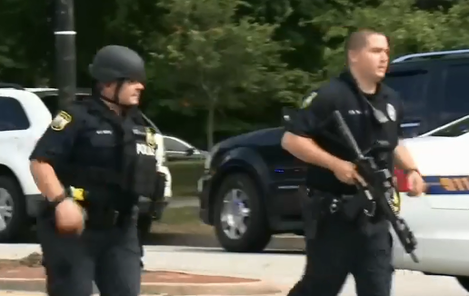

May 31st, 2019

Slide 5


Dawn of a New Day Player Pre-brief
Full Scale Exercise
Saturday, June 8th, 2019, 8:00AM-12:00PM
City of Sidney
Presented by:
David Gerstner
Dayton MMRS Coordinator

Slide 6

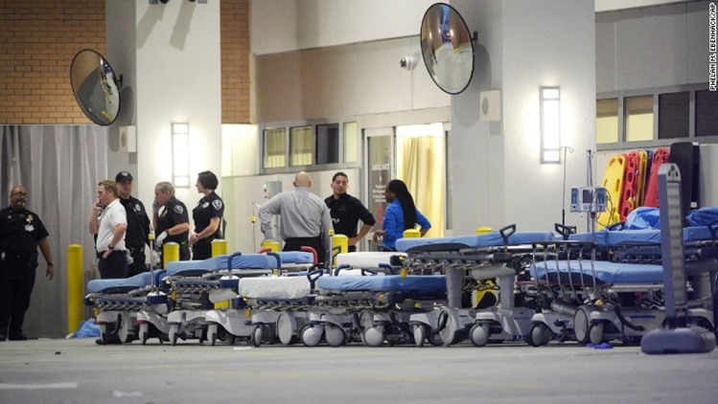
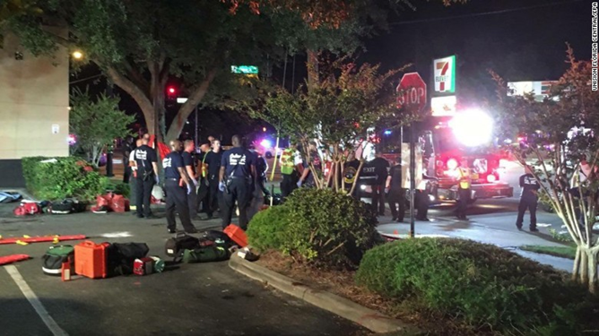
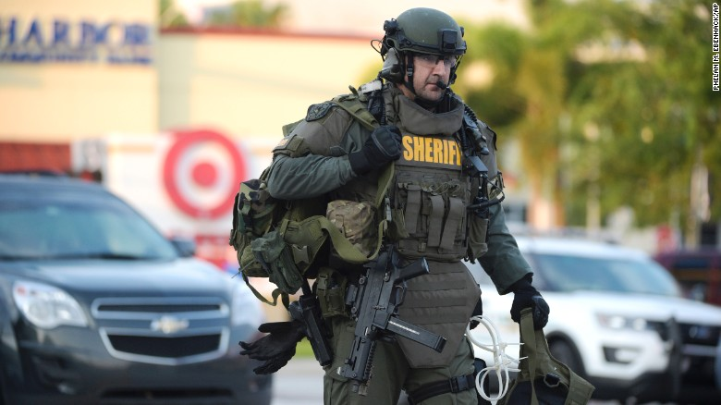
Orlando Response

Slide 7
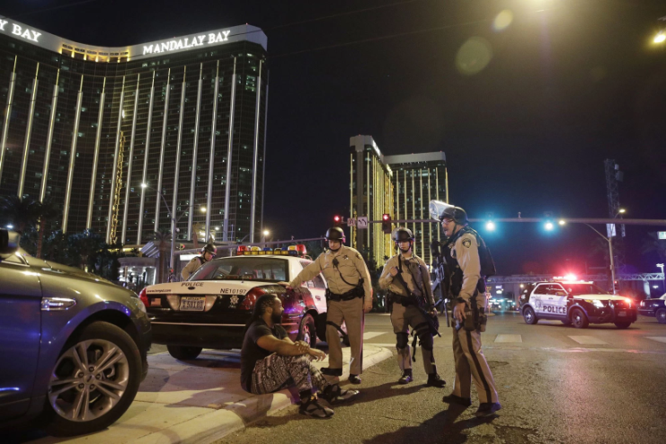
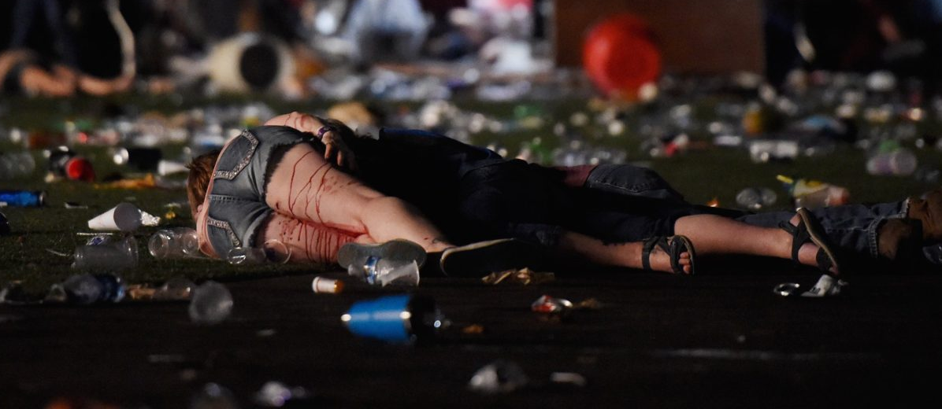
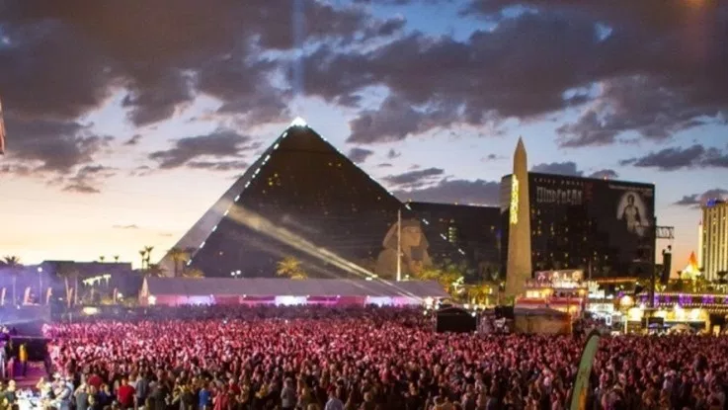
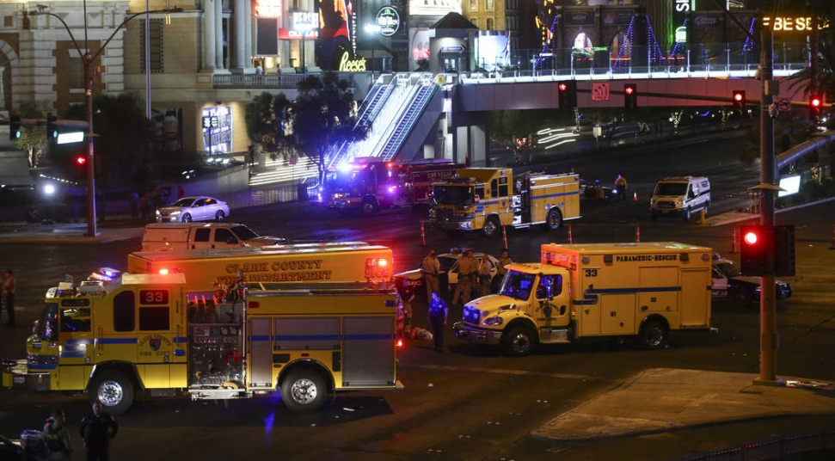
Las Vegas Response

Slide 8
Exercise Parameters
Multiple organizations participating
Lead-in scenario provided on Wednesday, June 5th via e-mail
Exercise date is Saturday, June 8th
Exercise will run from approximately 8:00 AM – 11:30 AM
Hospital play will begin at ~9 AM
Half-hour Hot Wash following

Slide 9
Exercise Parameters (continued)
Participants should be on location 30 minutes prior to start of exercise
Hospital will receive multiple patients
EMS and Hospital will use Drill Triage Tags provided for exercise
Hospital will track patients with OHTrac
  Need to create OHTrac incident
  Update GDAHA Surgenet MCI Page

Slide 10
Player Rules of Conduct

Slide 11
SAFETY!
Most important concern
Safety Officer will conduct weapons check
Other than specific training weapons no weapons of any kind are allowed in Sidney-Shelby County Health Department exercise area
  Includes firearms, ammunition, impact weapons, chemical spray, knives, and electrical weapons (Tasers)
Approved training weapons may include blanks, simulated firearms, guns rendered inoperable or inert blue guns
Every participant in Testing Center exercise area will be searched for unauthorized weapons

Slide 12
Exercise Assumptions
The exercise will be conducted in a no-fault learning environment wherein systems and processes, not individuals, will be evaluated
The exercise scenario is plausible, and events occur as they are presented
Exercise simulation contains sufficient detail to allow players to react to information and situations as they are presented as if the simulated incident were real
Only those agencies listed in the Player Directory (and their personnel) may be contacted during the exercise
All departments and personnel at Wilson Hospital, including HICS, may be called at any time
Use the SimCell for all others

Slide 13
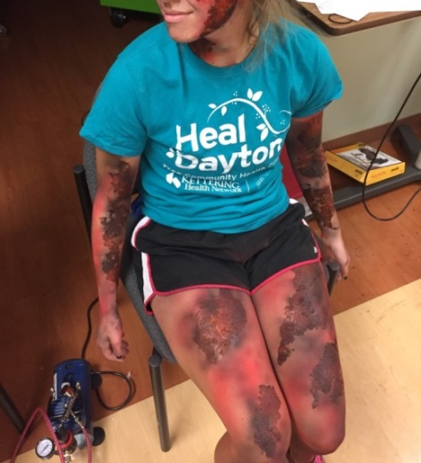
Exercise Assumptions
Use your agency’s plans, policies, processes, and procedures as well as individual judgments in determining how to respond
To the greatest degree feasible, respond as you would during an actual event
Participating agencies may need to balance exercise play with real-world emergencies. Real-world emergencies take priority
Simulation will be used at times during the exercise
Exercise simulation will be as realistic and plausible as possible in the exercise

Slide 14
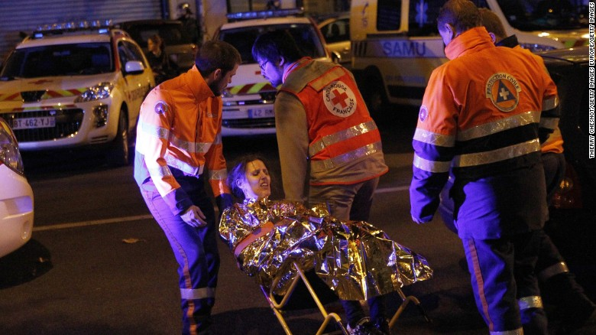
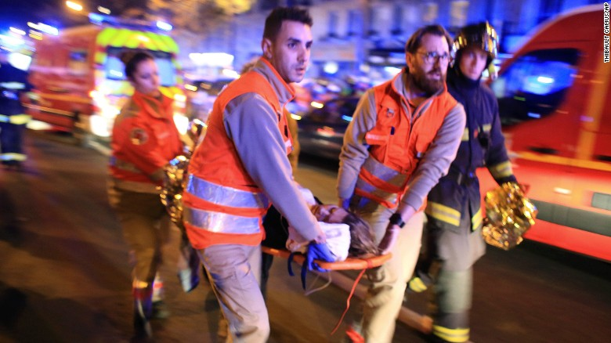
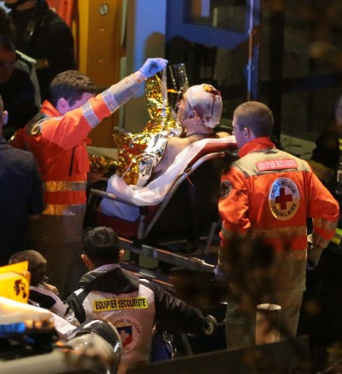
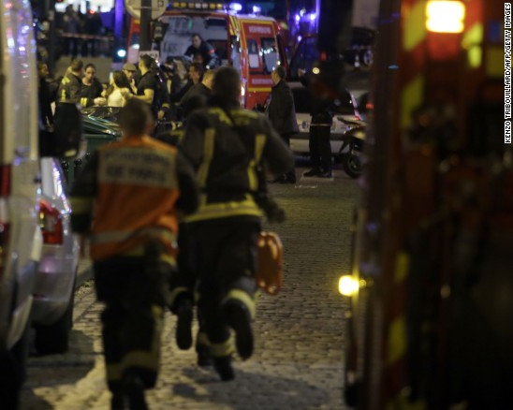
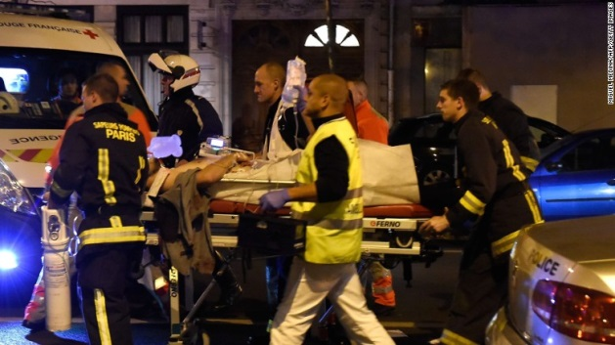
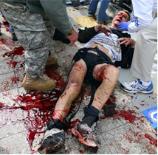
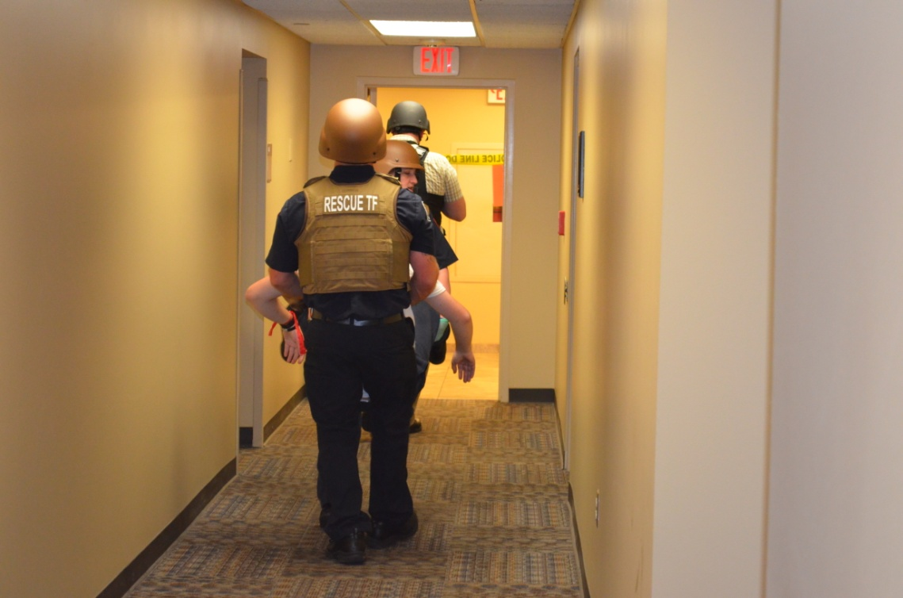
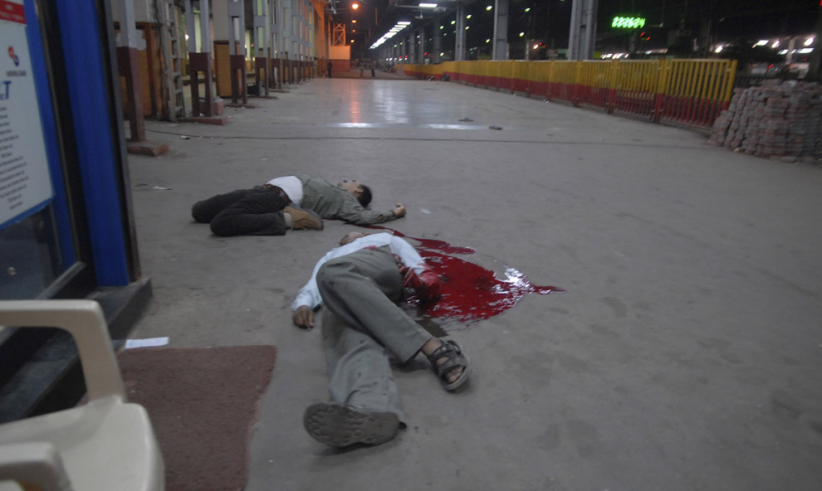

Slide 15

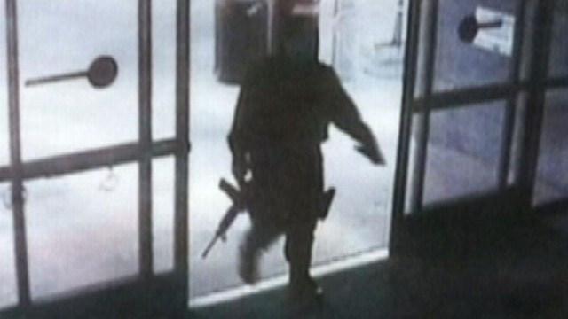
Scenario
Man enters a building and begins shooting visitors and faculty
An IED explodes
Numerous victims with some fatalities

Slide 16
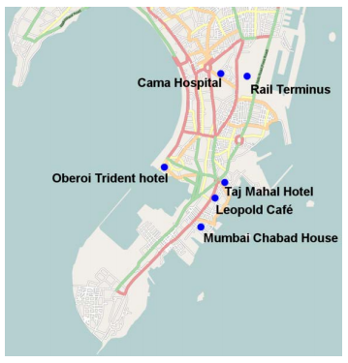
Scenario
This attack is part of a Complex Coordinated Terrorist Attack (CCTA)
  Opportunities to transfer patients to other hospitals may be limited
Sites of the Mumbai 2008 CCTA

Slide 17
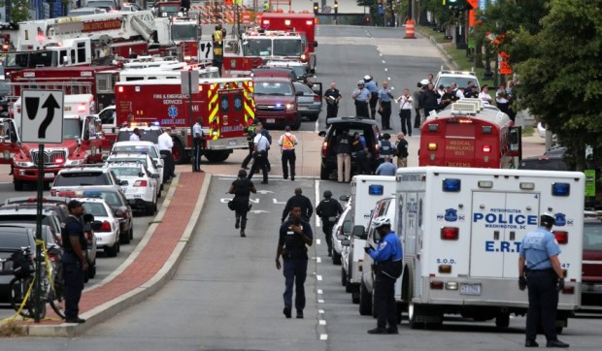
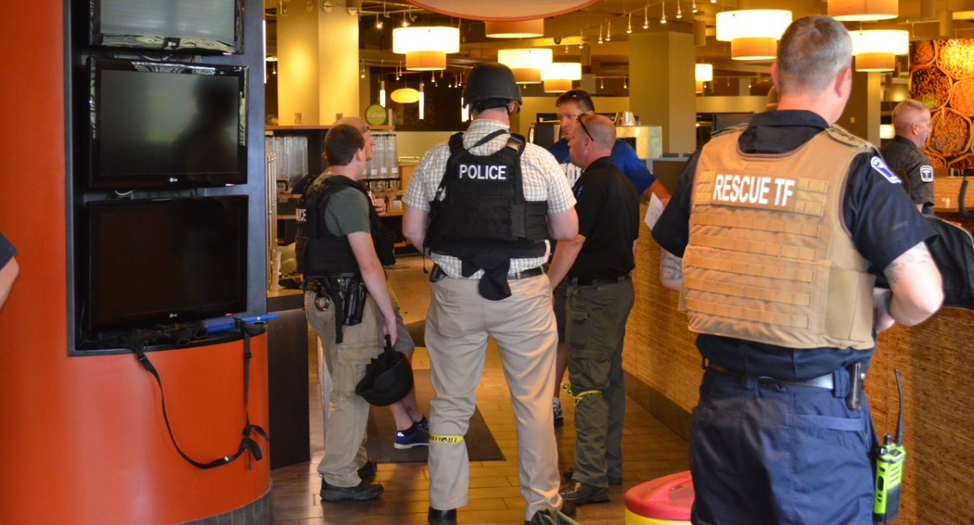
Law Enforcement Agency Activities:
Likely first of the first responders to arrive on the “scene”
Locate and stop perpetrator(s)
Participate with EMS in Unified Command structure

Slide 18
Fire and EMS Agency Activities:
Command structure
  Participate with Law Enforcement and others as Unified Command Develops
Rescue Task Force
  Warm Zone triage and patient care (LSIs)
Communications structure and interoperability plan

Slide 19
Fire and EMS Agency Activities:
Simulate determinations of where patients are to be transported
  For EMS on scene, ALL Victim-Actors will go ONLY to Wilson Memorial However, Transport Officer and aide:
  Will use MCI Talk Group to determine hospital capabilities
    Limited to hospitals listed in Player Phone Book
    Use Sim Cell for all others – radio call SimCell & Hospital Name
  Act as if ALL hospitals are available
  Simulate appropriate patient distribution
  *There will be a Sidney SWAT van to transport 5-6 “walking wounded” victims to WMH to act as walk-ins to the ED.

Slide 20
Fire and EMS Agency Activities:
Regional Hospital Notification System
Triage patients
Transport patients
  Green Drill Triage Tags will be used for the exercise, and will be provided

Slide 21
Wilson Hospital Activities:
Command structure
Triage patients
  Expect walk-ins as well as transports from EMS

Slide 22
Wilson Hospital and EMS Activities:
Treat patients
  Patients should actually move to all playing areas of the hospital as necessary
    Player Directory
  Moulaged actors as injured victims;
    NO INVASIVE PROCEDURES (IVs, airway adjuncts, radiological examinations, etc.)
May also be actors simulating other roles (e.g., family members, press, etc.)
As practical, Players and Controllers should say out loud “This is an exercise message.”

Slide 23
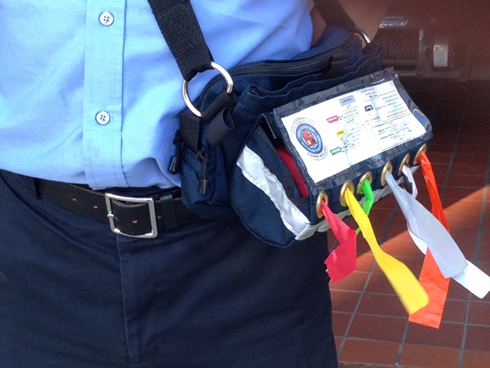
Dayton MMRS Triage Ribbon Kit
Triage Ribbon is principal indication of the patient’s category
Use Ribbons to attach the Tags
If Triage Category changes:
  change the ribbon!
But keep the same Tag

Slide 24
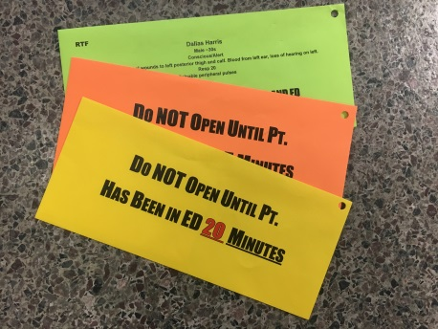
Victim Envelopes
Simulated victims will carry envelopes
  Inside envelopes is more information on patient condition
Envelopes will be color-coded based and labeled
Envelopes must NOT be opened until the time and location indicated

Slide 25
Victim Envelopes
    Purple
    Green
    Pink
    Yellow
    Orange
Victim envelopes will be labeled, e.g.:
  Do not open until after 20 minutes in ED
  Do not open until patient is in OR

Slide 26
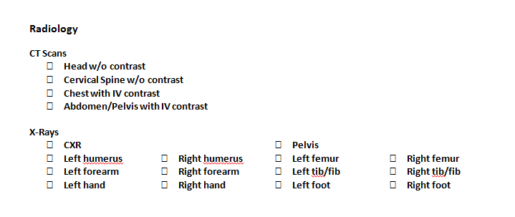
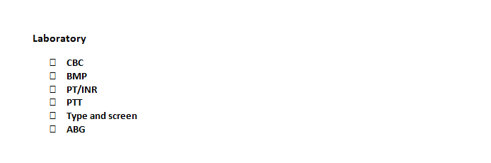
Labs and Imaging

Slide 27



Labelling
Dawn of a New Day
Pt. Name
Pt. #
Tourniquet
Time:________
FAST Exam
Time:________
IV Start
Time:________
Chest Tube
Time:________
Packed RBCs
Time:________

Slide 28
OR Cards
[Patient Name] [Reference #] The purpose of this card is to help you realistically think through issues involved, including timelines, personnel availability, equipment availability, and clinical decision-making needed in a large MCI. P:____ BP: ____/____ R:____ SpO₂:____ GCS – E: ___ M:___ V:___ [Victim Condition] Priority of this patient for surgery (circle one): High Moderate Low Time surgery started: ___________________ Estimated surgical end time: _____________ What would you anticipate is the optimal surgical procedures if this were a single victim incident: __________________________________________________________ __________________________________________________________ What surgical procedures would you opt for instead for this patient in a major mass casualty incident (MCI) with limited resources? __________________________________________________________ __________________________________________________________ Any personnel not on site should be called. The time of the call for each, and the estimated time of arrival (make sure to say, “This is an exercise” and tell them NOT to actually come to work!) should both be listed on the opposite side. | [Patient Name] [Reference #] SURGICAL RESOURCES OR #:____ Anesthesiologist/Anesthetist Name: ______________________ Onsite or Called in? (Circle) If called in, time called/ETA given: ____ /____ Surgeon Name: ______________________ Onsite or Called in? (Circle) If called in, time called/ETA given: ____ /____ Specialty Surgeon Name & Specialty Name: ______________________ Onsite or Called in? (Circle) If called in, time called/ETA given: ____ /____ Specialty: ______________________ Additional surgeon/physician Name: ______________________ Onsite or Called in? (Circle) If called in, time called/ETA given: ____ /____ Specialty: ______________________ RN1 Name: ______________________ Onsite or Called in? (Circle) If called in, time called/ETA given: ____ /____ RN2 Name: ______________________ Onsite or Called in? (Circle) If called in, time called/ETA given: ____ /____ PA/APRN Name: __________________ Onsite or Called in? (Circle) If called in, time called/ETA given: ____ /____ Other personnel: _________________ Onsite or Called in? (Circle) If called in, time called/ETA given: ____ /____ Anesthesia Machine: __________ Major Procedure Tray: __________ Vascular Surgical Tray: ____________

Slide 29
Participants

Slide 30
Participants
Players
  Actively involved
Controller/Evaluators
  Initiate play/monitor response
  Identified with vests or badges
Actors/Volunteers
  Role play patients
Observers
Simulation Cell (SimCell)
  Injects information
  Responds to player requests
  Role plays for non-playing entities

Slide 31
Participating Organizations
Wilson Memorial Hospital
City of Sidney
Sidney Fire and Rescue
Sidney PD
Shelby County Sheriff’s Office and other law enforcement agencies
Regional MMRS Rescue Task Force
Montgomery County Regional Dispatch (RDC) and others
Other hospitals as functional players (via SimCell)

Slide 32
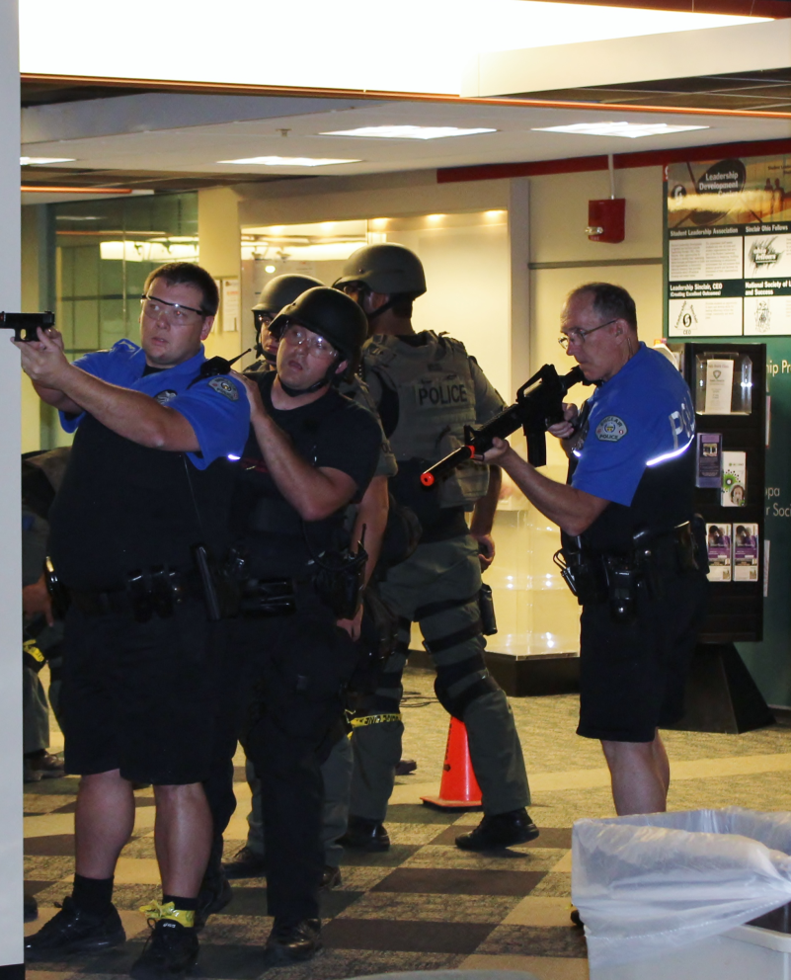
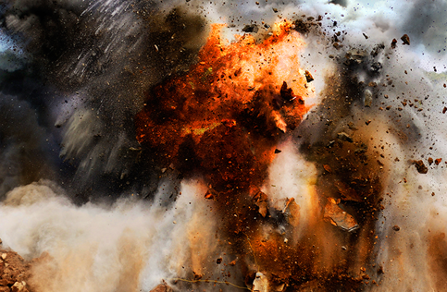
Communications:
Signage
Announcements
Explanations
  Explain sights and sounds and reassure that it’s just a training exercise

Slide 33
Communications
Wilson Hospital Media Liaison

Slide 34
Suspending or Terminating Exercise

Slide 35
Suspending or Terminating Exercise
In the event of a real emergency the player will inform the controller/evaluator with the phrase
“REAL WORLD EMERGENCY”
The controller/evaluator will forward the information to the Senior Controller and the SIMCELL

Slide 36
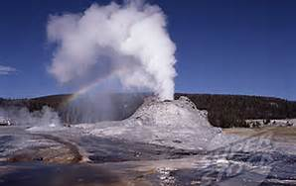
Player
Hot Wash
Debrief

Slide 37
Player Hot Wash
Immediately following end of play (ENDEX):
Complete a player hot wash
Controller/Evaluator will facilitate group discussion
What went well/needs improvement
Controller/Evaluator will document discussion on group feedback form
Participant Feedback forms will be circulated and collected

Slide 38
Player Reference Items
EXPLAN
Player Guide
Player “Phone Book” with Communications Plan

Slide 39
QUESTIONS?
Email to david.gerstner@daytonohio.gov

Slide 40
THANK YOU FOR PARTICIPATING!
PLEASE COMPLETE THE EVALUATION FORMS AFTER THE EXERCISE!

